Slide 1
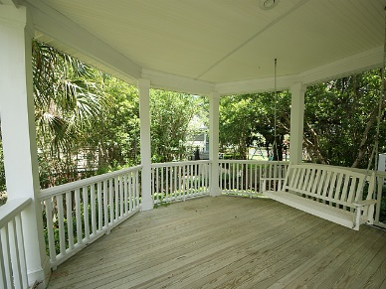
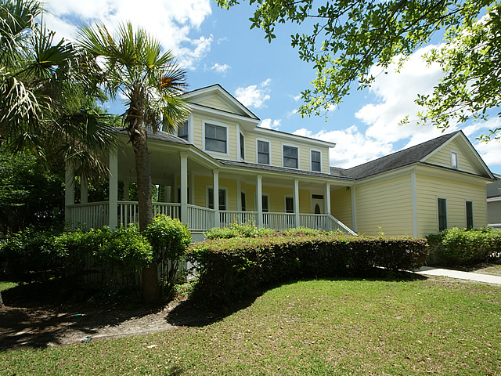
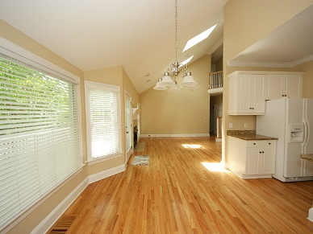
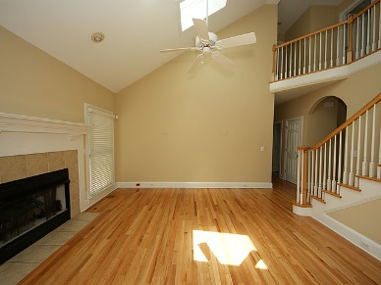
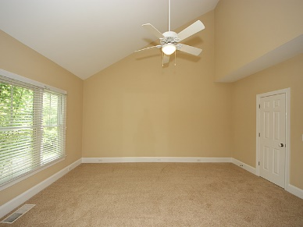
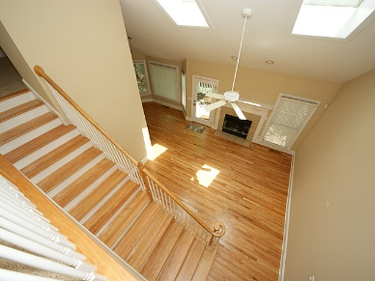
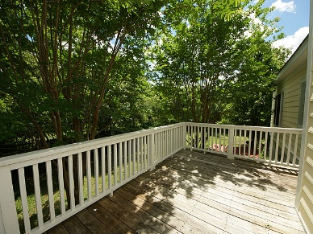
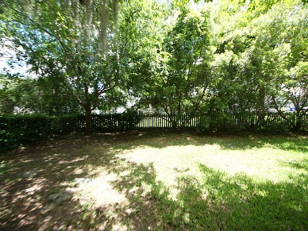


2045 Laurel Springs Lane
Rivertowne On The Wando ~ Mount Pleasant
MLS# 16012262 ~ $439,000
Need Some Extra Christmas Cash?
$1500 Agent Bonus for an acceptable offer that closes before Jan 31, 2017
(with BIC approval & paid at transfer of deed)
Come view this custom home with large rooms, hardwood floors, and glimpses of the Wando River. The neighborhood is reminiscent of an old fishing village where you can sit on your front porch, walk the sidewalks and enjoy the views of the Wando River. The home features a large master suite located on the main floor and three bedrooms upstairs, the third bedroom upstairs is the room over the garage. Don't miss the loft that can be used for an office or a quiet get away to slip into one of your favorite novels. The floor plan flows wonderfully for entertaining and/or family life. Entire interior recently painted, floors refinished, new carpet in bedrooms and new doors & drawers on all cabinets.
Maggie Curtis
REALTOR, EPRO, LMC, ABR
(843) 693-8207
maggiecurtis@comcast.net
Coldwell Banker Residential Brokerage
1127 Queensborough Blvd. 103
Mt Pleasant, SC 29464

