Slide 1
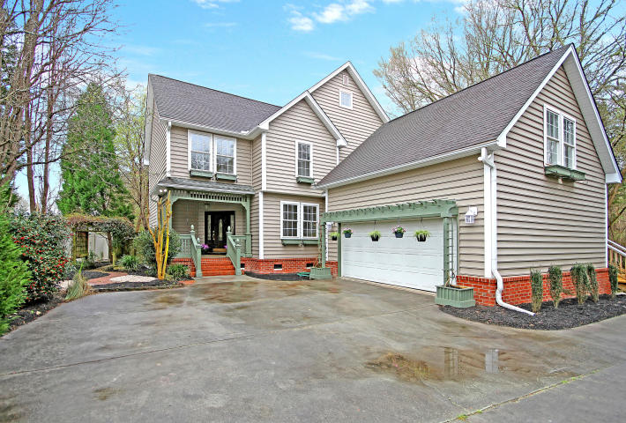
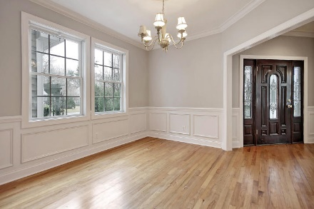
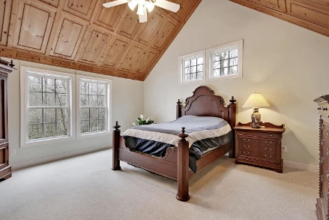
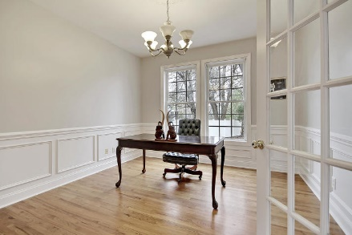
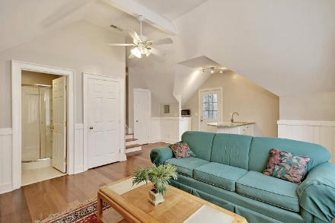
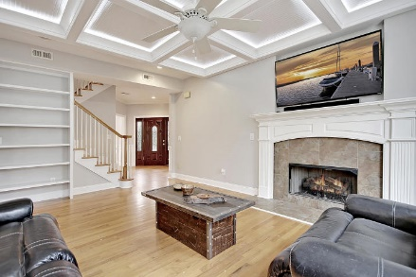
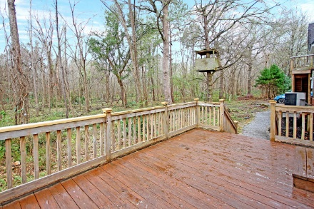
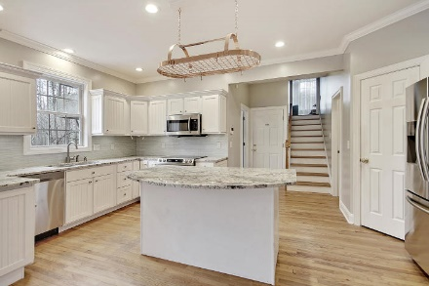
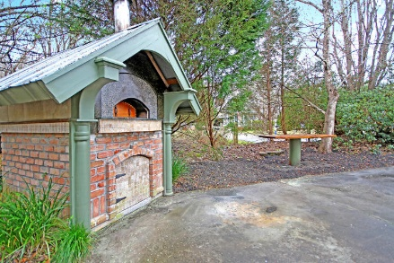
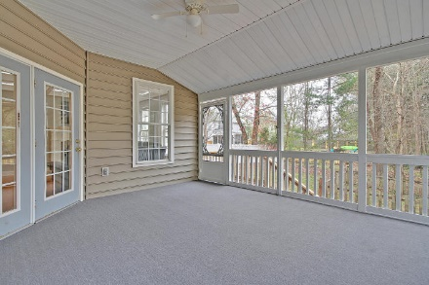

"SECOND TO NONE" HOME FEATURES!
SUPER VALUE PRICE!
Price Reduced!
2045 Thornhill Drive
Ashborough ~ Summerville, SC 29485 ~ MLS# 19007348 ~ $374,900
AUTHENTIC BRICK PIZZA OVEN! One-of-a-kind outdoor pizza oven is the piece de resistance for an exceptional home situated on a private lot in Ashborough that backs to wetlands. This pristine home has notable features such as the lit, coffered ceiling in the living room, a central vacuum system, all hardwoods on the main level, a soaring master cathedral ceiling with wood wainscoting, back porch with wiring and plumbed for hot tub, brand new stainless kitchen appliances, hidden storage and safes... and the wooded view you can enjoy from the screened-in porch and deck. There is even a private in-law suite with its own entrance, kitchenette area, full bath and living room. And... if you are wondering, the brick pizza oven can cook the best pizza of your life in exactly 2 minutes!!
Additional features include:
Hardwood floors
Front porch
Attached two car garage
Fireplace in the living room
Built-ins on your way to the spacious eat-in area
Master bath has a dual vanity, jetted tub and walk-in shower
Walk-in closet in the master
Book your showing today!
Chip Walsh chip@mattoneillteam.com 843-822-4663

