Slide 1
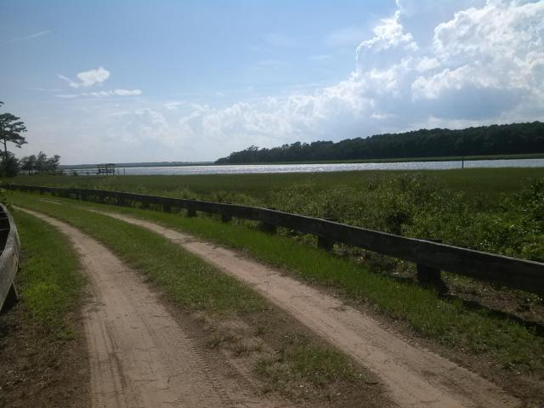
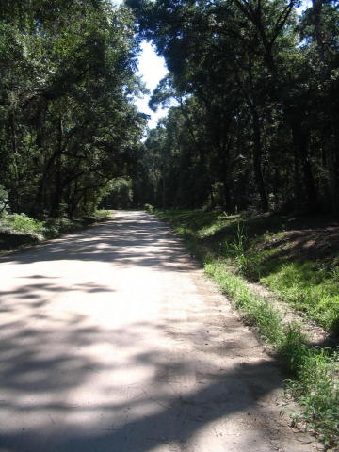
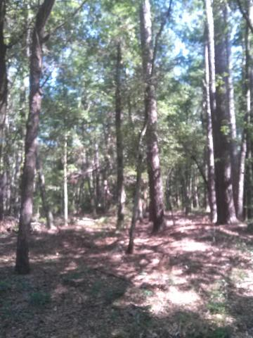


7.6 Acre Country Estate with Water Access on Wadmalaw Island
2047 Leadenwah Drive ~ Leadenwah Acres ~ MLS# 17019511 ~ $199,900
What a wonderful opportunity to build your own private Estate on this 7.5 acre lot located only 30 minutes from Historic Charleston. This location is perfect for the nature enthusiast with the abundance of wildlife, creeks, and trees that surround Wadmalaw Island. Close to Rockville, Cherry Point Boat Landing and Marina. Timber on land has great income value. Water access through the lot across the street.
Handsome Properties, Inc 53 Broad St Charleston, SC 29401
Ellen Leigh Murray
843 813-2006
chaspremierprop@bellsouth.net

