Slide 1
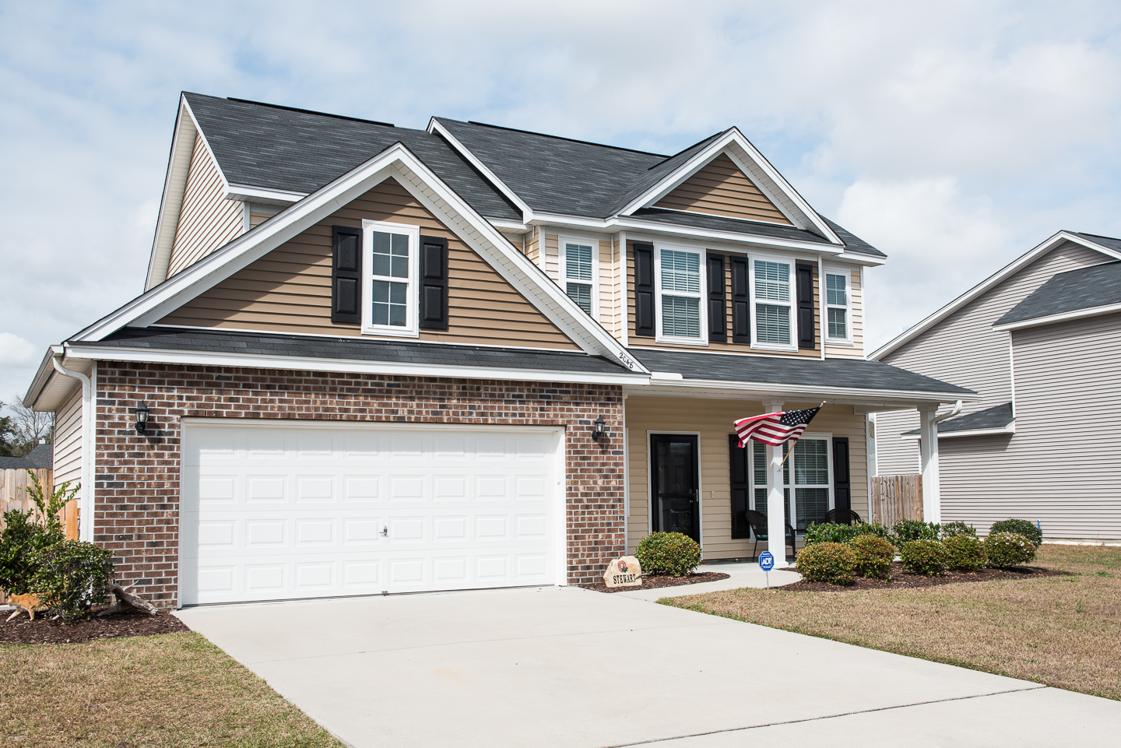
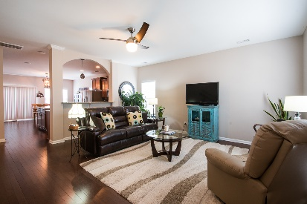
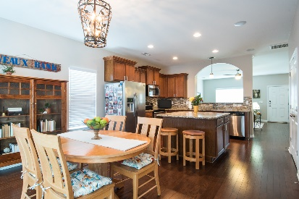
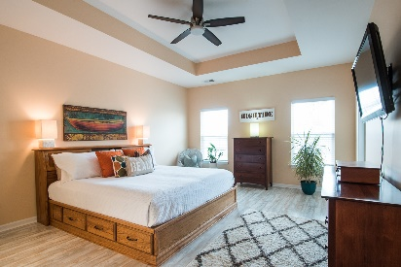
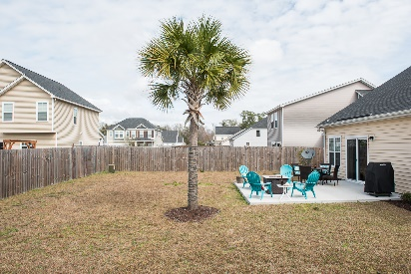


2048 Chilhowee Drive Staffordshire MLS# 17006731 :: $295,000
Move-in Ready on Johns Island
Must See!
Join me for an Open House on Sunday from 2-4
Welcome to this beautiful updated, newly painted, Immaculate 4 Bedroom, 2.5 Bath home in Staffordshire. Open floorplan, abundant natural light throughout the home, 9' ceilings. Great Room opens into the kitchen and dining area. MUSIC/ipod dock with built in speakers great for entertaining in the family room, kitchen and dining area. Granite counters in kitchen, 42" cabinets, large island.
Spacious master bedroom on first floor with smooth tray ceiling, and new flooring. Two add'l bedrooms upstairs plus a large FROG w/closet which could be a bedroom. Ample storage in FROG, nice size closets in all bedrooms. Covered front porch, large backyard patio & fenced yard!
Ready for move in!! $1500 credit available toward buyer's closing costs and pre-paids with acceptable offer & use of preferred lender.
Jeanie Acsell
M (843) 224-9589 | O (843) 884-1622
jean.acsell@carolinaone.com
Carolina One Real Estate | 628 Long Point Rd | Mt Pleasant, SC 29464-3032

