Slide 1
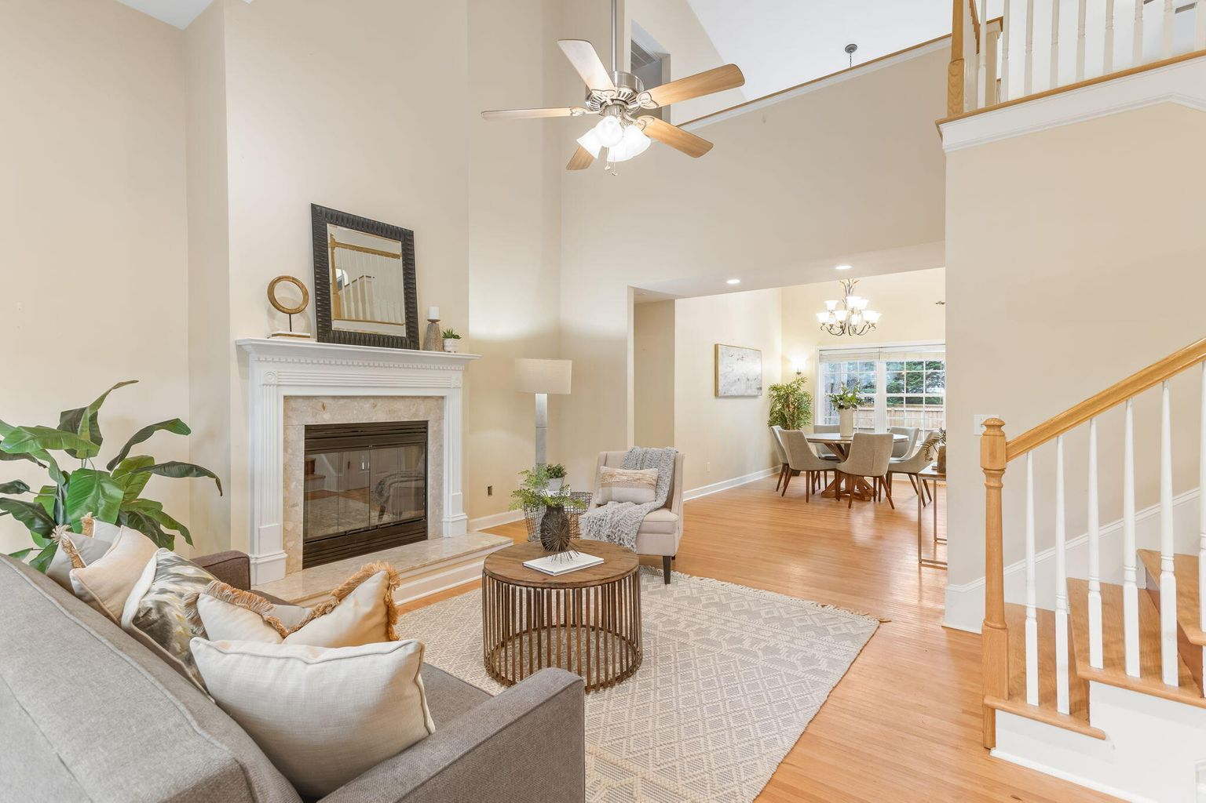
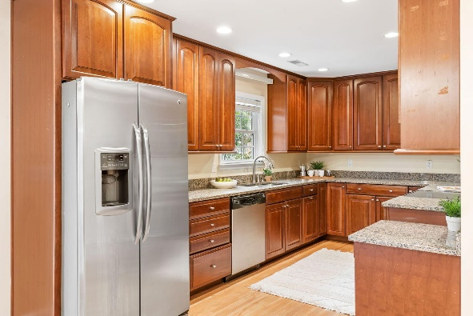
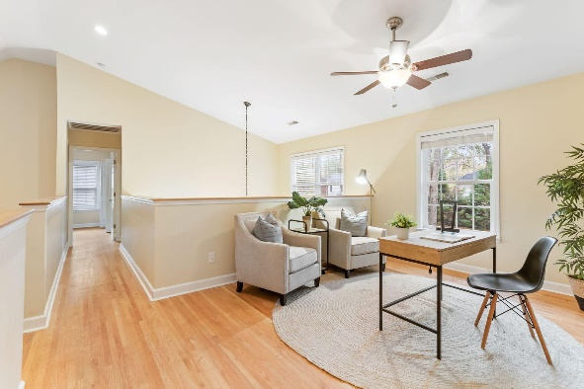
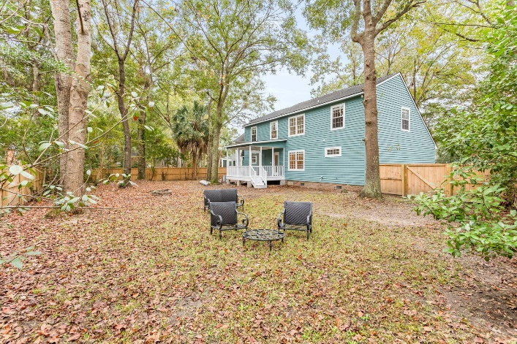
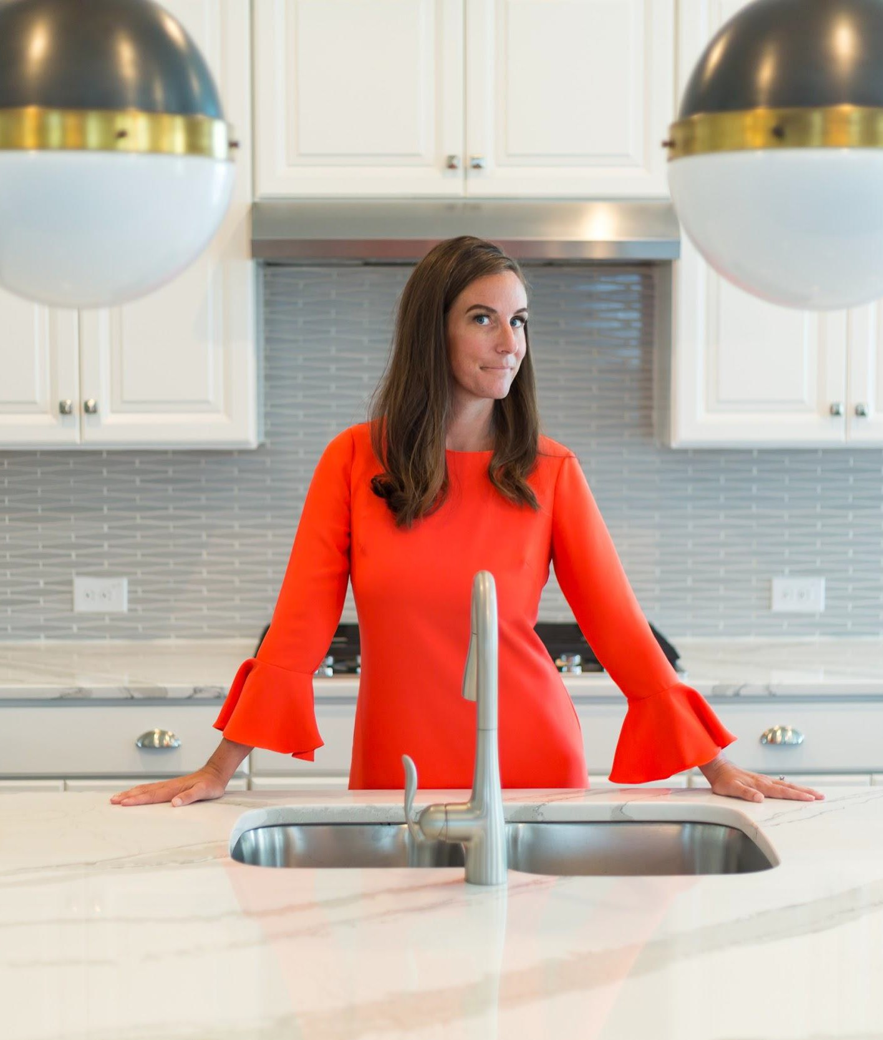
Best value in 29464
4 bedroom ~ 2 ½ bath with loft &
downstairs master
2048 Hallahan Court • Mount Pleasant, SC
MLS# 22029027 • $650,000 • 4 Bed • 2.5 Bath • 2,108 sq ft
Only minutes to downtown Charleston & the beaches, Longpoint subdivision offers a Charleston County Park complete with waterslides, walking trails and nature everywhere. This home has been lovingly cared for & is the perfect blank slate for buyers to come in and make their own!
Mary Beth Bennett
843-367-1774
marybeth.bennett@agentowned.com
mbbennettrealestate.com

