Slide 1
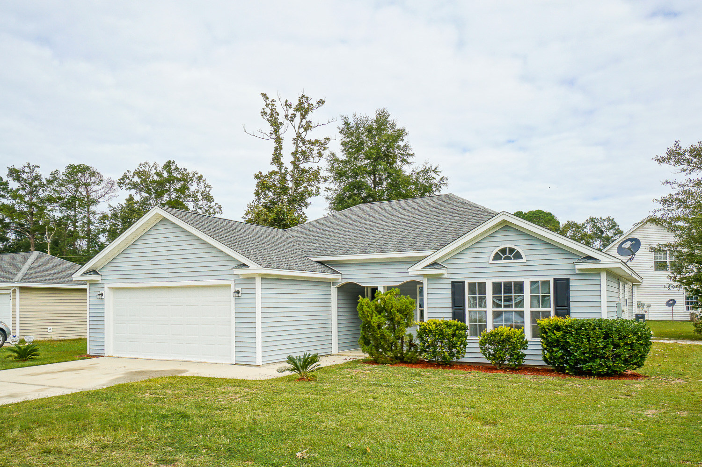
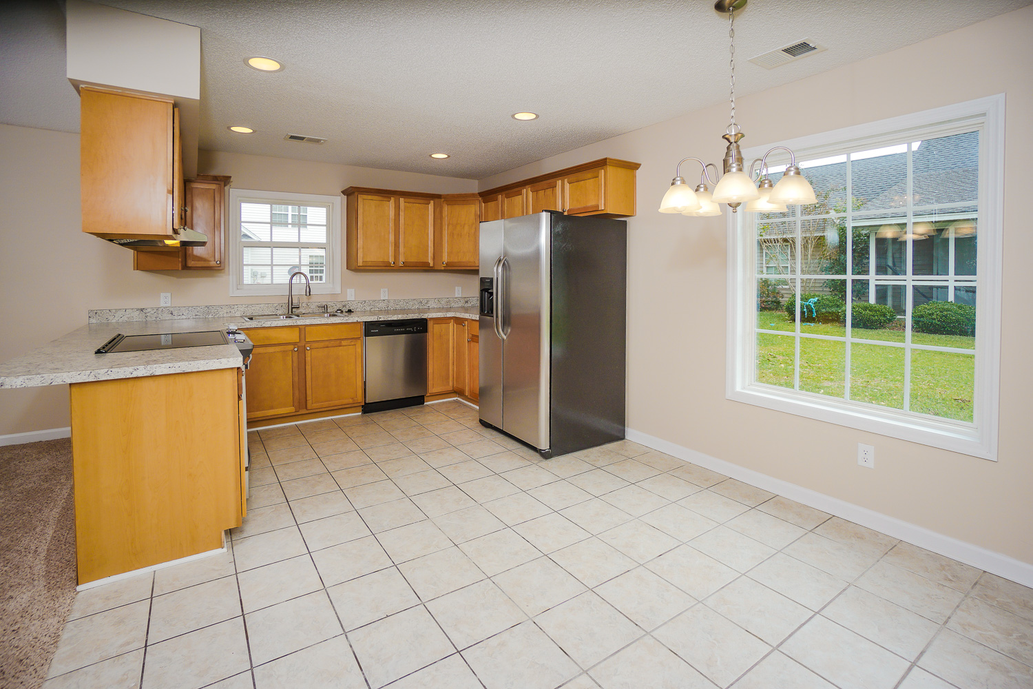
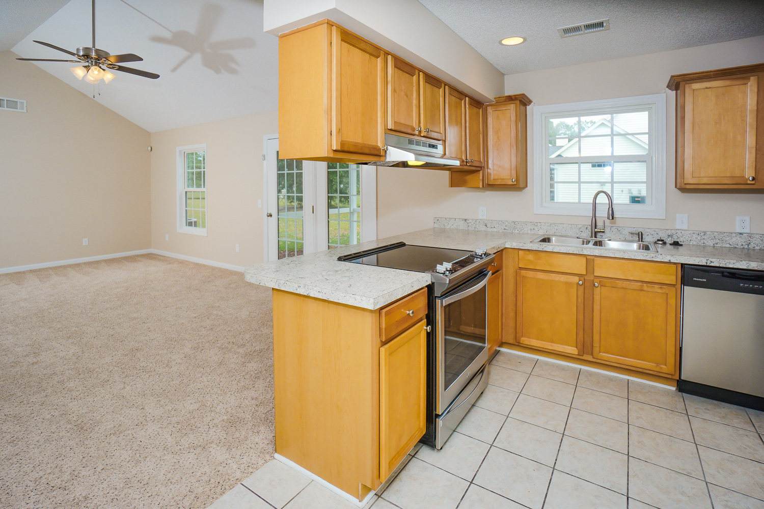
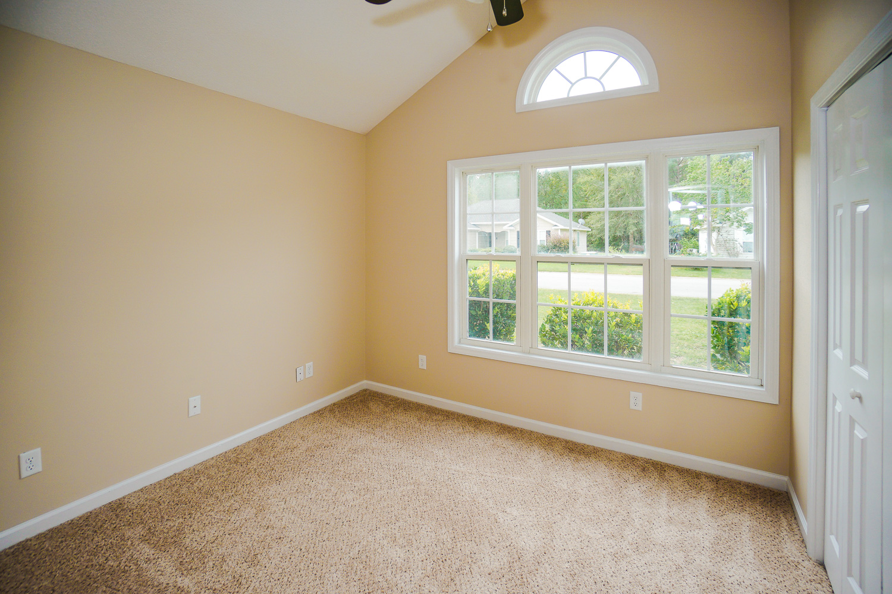
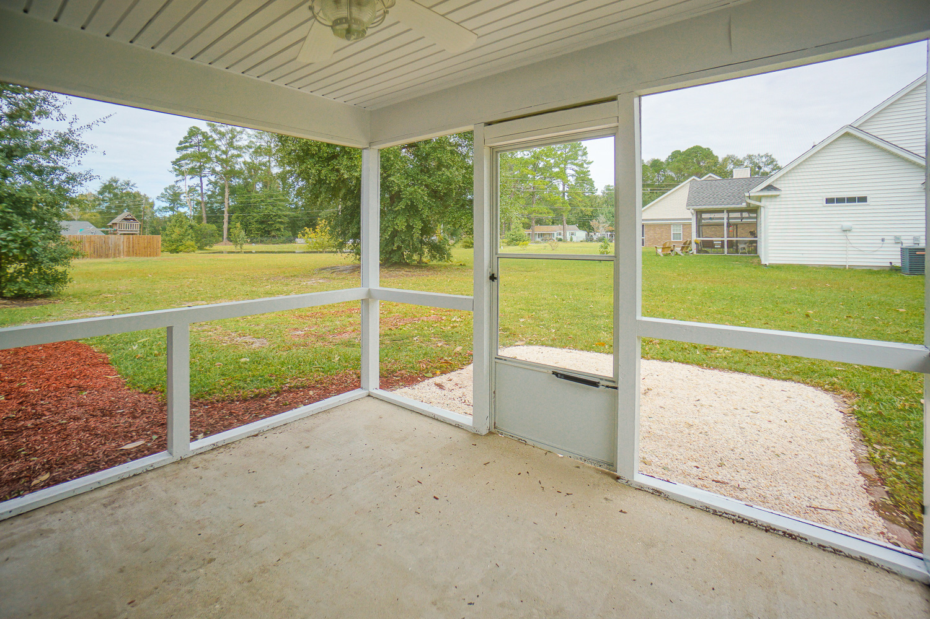
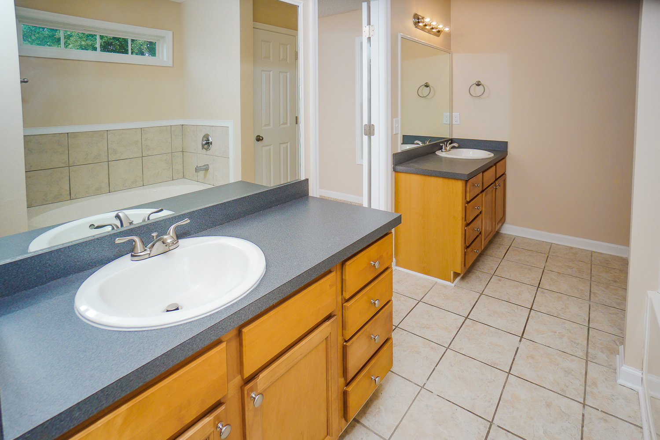
204 Brandon Cove ~ Ridgeland
$139,900
Beautiful Renovation just completed on this 3 BR/ 2 BA home! Just professionally painted! Architectural roof! Ceramic tile floors, NEW frieze carpet/pad! Family Room w/ vaulted ceiling opens right to dining area & kitchen, which has premium wood cabinets, NEW countertops & NEW Stainless Steel appliances, including a side-by-side fridge! Large master suite with private bath has separated double sinks, dual vanities, separate tiled shower & large soaker tub! Brushed nickel upgraded fans, lights, door hardware & fixtures throughout entire home! 2-Car Garage! Beautiful landscaping with nice screened-in porch!
Bedrooms:
Bathrooms:
Sq Ft:
Garage:
Lot Size:
3
2
1372
2-Car
0.19 Acres
Year Built:
Porch:
Appliances:
Fixtures:
Type of Floors:
2005
Screened
Stainless Steel
Brushed Nickel
Ceramic Tile, Carpet
Greg Cook
Anchor One Realty, LLC
843-343-3030
gcook@AnchorPropertiesofSC.com

