Slide 1
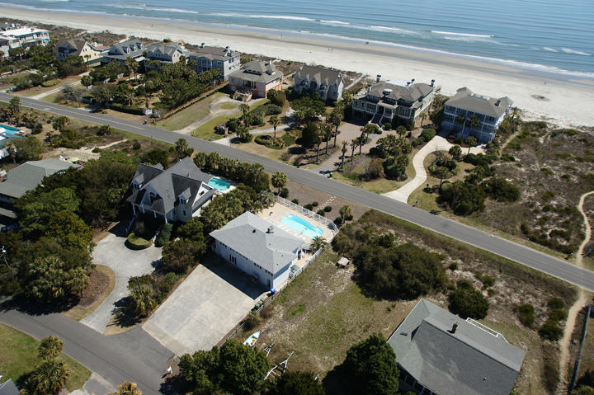
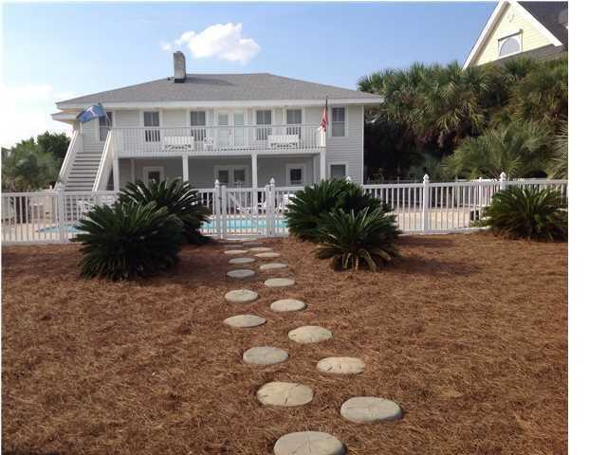
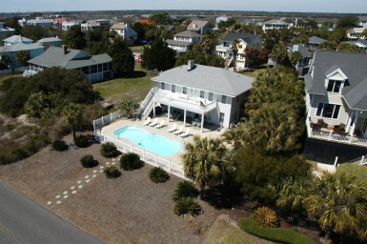
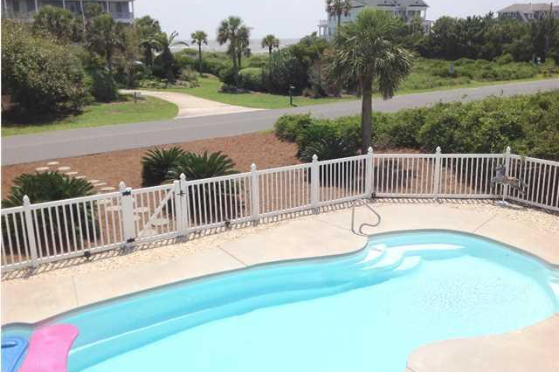
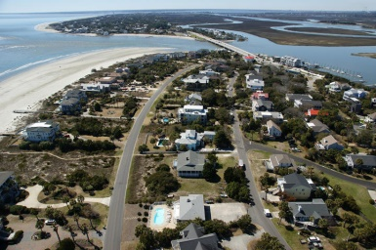

204 Charleston Boulevard
Isle of Palms, SC 29451 :: MLS# 1422241 ::$1,375,000
Calling all investors!
Just across the street from the beach
Great Rental
History!
Just across the street from the beach and perfect for a primary residence, secondary home or a beach rental. This home is currently on a rental program, has a great rental history, is being offered completely furnished and has a beautiful pool. Two separate entrances serve to create a wonderfully flexible floor plan which can accommodate one large family or offers the opportunity to live on one level and rent out the other. Upstairs showcases beautiful hardwood floors, handsome pickled wood walls and a wood burning fireplace as well as two bedrooms(each with a queen bed and private bath), a spacious new kitchen appointed with 2 sinks, a warming drawer, wine refrigerator and granite counters with a section for convenient casual dining. The 30 x 36 ft Great Room has French doors which open to the deck overlooking the pool and to a stunning view of the ocean. The furnishings of the Great Room include a sectional sofa, two additional sofas and a 60'' flat screen. Crown molding and plantation shutters throughout add warmth and charm to the home. Downstairs features a second full kitchen ( with breakfast counter and bar stools plus dining table and chairs ) open to the family room, both of which are tiled for easy maintenance. Two baths and three bedrooms occupy this lower level accommodating one queen bed and one twin in the first bedroom, a King in the second and in the third bedroom a double and a single bed. A large utility area, which can be accessed by both levels, houses storage closets and a washer and dryer. The outdoor shower happily saves any beach sand from finding its way into the home. The 16 x 36 fibreglass pool has a concrete surround with plenty of otdoor furniture and a large grill providing wonderful space for lounging and entertaining with friends and family. Whether you desire a private residence, a vacation home or an investment or a combination of the three, this home is perfect for you. Gross income for 2013 was 64,523.15. Insurance: Lloyd's of London: $ 6270.96 includes wind and hail and Auto Owners ( flood ) $2870.00. Flood Zone is VE. Improvements and Renovations : Pool and New Fence - $30,000, 2nd Floor Renovation: 2011 - $70,000. New Roof: laminated asphalt, architectural class H, high wind shingles in 2014 - $6,600. Pool : fiberglass, concrete surround, 16 x 36 feet. New Heat Pumps : 2012 upstairs and 2006 downstairs, 7 TVs, new 60 '' and 42'' flat screen Available for showings subject to rentals
Catha Remington
843-697-1667 - M
843-884-1622 – O
cremington@carolinaone.com
www.catharemington.com
Carolina One Real Estate
Mount Pleasant Office
628 Long Point Rd.
Mt Pleasant, SC 29464

