Slide 1
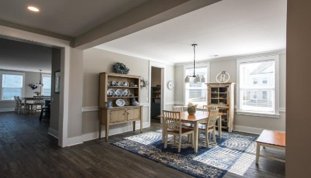
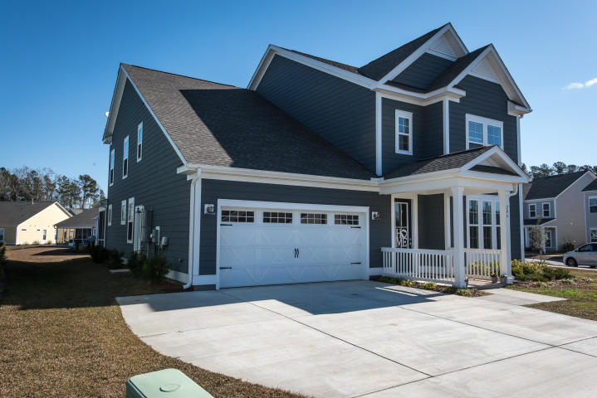
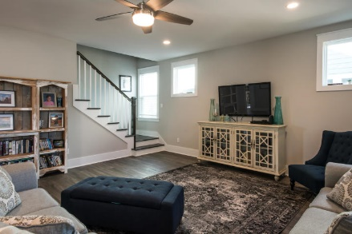
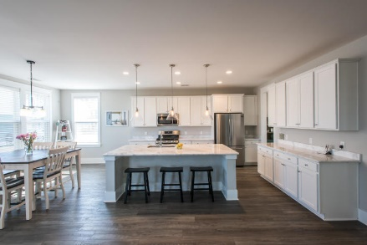
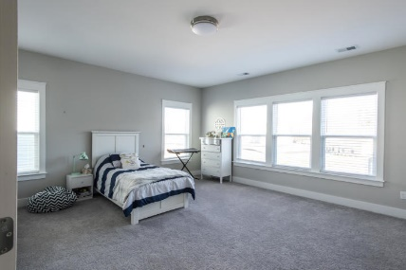
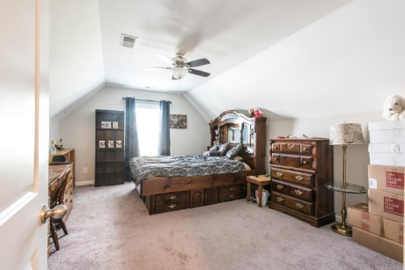
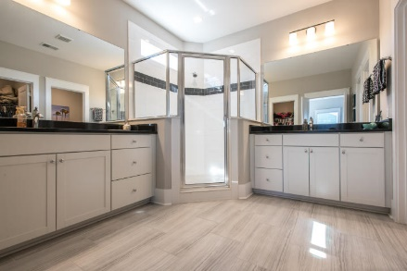
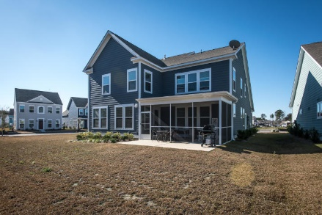
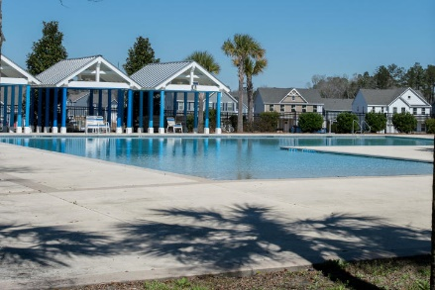


204 Corvus Street
The Ponds · Summerville · MLS# 20005691 · $425,000
This Home Shows Like A Dream!
Fabulous In Foxbank...
Sellers Say Sell!
Just under a year old and built by the higher end builder Kolter Homes. The finishes are to die for with marble countertops, stainless steel appliances with a gas range with a convection over and griddle and a GE hybrid dishwasher in the kitchen, a huge island, a walk in pantry and stop and drop built-in cabinetry in the mud room. The gorgeous vinyl plank flooring that is scratch, stain and dent resistant is throughout the first floor. In the master there is custom tile in the shower and upgraded flooring and granite counter tops. Also, there is a 220 car charging station in the garage, a gas line out back for the grill, a screened in porch and a large lot, almost a quarter of an acre with a huge side yard. The home is light and airy with tons of natural light. When you enter the home you will immediately notice the high ceilings and doorways. Just to the left of the foyer there is a flex space that could be used as a formal living room, office, library or den. As you continue down the wide foyer there is the half bath and then the dining room that connects to to the kitchen through the pantry area. Across from the dining room is the mud room with built ins as mentioned above that connects to the garage. The open kitchen has an enormous island and the counter space is seemingly endless! Just off of the kitchen is a large breakfast area and just to the left is the large family room. Upstairs you will find 4 bedrooms and a large landing at the top of the stairs. The master bedroom is large with the gorgeous en suite bath that also boasts two closets. The second and third bedrooms are of generous size and the 4th bedroom is enormous that could be a bedroom or an entertainment area. This magnificent home is located in the beautifully developed Ponds that boasts a top of the line amenity center designed around the original farmhouse nestled amongst live oaks. Amenities include a neighborhood pool, tree house, play park, walking trails and even an amphitheater for neighborhood entertainment. And you can fish and paddle board or kayak. And inside the Ponds in the recently built YMCA with yoga classes, parents night out options, a variety of fitness classes and kids activities like soccer and summer camps, all right inside the neighborhood.
Carey Nikonchuk
(843) 276-1701 M
cnikonchuk@gmail.com
www.palmettoproperty.net

