Slide 1
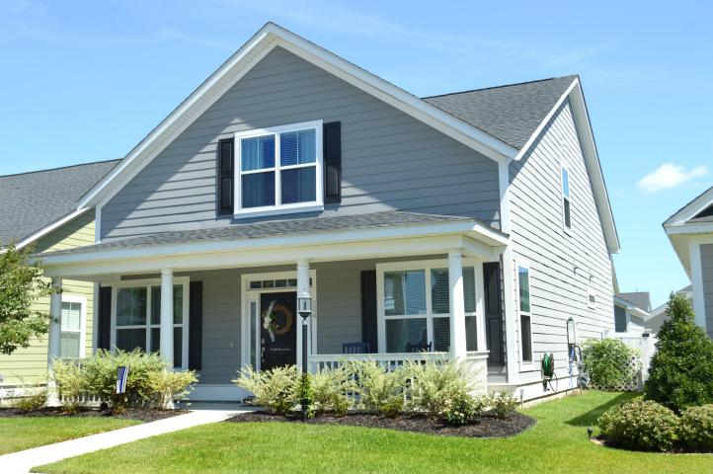
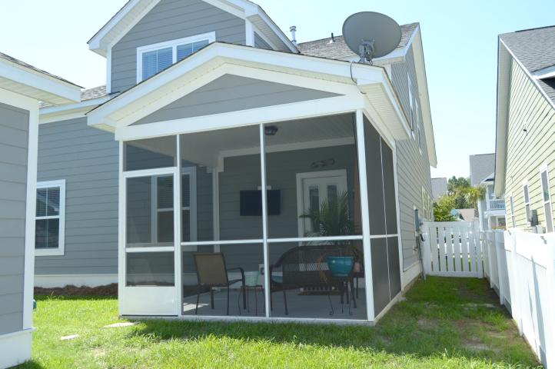
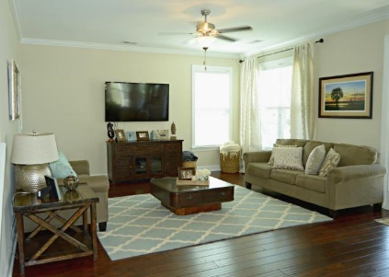
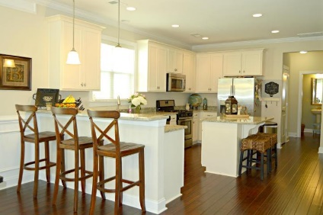
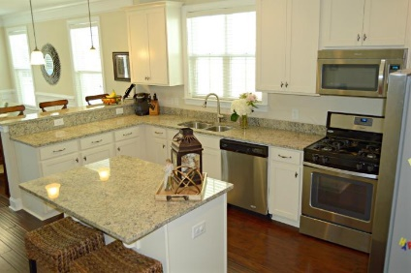
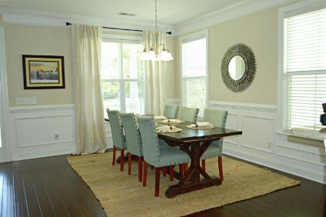
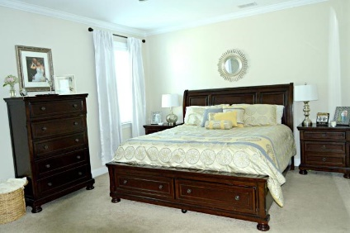
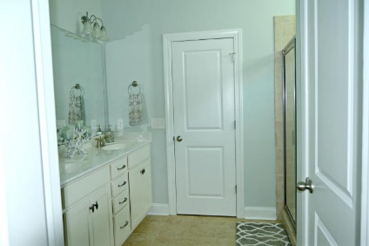
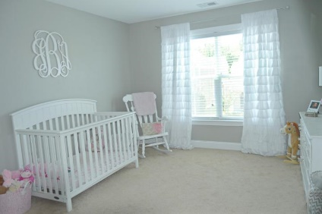
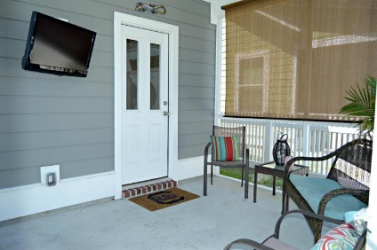


204 Crossandra Avenue
White Gables | Summerville, SC 29483 | MLS# 16014951 | $269,900
4 Beds | 3½ Baths | 2,527 Square Feet
Better than new construction, this house is a MUST SEE to appreciate! Formerly the model home for Crescent, you can no longer get as many upgrades and amazing additions for this low price. Come check out the HUGE bedrooms, each with its own large walk-in closet! Additional storage throughout the home as well. The garage is wired with cable and is ready for a man-cave or extra retreat for the homeowner, and is finished with extra attic space inside. The open floor-plan in the living room and kitchen is perfect for entertaining. Current owners spared no expense with the gorgeous extension of the island, beautiful wrought-iron railings, and more. All kitchen appliances convey. Dining table, master bedroom furniture, and curtains negotiable with acceptable offer. Come check out TODAY!!
Leah Day
(843) 226-4135
leah.day@agentownedrealty.com
AgentOwned Premiere Group · 1800 Trolley Rd · Summerville, SC 29485 · www.agentownedrealty.com

