Slide 1
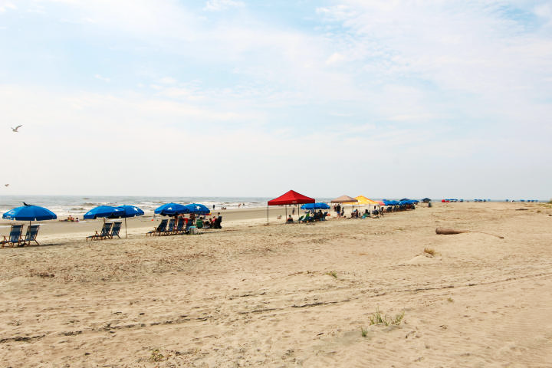
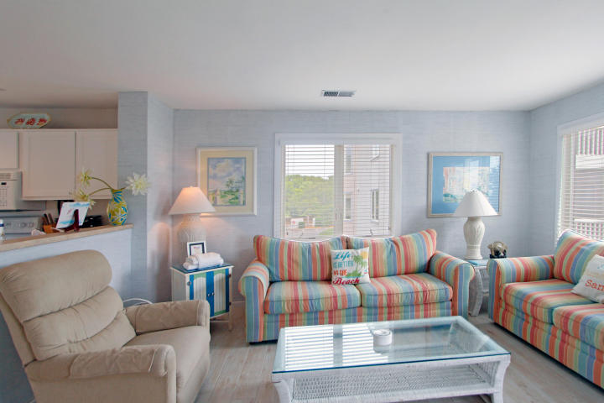
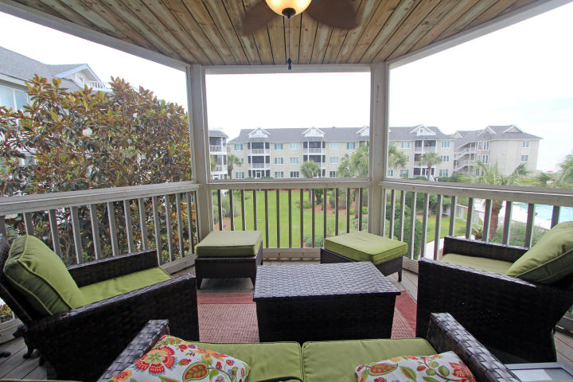
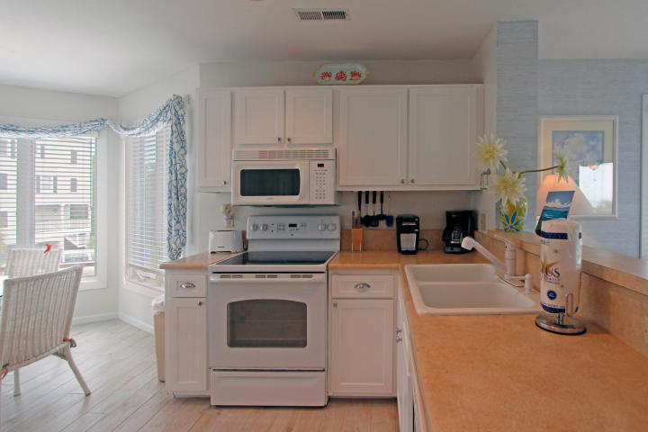
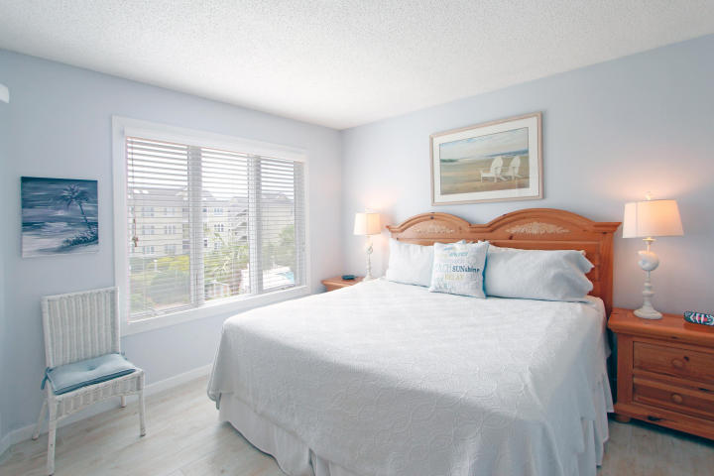
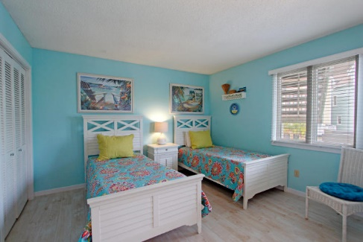
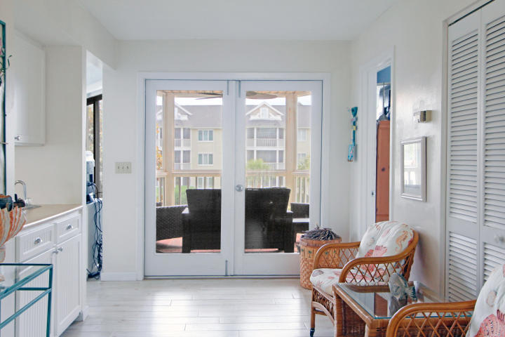
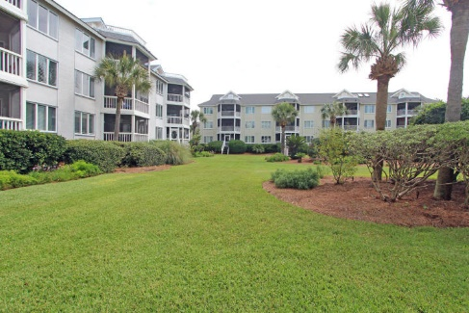


204 I Tidewater Wild Dunes Isle of Palms, SC 29451 MLS# 16026518 $575,000
BEST PRICE IN TIDEWATER!!
Fantastic Rental Property
Tidewater is known for its screened porches and this CORNER UNIT view will not disappoint. Corner units offer extra windows and light and a large, private entry porch for convenient bike/beach chair storage. This two bedroom, two bath unit is beautifully tiled throughout and offers fantastic views from both the living room and screened porch. It's being sold fully furnished as a turn-key rental or second home with easy access to both beach and pool.
Don't let this one get away!
Ann Cortes Office - (843) 886-8110
Mobile - (843) 324-6808
ann.cortes@carolinaone.com
Carolina One Real Estate | 1503 Palm Blvd | Isle of Palms, SC 29451-2280

