Slide 1
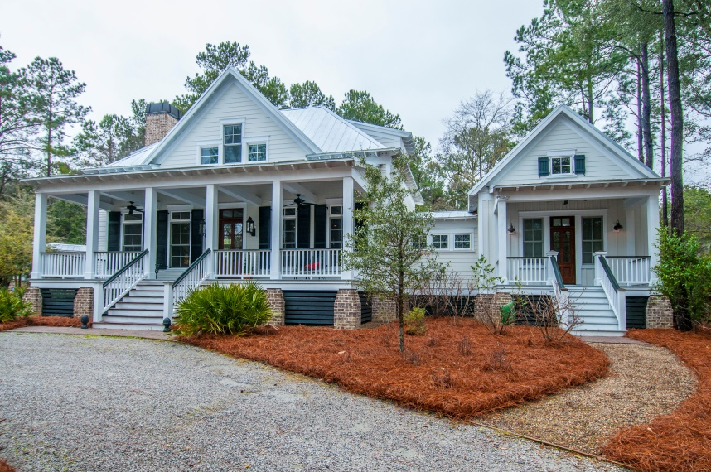
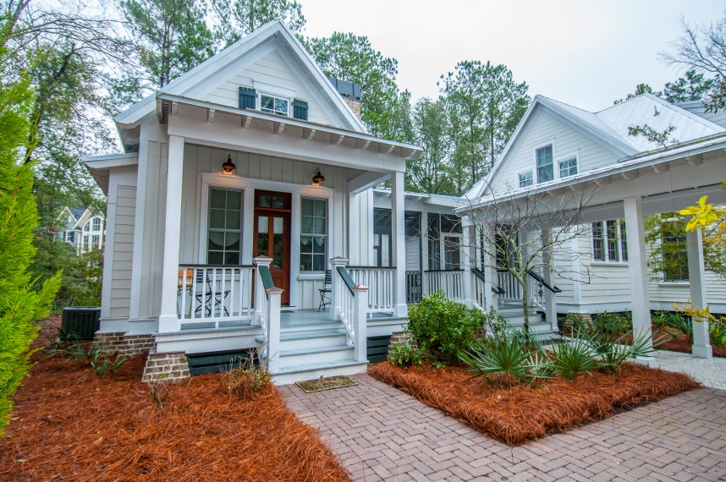
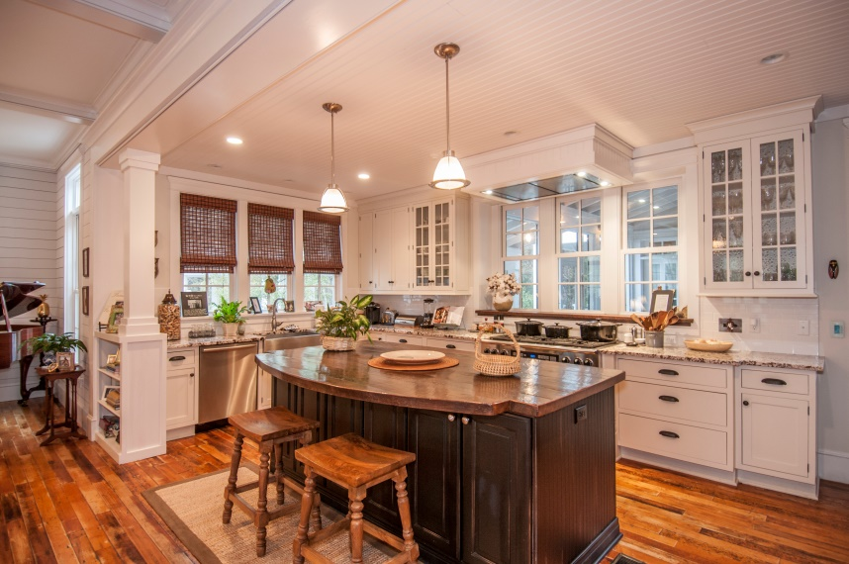
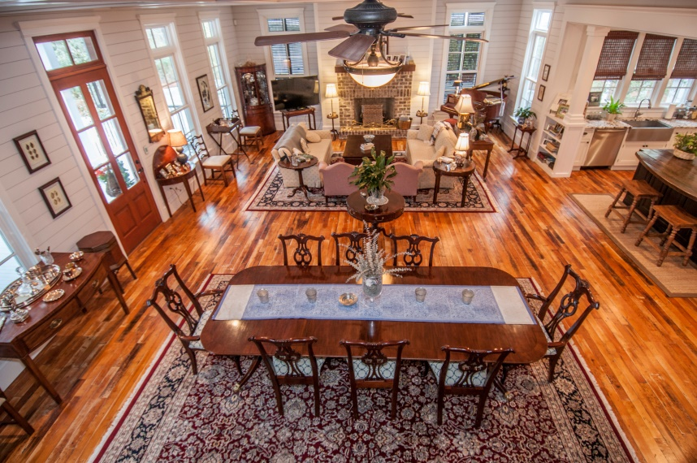

204 Royal Assembly Drive Beresford Hall :: Charleston :: MLS# 15004248 :: $949,000 4 Bedroom :: 5½ Bath :: 3,623 Sq Ft
This Lowcountry Jewel is a Must See!
Filled with reclaimed treasures, this Lowcountry jewel offers a dream kitchen with all the upgrades; the master on the main level boasting a beautiful wood beamed ceiling and separate sitting room; stunning antique maple flooring throughout; a quaint guest cottage with mini kitchen, full bath, and sleeping loft; and a 2 car detached garage with boat port and a 5th bedroom above with full bath, window seating and tons of extra storage. This MUST SEE treasure has won multiple “Best Home Design” awards. The gorgeous natural lot coupled with Beresford Hall’s fabulous amenities work to create your own private paradise.
Welcome Home!
Wendy Arnsdorff
843-364-8619 - M
843-284-1800 – O
wendy.arnsdorff@carolinaone.com www.wendyarnsdorff.com
Carolina One Real Estate
Mt. Pleasant North Office 2713 N Highway 17
Mt. Pleasant, SC 29466

