Slide 1
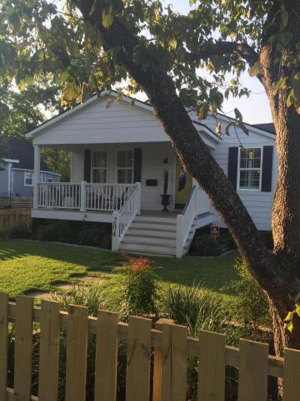
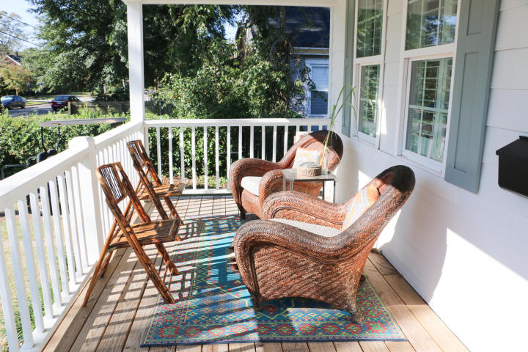
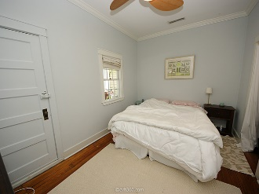
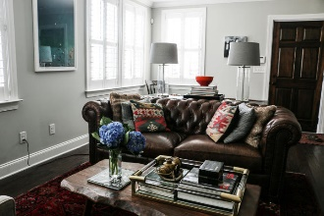
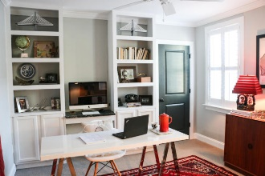
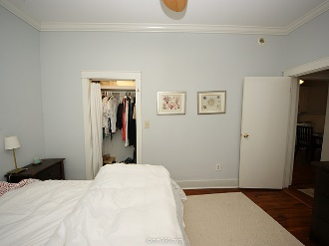
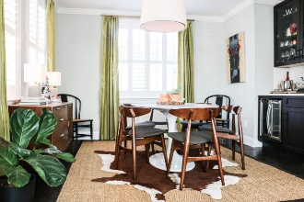
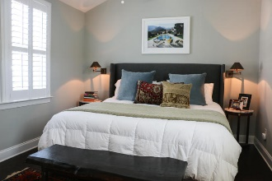
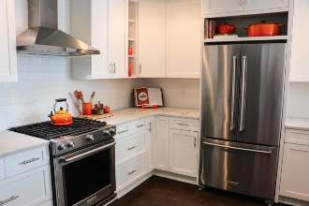
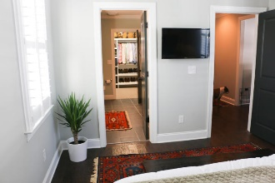


Wagener Terrace Agent Open House Friday, Sept 15th ~ 11-2
204 Saint Margaret Street
Charleston
MLS# 17024995 · $599,000
Come see this fully renovated, open, and modern 1940's bungalow in desirable Wagener Terrace. This chic home was renovated in 2015, with three large bedrooms, two baths, spacious front porch, and large yard with 500 sq ft garage. Inside, this mid-century home features an open floor plan, plantation shutters throughout, professional series appliances, white shaker cabinets with soft-close drawers and doors, honed Carrera marble countertops, farmhouse sink, hardwood floors, and a wet bar. The master bedroom is a great size with W/I closet with built-ins, and the en-suite bath has dual sinks, walk-in shower, and beautiful finishes. The additional two bedrooms are large with ample storage, and the hall bathroom is also top-of-the-line. Walk to many neighborhood amenities including Hampton Park.
Casey Anderson
Cell 843-410-3525
caseysellscharleston@gmail.com
Keller Williams Realty Charleston | 496 Bramson Ct, Suite 200 | Mt Pleasant, SC 29464

