Slide 1
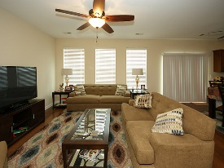
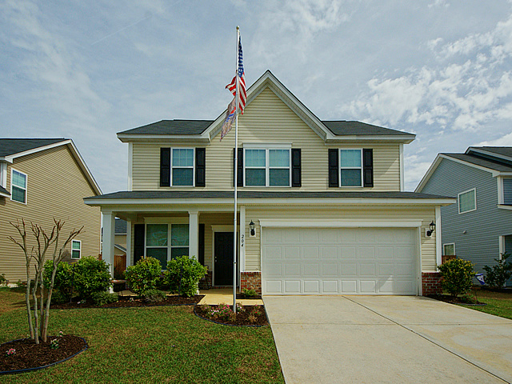
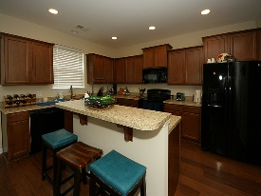
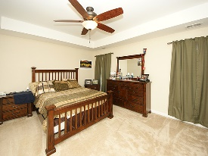
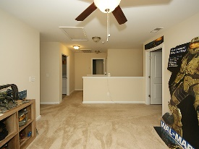
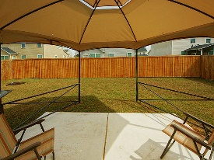
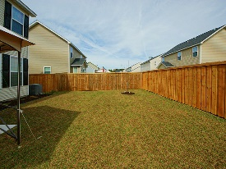
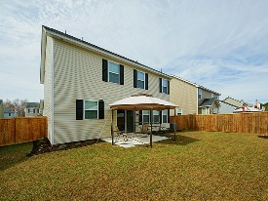


Move In Ready!
204 Two Forts Road
Stoney Creek
Moncks Corner, SC 29461
Open House Canceled!
Under Contract In 3 Days!
MLS# 17006029 | $197,500
3 Bed / 2½ Bath
Best priced home in Stoney Creek! This home is in spectacular condition waiting for a new owner. Wood floors, open kitchen concept, 3 large bedrooms, large master with separate bath/tub, double sink vanity and a loft. Sellers have taken great care of this home and installed a gorgeous privacy fence. This home is priced to sell and move in ready! Pictures are worth a thousand words!
Connie White, Broker
C: 843-532-3356
conniesyouragent@gmail.com
Charleston Homes
597 Old Mt. Holly Road
Suite 301
Goose Creek, SC 29445

