Slide 1
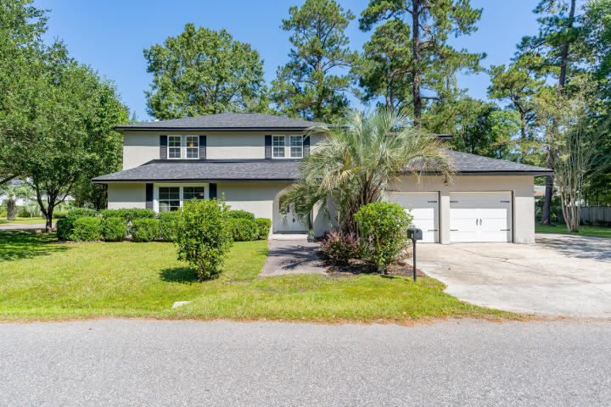
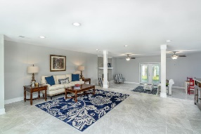
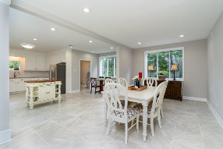
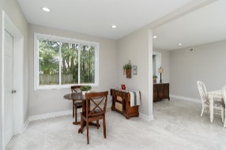
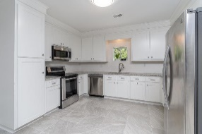
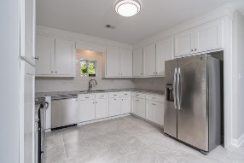
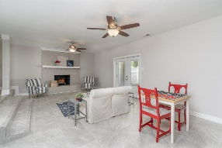
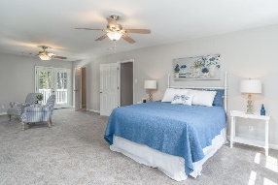
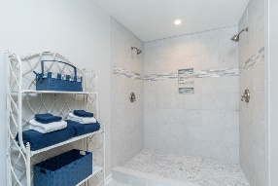
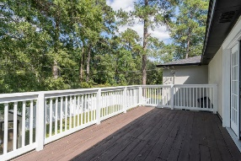
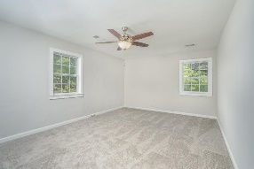
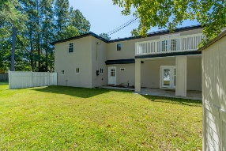
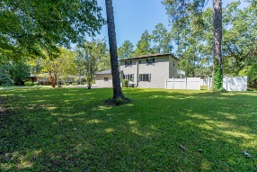


Downtown Summerville Open House Sat 11-1 & Sun 1-3
204 Waring Street
Historic District
Summerville, SC 29483
MLS# 20000191
$488,900
4 Bedrooms | 2½ Baths | 3,666 sf
This beautiful 3,666 Sq. Ft. home is located in the historic district of Summerville and is in IMMACULATE, move-in condition! With a new roof, HVAC and hot water heater, buyers will have no large ticket home maintenance items to worry about! The home has been FULLY renovated to include all new flooring, new kitchen cabinetry, stainless steel appliances and granite counters, new electrical throughout, beautifully renovated bathrooms, fresh new paint, some new windows and much more. This home is in close proximity to downtown historic Summerville and has a large double lot which can be used to park a boat, RV, trailer or maybe to build a detached garage. Inside, buyers will find a formal living room, family room with wood burning fireplace, newly renovated kitchen and separate dining room.
The home has 4 bedrooms and 2.5 bathrooms. The master bedroom is very spacious with an attached sitting area and fireplace as well as its own back porch. The master bathroom has 2 walk-in closets, dual vanities and a beautiful custom tile shower! Two of the other 3 bedrooms are very large allowing plenty of room for all your needs! The home also features a laundry room, 2 car garage, fenced-in backyard with shed and back patio. The great location and renovations will make this home hard to beat - come view it today!
Larry & Kathy Mazalatis
Larry Cell 843-693-0529
Kathy Cell 843-693-0159
Office 843-871-9133
AGENTOWNED PREMIERE GROUP | 1800 TROLLEY RD | SUMMERVILLE, SC 29485

