Slide 1
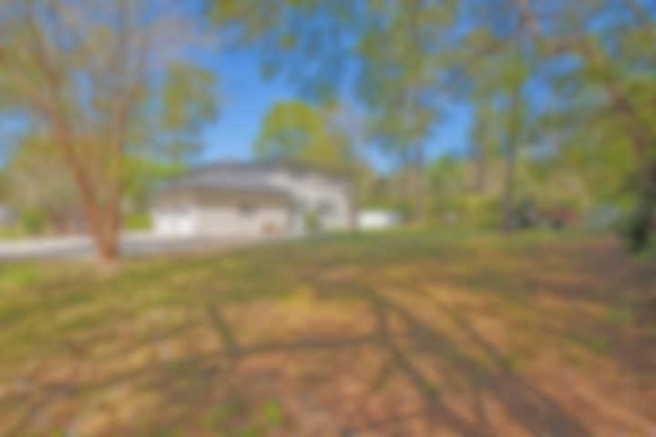
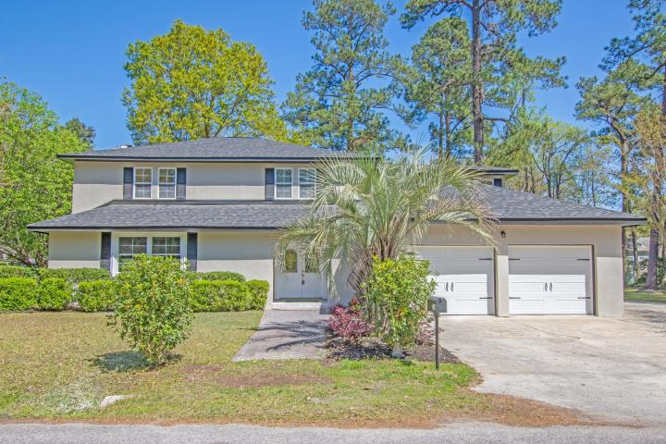
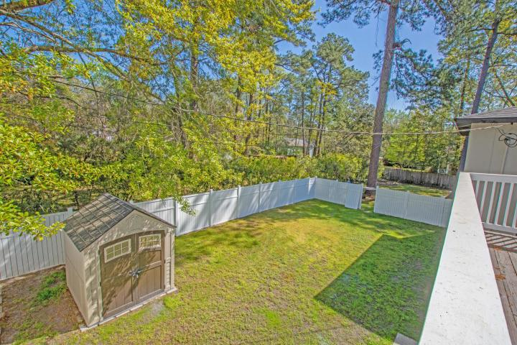
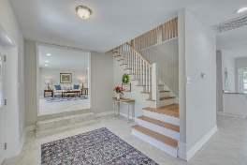
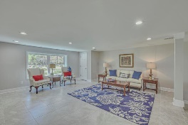
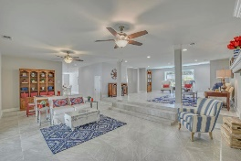
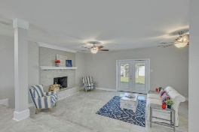
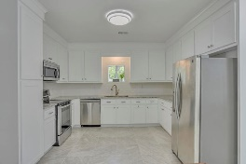
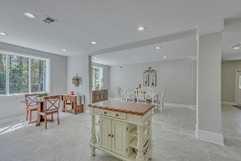
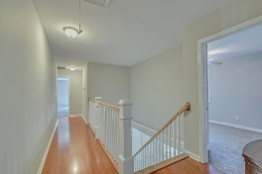
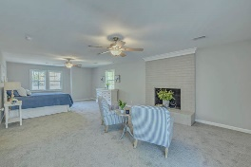
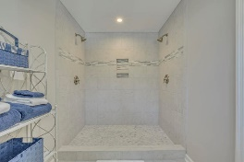
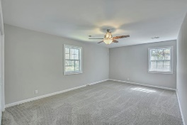
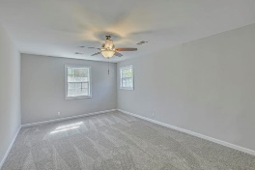
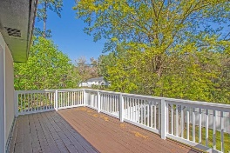


Closing Costs Paid By Sellers!
204 Waring Street
Summerville, SC 29483 ~ MLS# 19009228 ~ $525,000
Exquisite home located in a quite neighborhood on a large double lot within walking distance of Historic District of Summerville. No expense was spared on this newly renovated executive style home. Sophisticated renovated gourmet kitchen with updated and modern stainless appliances.
New travertine flooring throughout the home. Extremely large bedrooms and master bath which came right out of a magazine. Privacy fence with shed in backyard. Extra large lot for entertaining or summer afternoon game of croquet or horseshoes. Covered patio suitable for entertaining. Large two car garage.
Phillip Woody
(843) 412-3057
ltcolphillipwoody@yahoo.com
AgentOwned Premiere Group | 1800 Trolley Rd | Summerville, SC 29485

