Slide 1
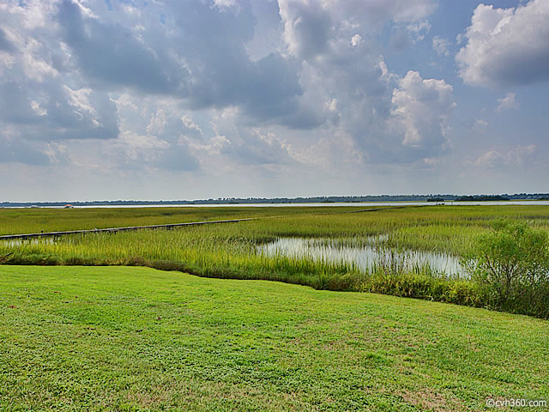
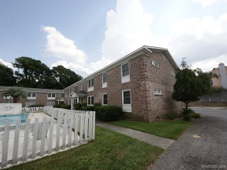
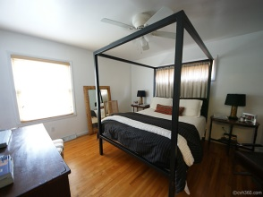
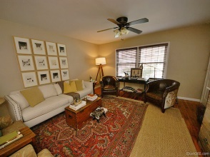
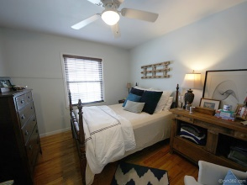
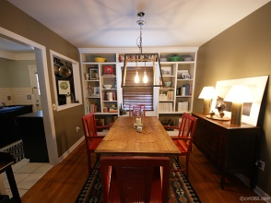
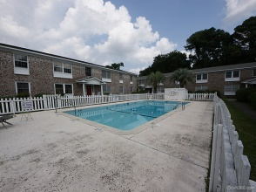
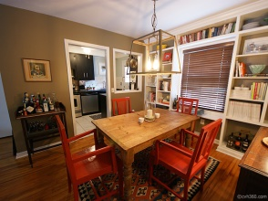
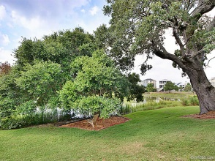

204-6B Sans Souci St
Charleston ~ MLS# 1323284 ~ $183,000
Wagener Terrace Condo Under $190k!
This absolutely lovely 3 bedroom, 2 full bath condo has been lovingly maintained and updated. Beautiful wood floors, custom built shelves in the dining room and 3rd bedroom, updated 2nd bath with travertine tile and much more. Don't miss this great home - Regime includes maintenance, insurance, termite bond, water bill and pool. This Sans Souci condo complex is beautiful riverfront community with marsh views of the Ashley River.
Marshall Walker
843-532-3214 M
mwalker@marshallwalker.com

