Slide 1

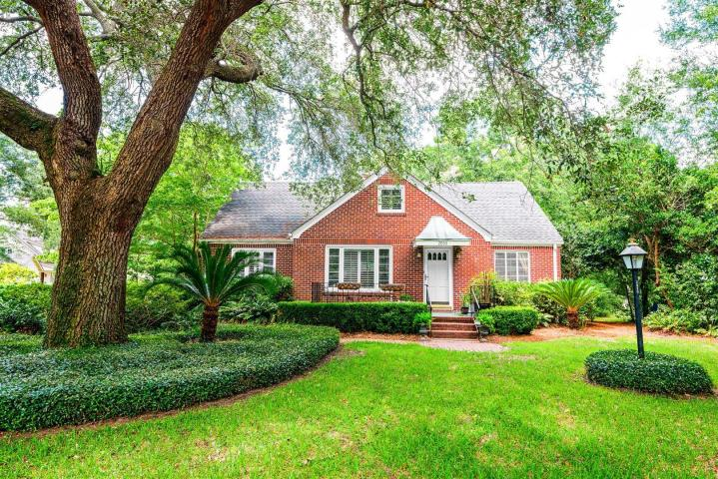
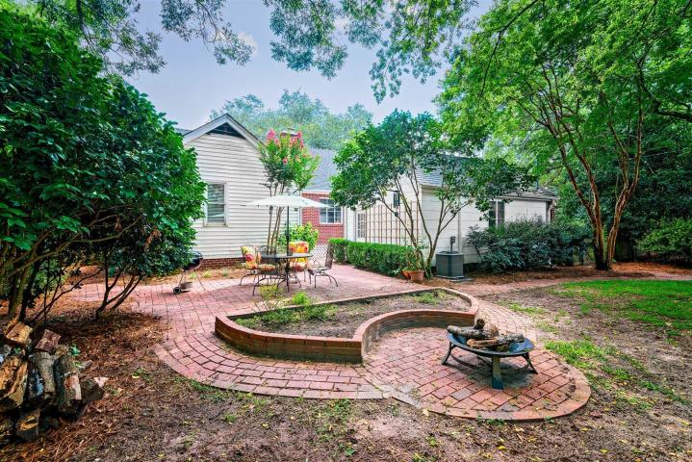
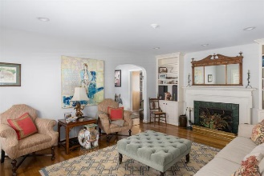
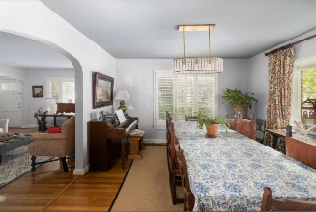
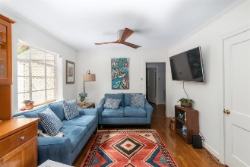
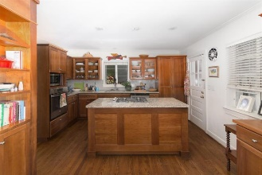
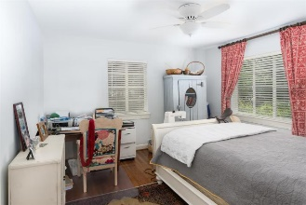
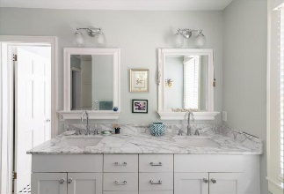
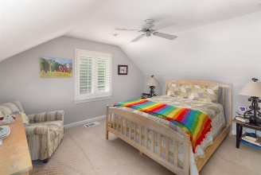
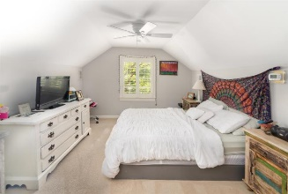
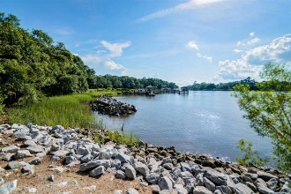
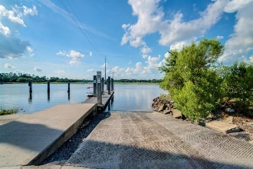


2050 Wappoo Drive
Riverland Terrace ~ Charleston ~ MLS# 18018417 ~ $675,500
Updated Home In Riverland Terrace Neighborhood
Charming updated home in the popular Riverland Terrace neighborhood! Sitting on a large beautifully landscaped corner lot, this is one of the larger homes in the area with 4 bedrooms and 3 full bathrooms. Meticulously maintained, it boasts hardwood flooring throughout the first level, remodeled kitchen with granite countertops, spacious island with gas cooktop and a concealed vent hood, GE stainless steel appliances, built in cabinetry surround for the refrigerator, lots of counter space and of plenty room to create scrumptious meals, perfect for the chef and home cook alike. Access the house through the air conditioned Laundry room/mud room with front loading washer and dryer and a granite counter top to easily fold clothes on. Directly off the kitchen is a spacious living area with large picture window overlooking the backyard. The first floor also includes a family room with wood burning fireplace, a nice sized secondary bedroom, full bathroom and a large master bedroom with en-suite bathroom and custom walk in closet. The master bath has gorgeous marble countertops, double sinks and a tiled walk in shower. On the second level is two more bedrooms and a loft, newer carpeting throughout and a recently updated bathroom. In the past couple of years, the ceilings have all been smoothed, large windows were replaced, plantation shutters were added, insulation was blown in the crawlspace, and the entire home had been professionally painted, all of this done, while maintaining the charm and many of the original features of the era. There is an extended driveway, off-street parking for multiple cars, an extra parking space on the side, and an attached one car garage, a private, fenced backyard with brick patio, and an irrigation system that covers the entire property. Located in X Floodzone, flood insurance is not required by lender. The Riverland Terrace community offers beautiful water views of Wappoo Creek, boat ramp, access to the Stono River, play ground, dog park, baseball field, enjoy all the Amenities and NO HOA Fees, while being centrally located to everything in Downtown Charleston, James Island, and Johns Island. Too many features and details to list all here. Set up your showing today! This home is one you have to see for yourself!
Asking $1,200,000
MLS# 17023051
3,692 SqFt
4 Bed/3½ Baths
Short Drive to Historic Downtown Charleston & Beaches
Jacqui Swain
(843) 295-9484
jacquiswainc21@gmail.com
www.JacquiSwain.c21.com
Century 21 Expert Advisors • 100 Seven Oaks Lane • Summerville, SC 29485

