Slide 1
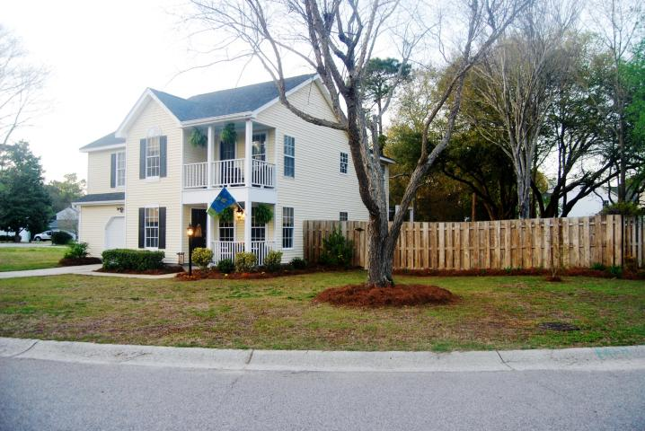
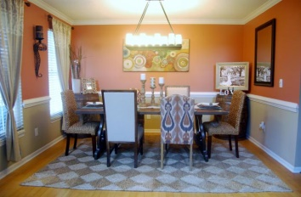
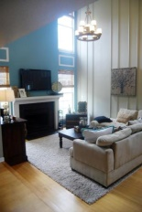
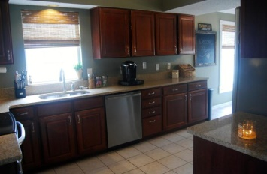

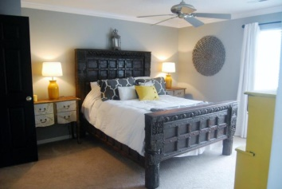

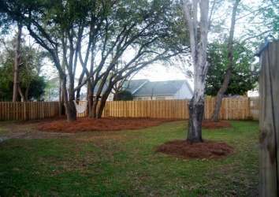


5 Minutes to the Beach!! 2051 Presidio Drive | Quail Hollow | Mount Pleasant | MLS# 15008482 | $355,000
137 Beaufain Street
MLS# 15000837 - $1,150,000
LOCATION, LOCATION, LOCATION!! 5 minutes away from the beach & Mt. Pleasant Towne Center! One of the biggest lots in the neighborhood with inviting curb appeal, full privacy fence, double porches & custom-made pergola for patio entertaining! The family room consists of 18ft ceilings, wood burning fireplace, transom windows allowing for tons of natural light! Cherry wood cabinets in the kitchen, granite countertops, stainless steel appliances & tile flooring. Upstairs you will find the large master with walk-in closet. Master bath has pedestal sinks, over-sized shower with 2 shower heads & a garden tub. Two additional bedrooms share 2nd full bath & guests can enjoy the walk out 2nd story porch. Backyard is a blank canvas with mature oak trees and tons of potential! Don't miss out!
Check out the virtual tour for more pix!
Melissa Britt Thierfelder, MRP melissabritt@remax.net
Office: 843-442-8787 | Cell: 843.725.8016
www.melissabritt.remax-carolina.com
RE/MAX Elite | 91 Broad St | Charleston, SC 29401

