Slide 1
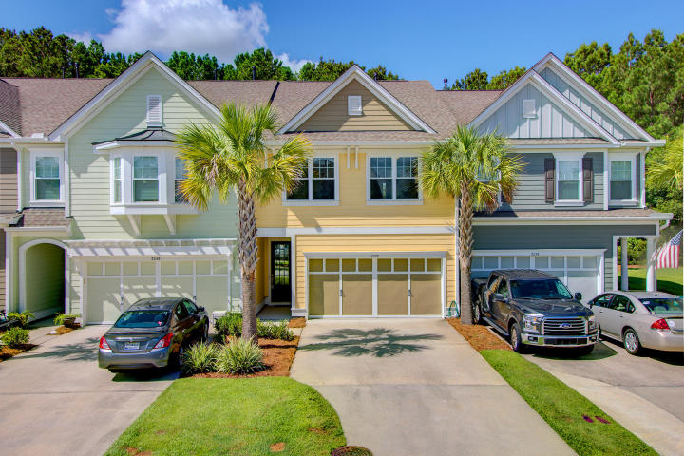
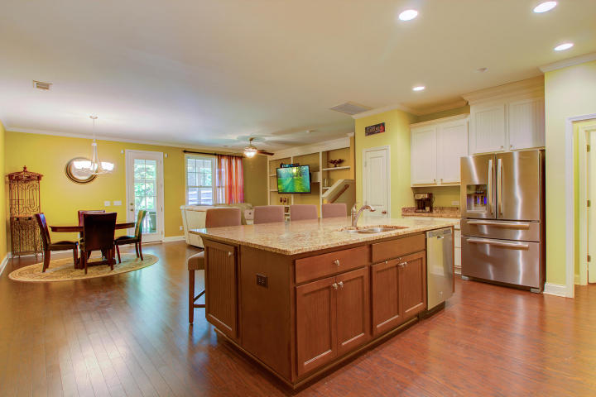
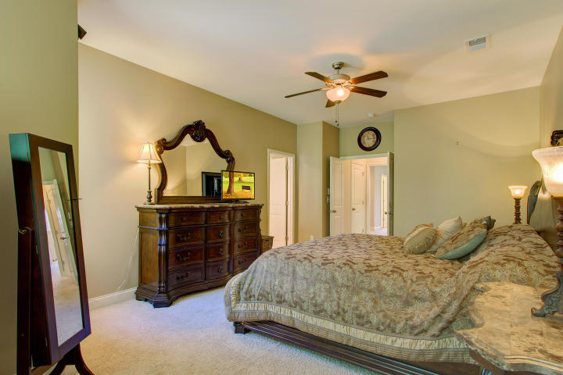
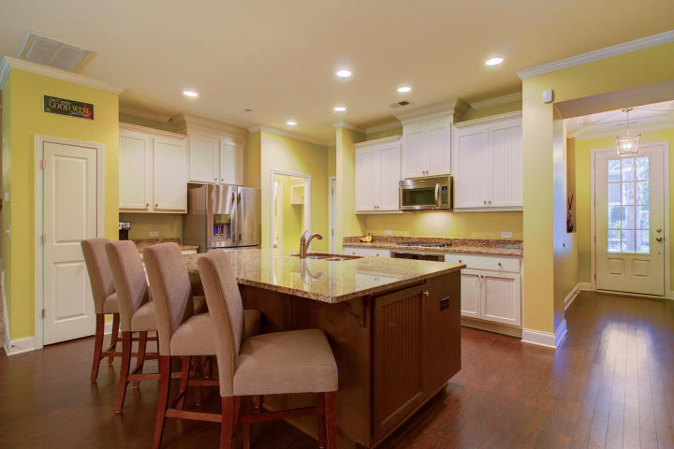
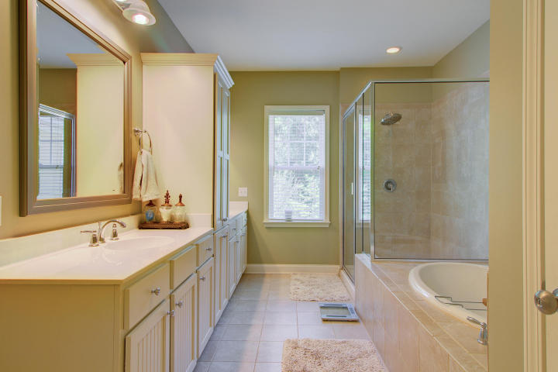
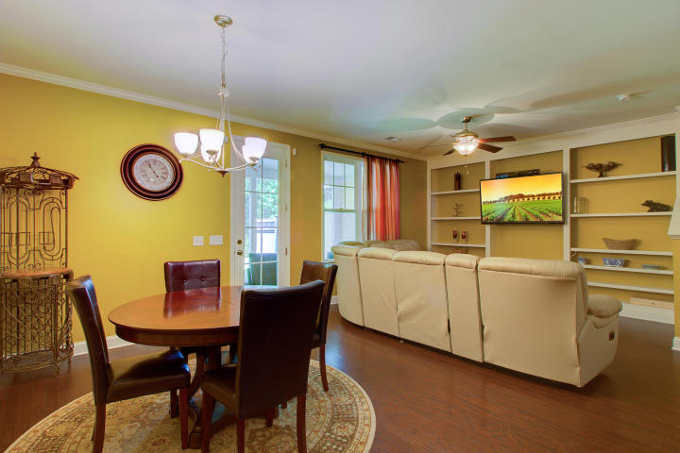
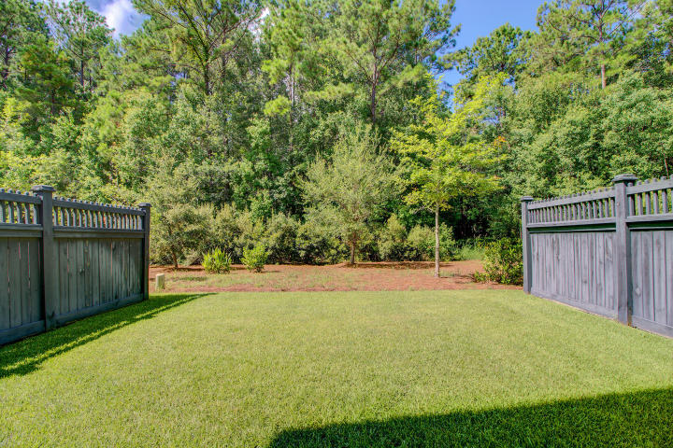
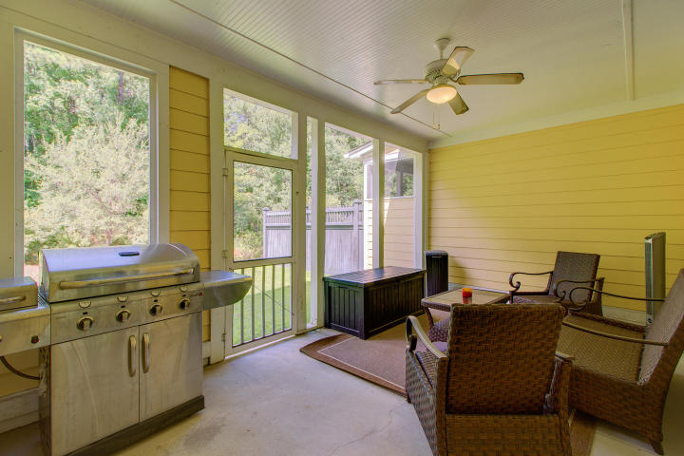
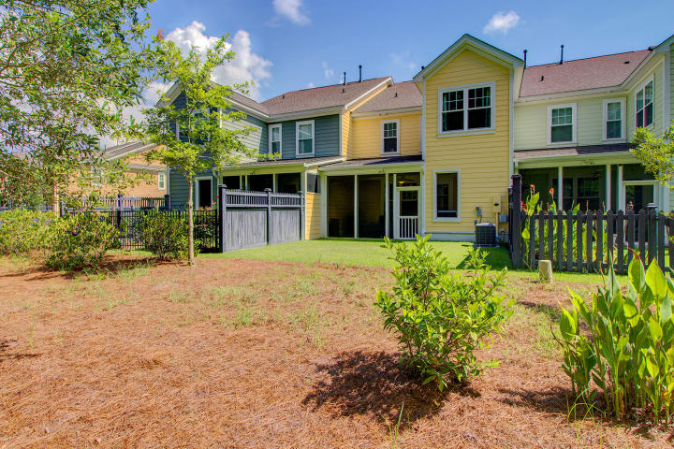

New Price
Dunes West Town Home
Can Be Yours For The Holidays!
2052 Kings Gate Lane
Dunes West ~ Mount Pleasant, SC 29466
MLS# 17019979 ~ $364,900
Sought after Dunes West location, minutes to the beach and historic Downtown Charleston!
This would make a lovely primary residence or vacation getaway! Resort like amenities including swimming, tennis, fitness center and golf are available. Open concept with a gorgeous kitchen including granite counters and stainless steel appliances. Huge screened porch overlooking a private, wooded back yard. All three bedrooms are upstairs with an extra bonus area- perfect for a playroom, home office, or an exercise area. Huge master suite with a sitting area and luxurious master bath. Laundry room upstairs for an added convenience. Seller will consider painting the main level or providing a painting allowance with a full price offer. CAN CLOSE BEFORE THE HOLIDAYS!!!
View the 3D Walk through tour here:
http://southcarolina3drentals.com/index.php/3d-model/2052-kings-grant/fullscreen
Ellen O'Neil
Broker/Owner
Ellen O'Neil Realty
ABR, e-PRO, CNE
Charleston Realtor of Distinction
(843)300-8530
http://EllenONeilRealty.com

