Slide 1
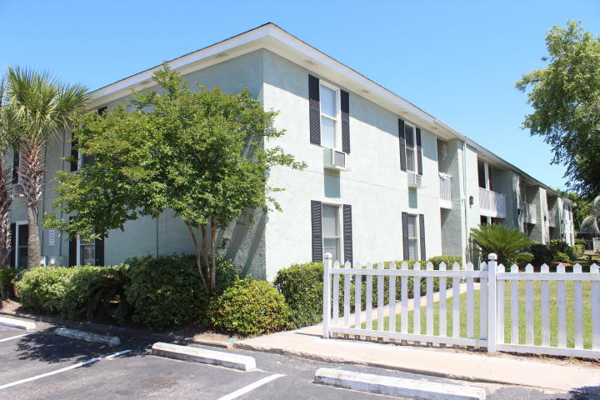
Sullivans Island Gem!
2057 Middle Street #3, Sullivans Island
MLS# 16005050 ~ $275,000
Enjoy island living in the heart of beautiful Sullivans Island in this lovely first floor one bedroom condo. Conveniently located within a five minute walking distance to the beach (two blocks), eight popular restaurants, shopping, and playground/children's park with tennis and basketball courts. The open floor plan connects the kitchen, dining area, and living/family room. Regime of $211.50 per month includes pest control, grounds maintenance, flood insurance, and water. This is a wonderful opportunity to own property on Sullivans Island as a permanent residence, second home, or long term rental investment. Easy to show! One bedroom units in this complex rarely come available.
Carol Varadi
(843) 224-0278
carolvaradi@gmail.com
The Boulevard Company, LLC
806 Johnnie Dodds Blvd
Suite 100
Mt. Pleasant, SC 29464

