Slide 1
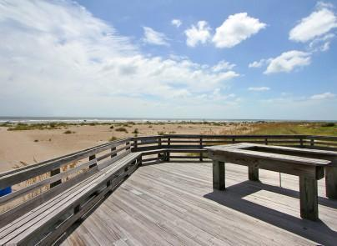
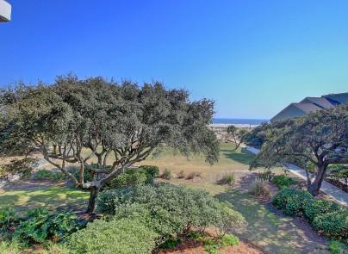
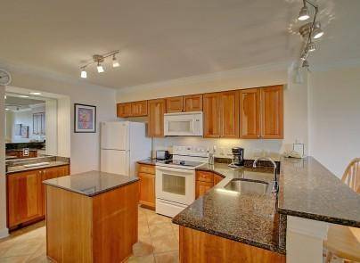
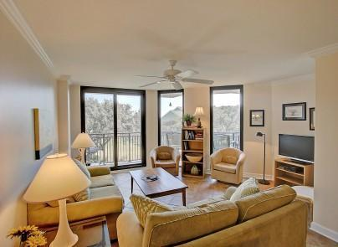
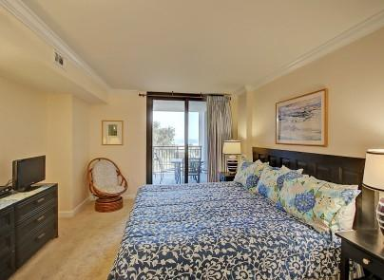
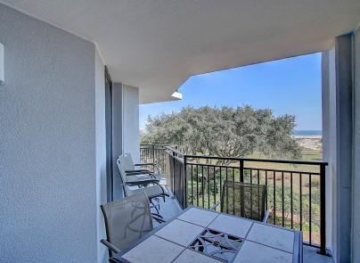
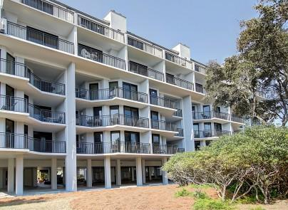
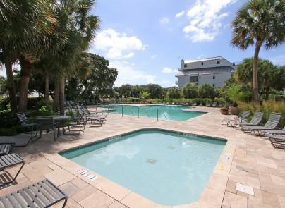


205 Shipwatch A Wild Dunes Isle of Palms MLS# 16005413 $585,000
MOTIVATED SELLERS!!
ALL OFFERS CONSIDERED!
Excellent Vacation Rental Potential
Oceanfront with Many Updates
Enjoy the ocean view at 205-A Shipwatch in Wild Dunes.
This luxurious 3 bedroom 3 bath oceanfront condo will accommodate your family and friends for entertaining and privacy. Excellent rental potential. Enjoy the ocean views from the balcony off the family room or master. This well maintained condo is an open plan from the kitchen through to dining area and living area out to balcony. Kitchen offers granite and lots of storage and counter space. Shipwatch has gone through an extensive renovation to include new siding, metal roofs, railings, and brand new storm-rated doors and windows. Great Vacation Rental Opportunity.
Darlene Smith Office - (843) 886-8110
Mobile - (843) 696-7824
darlenesmith@carolinaone.com
DarleneSmithTeam.com
Carolina One Real Estate
1503 Palm Blvd Ste
Isle of Palms, SC 29451

