Slide 1
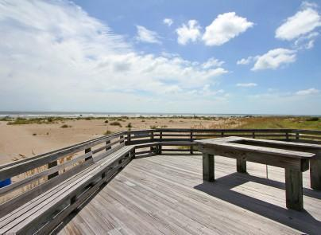
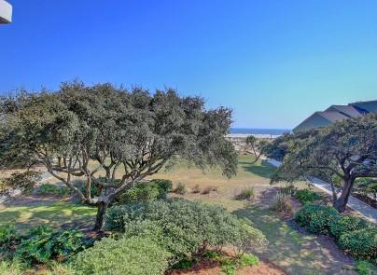
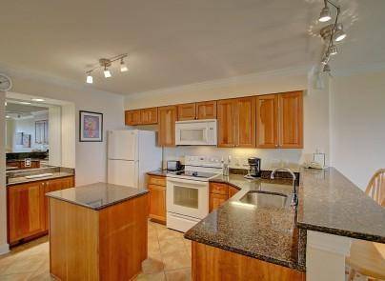
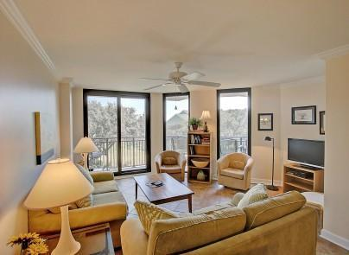
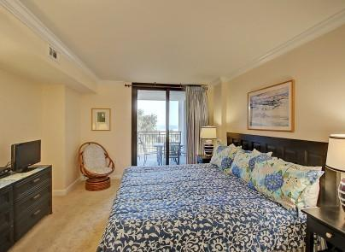
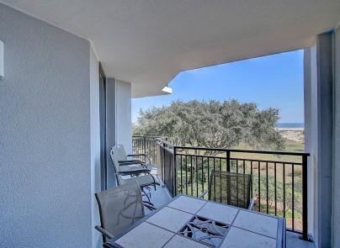
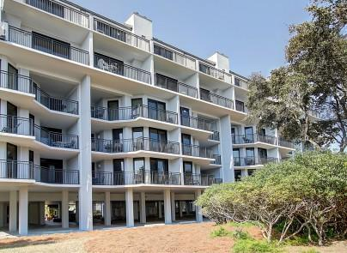
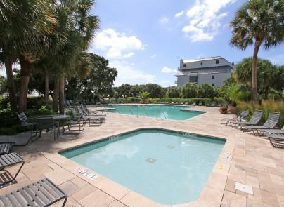


205 Shipwatch A
Wild Dunes
Isle of Palms
MLS# 16005413
$649,000
Motivated Sellers...
Terrific Condo w/Ocean Views.
Oceanfront with Many Updates
Great Vacation Rental Opportunity!
Enjoy the ocean view at 205-A Shipwatch in Wild Dunes. This smart 3 bedroom 3 bath condo will accommodate your family and friends for entertaining and privacy. The master bedroom balcony enjoys a view of the ocean as well. This well maintained condo is an open plan from the kitchen through to dining area and living area out to balcony. Kitchen offers granite and lots of storage and counter space.
Darlene Smith
Office - (843) 886-8110
Mobile - (843) 696-7824
darlenesmith@carolinaone.com
DarleneSmithTeam.com
Carolina One Real Estate
1503 Palm Blvd Ste
Isle of Palms, SC 29451

