Slide 1

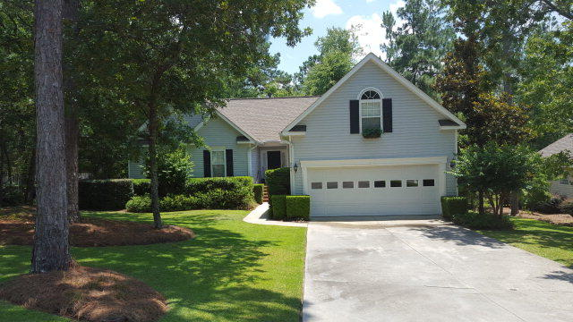

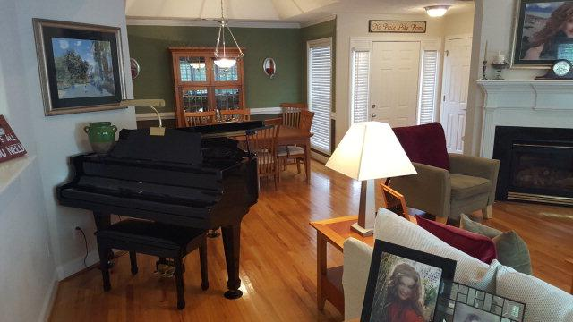
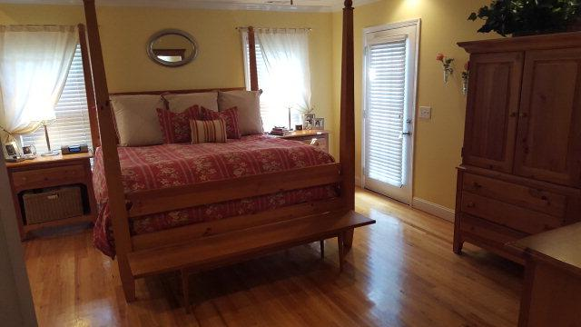
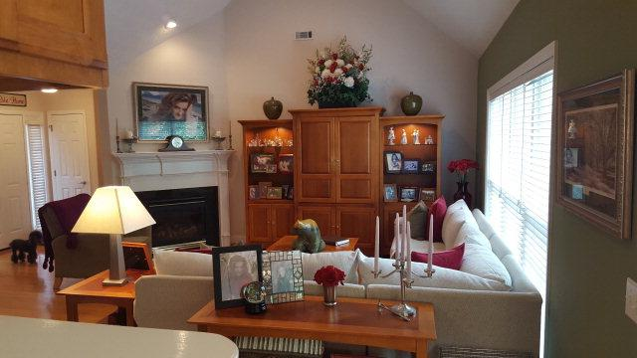
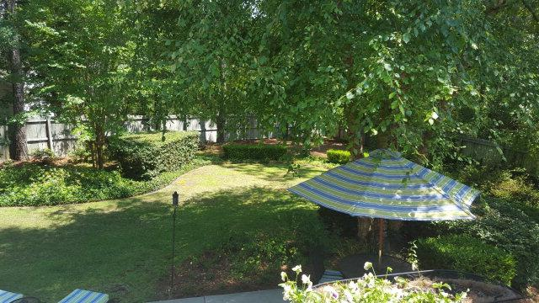
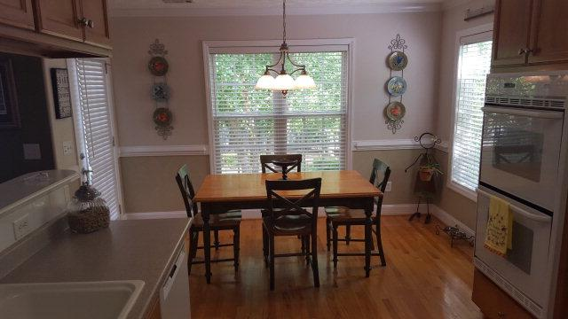
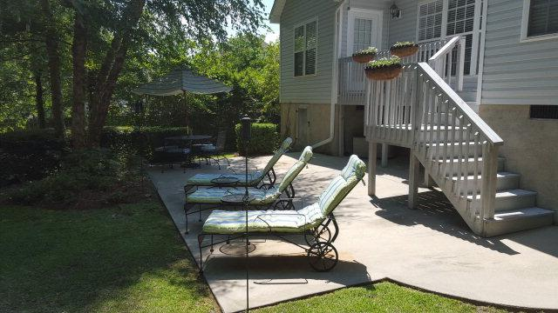


205 Buck Point Ct Aiken, SC 29803 MLS# 91017 / $262,500
Beautiful impeccably maintained home in desirable Plantation South. Original owners of this custom built home have added designer touches throughout and it truly shows better than new. Gleaming hardwood floors add to the pristine condition of this home. Great floorplan features 3 bedrooms and a bonus room. Backyard is like an oasis with privacy fencing surrounding attractively landscaped spacious backyard. This home is a pleasure to show.
Valli Catchpole 803.617.8540 / valli1@me.com Property Consultants of the South, 1429 Lyon Dr SE, Aiken, SC 29801 / www.FineSouthernLiving.com

