Slide 1
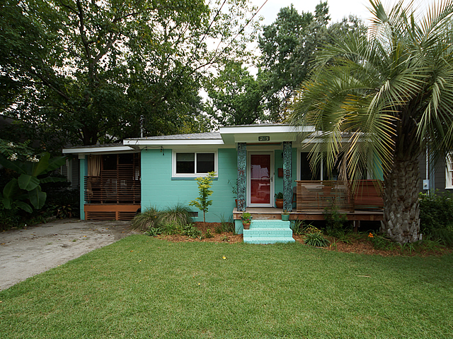
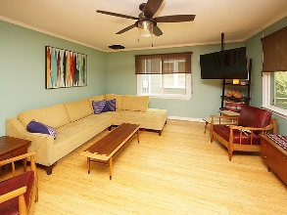
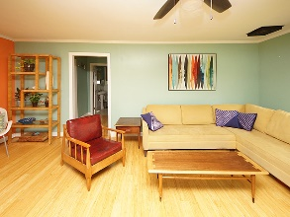
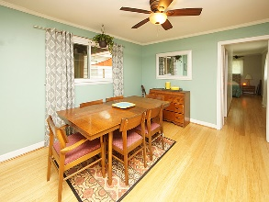
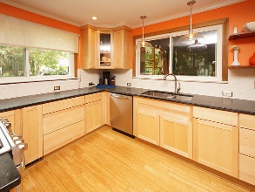
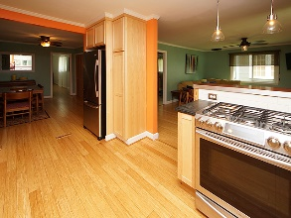
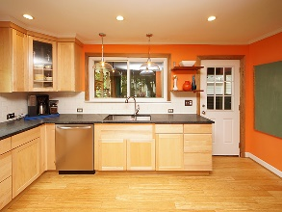
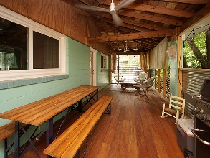
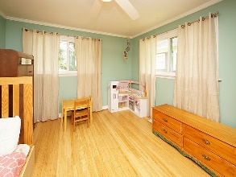
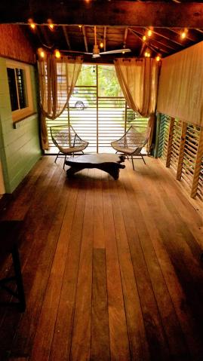
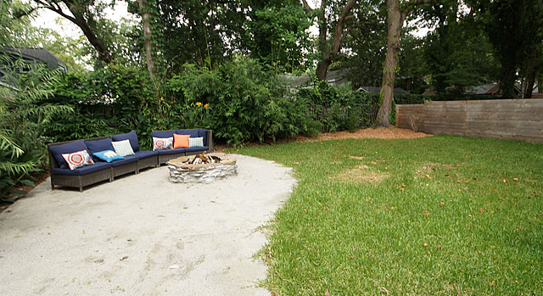
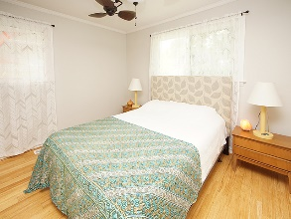


Price Reduced!
Walk to dinner, coffee and much more! Priced To Sell!
205 Hickory Street
Ashley Forest ~ Charleston, SC 29407
MLS# 18019972 ~ Price Reduced to $384,300
This house is must see! The backyard and porch has a serene atmosphere while being walking distance to many amenities. The kitchen has been totally renovated and is entertaining ready. Hardwood floors, large bedroom with great closet space, open floor plan, large yard and tons of updates. New roof, new windows and new HVAC. See owners upgraded list. Under termite bond.
AgentOwned Charleston Group
902 Savannah Hwy
Charleston, SC 29407-7802
Lisa Deaton
843-224-7878
lisamdeaton@comcast.net
www.agentownedrealty.com

