Slide 1
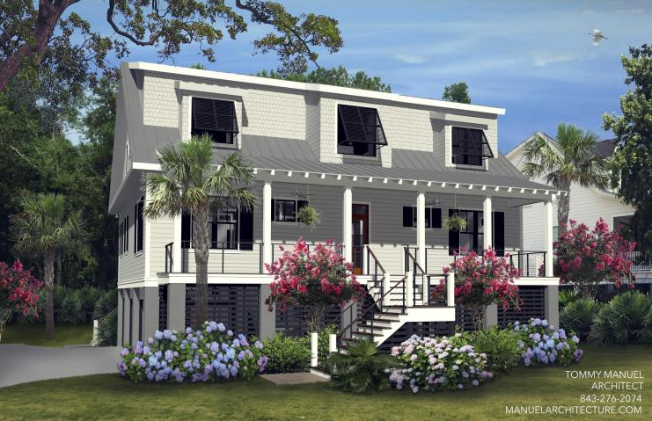
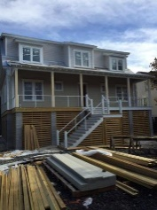
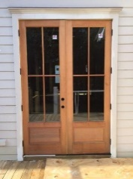
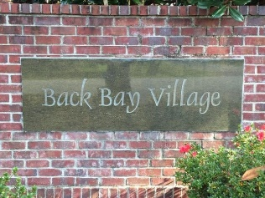
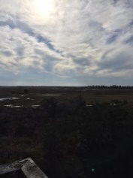
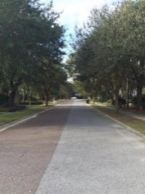


205 Indigo Bay Circle Back Bay Village | Mount Pleasant | MLS# 15024604 | $939,900
Spectacular New Construction Ready Soon
$775,000
New Construction on one of the last remaining lots in Back Bay Village, one of Mt. Pleasant's most desirable neighborhoods. Back Bay Village is only minutes to the Ravenel Bridge, I 526, the Mt. Pleasant Town Center, and both Isle of Palms and Sullivan's Island, definitely one of the best locations in Mt. Pleasant. This spectacular 3531 square foot home will have everything your family could ever need including 5 bedrooms and 4 1/2 bathrooms a three plus car garage and too many extras to mention. Estimated completion date of June 2016.
Krista Barnes
REALTOR
(843) 224-4474
krista@carolinaone.com
www.kristabarnes.com
Carolina One Real Estate | 2713 Highway 17 North | Mt. Pleasant, SC 29466

