Slide 1
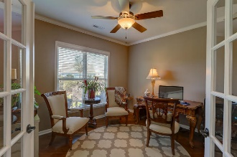
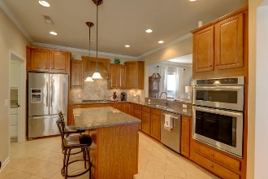
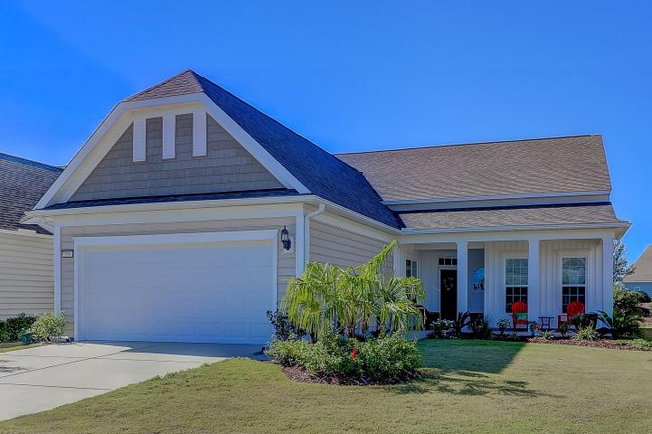
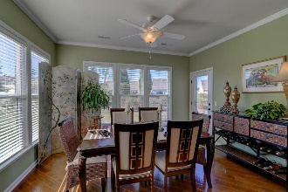
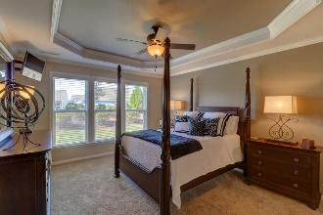
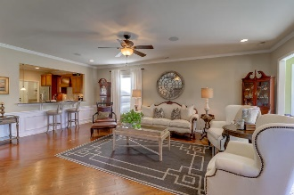
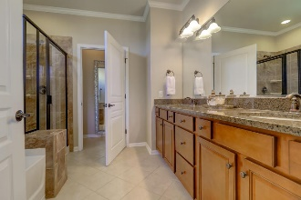
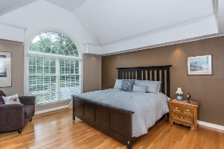
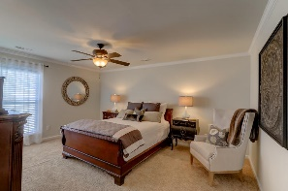
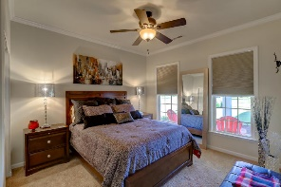
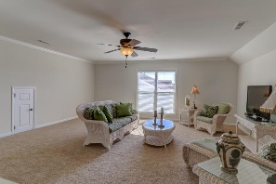
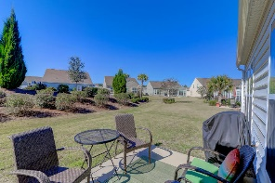
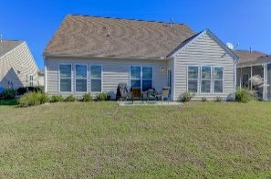
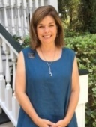


Open House Sunday 1-3pm
Motivated Seller!
205 Sweet Tea Lane
Cane Bay Plantation - Summerville, SC 29486
MLS# 17030451 - $359,500
Life is good on Sweet Tea Lane in this charming cottage style home with upgrades galore! Nestled in the premier active community of Del Webb at Cane Bay, you will be greeted with new landscaping leading up to a covered front porch. Beautiful 5” wood plank floors lead into the expansive great room, guest bedroom with a full bath and kitchen situated in the front of the home. The kitchen is equipped with granite counter tops, 42 inch maple cabinets, stainless steel appliances, wall ovens, a gas cook top, dishwasher and refrigerator. Plenty of space for meal prepping with the large kitchen island, pendant lighting, a breakfast nook and a serving bar overlooking the spacious great room, and a sunroom with access to the outdoor patio for entertaining. Off the corner of the great room is a private library/study. A hallway leads to a luxurious owner's suite featuring a tray ceiling, a large walk-in closet with new custom organization system and a private, spa like bath with granite counter-tops and rubbed oil bronze fixtures. Upstairs is an oversized guest suite with a huge sitting area, large bedroom with a walk in closet and a full bath. The laundry room located off the kitchen has a counter for folding and washer and dryer which lead into an oversized 2 car garage. The garage houses beautiful new custom storage cabinets and a freshly painted and sealed garage floor. Recent upgrades include 2 new storm doors, new landscaping, new custom storage in the garage and master bedroom closet, painted and sealed garage floor.
The Surrey Crest design offers beautiful living space to accommodate your needs. Del Webb is an active adult community located in the master planned community of Cane Bay. Clubhouse, resort style pool, fitness center, tennis, pickle ball, bocce and many other activities and clubs to fit ones interest, and a dog park too!
Elaine Nugent
(843) 330-7044
enugent@carolinaone.com
John Nugent
(843) 304-2061
john.nugent@carolinaone.com
nugentknowsrealestate.com
Carolina One Real Estate | 628 Long Point Rd | Mt Pleasant, SC 29464

