Slide 1
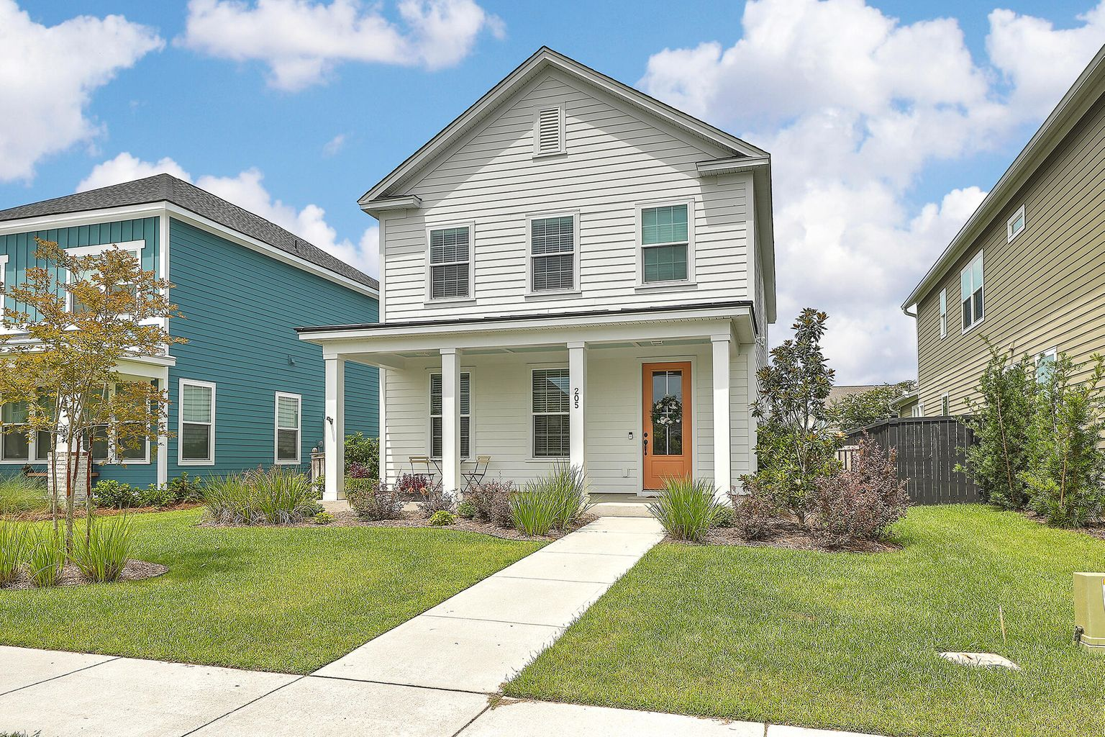

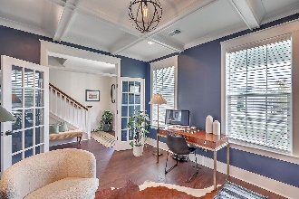
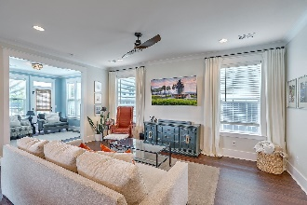
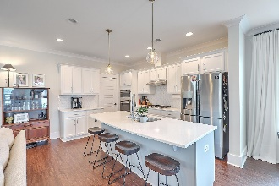
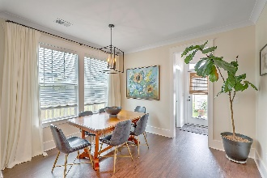
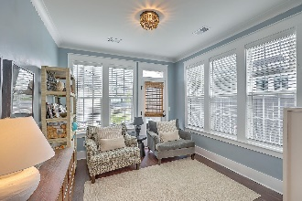

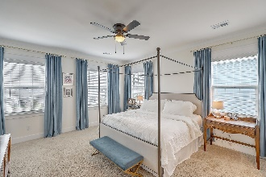
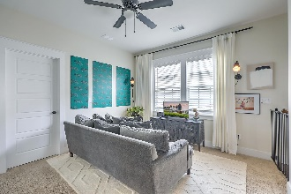
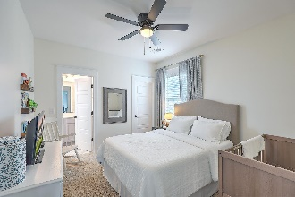
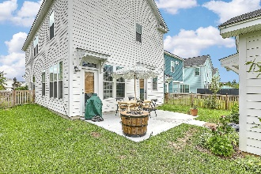
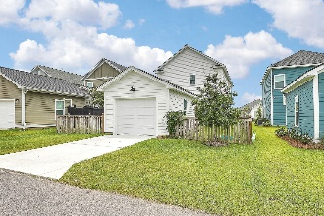
Kent Susong
M (843) 324-0190
O (843) 856-0021
larrykentsusong@gmail.com
Better than New!
205 Billinger Street
Carnes Crossroads | Summerville, SC 29486 | MLS# 22018566 | $509,000
This is an amazing home located in Carnes Crossroads subdivision.The office/bedroom on first floor has coffered ceiling and access to full bathroom. Open concept floor plan is great for entertaining has all luxury vinyl downstairs. Kitchen was upgraded to Chef's kitchen, upgraded backsplash, kitchen island stainless steel, gas stove. Also, has drop zone at backdoor, extra storage. Owners upgraded for a sunroom, and patio, has detached garage. Newly fenced backyard. Home has been upgraded with the Craftsman package which includes wide trim. Upstairs you will find a loft area, and 2 bedrooms with jack ad jill bathroom. Master bedroom is large with walk in closet, separate tub and shower. Upgraded light fixtures.
Century 21 Properties Plus | 1090 Park West Blvd; Ste 3 | Mount Pleasant, SC 29466

