Slide 1
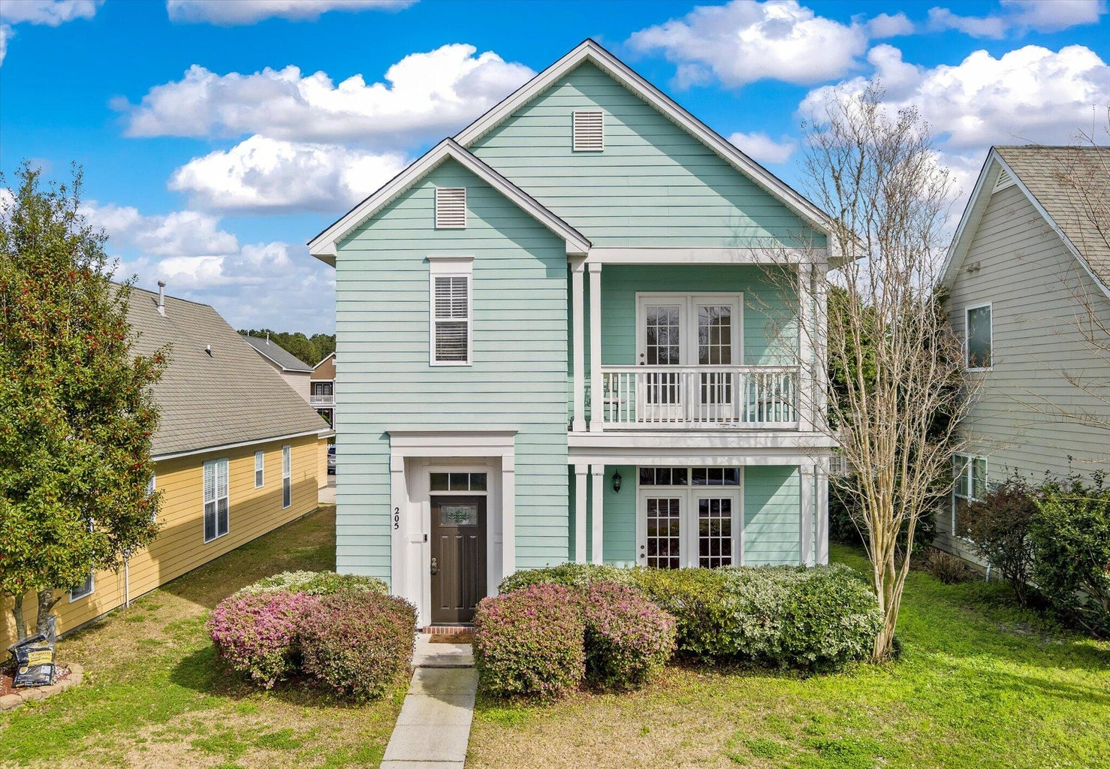
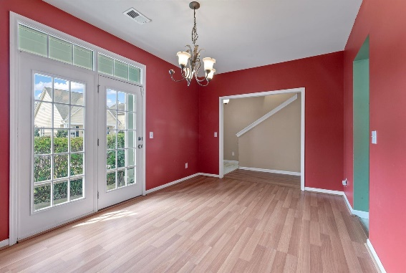
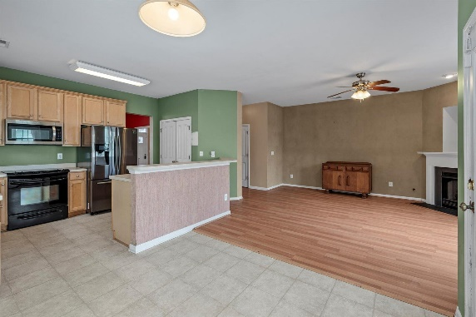
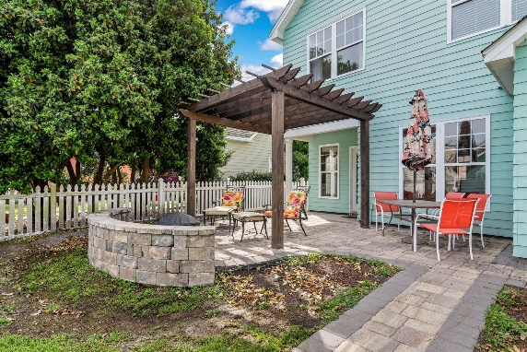

White Gables Diamond In The Rough- Easy to Show
205 Dandelion Street
White Gables | Summerville, SC 29483 | MLS# 24004721 | $365,000
Welcome home to White Gables Community! Beautiful homes and streets. Property has detached 2 car garage with alley access. Two story home featuring back and front yard patios. Second floor master bedroom balcony. First floor has open floor plan leading into magnificent backyard entertaining area for cookouts featuring paver patio and pergola. HVAC unit replaced in 2020, water heater 2023, range 2017. Ready for you to come and make it your own. Awesome Amenity Center offers a pool, playground, tennis courts, basketball(1/2 court) and clubhouse. Walking/jogging/wheeling trails and storage area for your boat and/or RV.
Steven Olson
solson1071@aol.com
Donna Urban
843-830-2913
Donna.Urban@AgentOwnedRealty.com
AgentOwned Charleston Group | 902 Savannah Hwy | Charleston, SC 29407-7802

