Slide 1
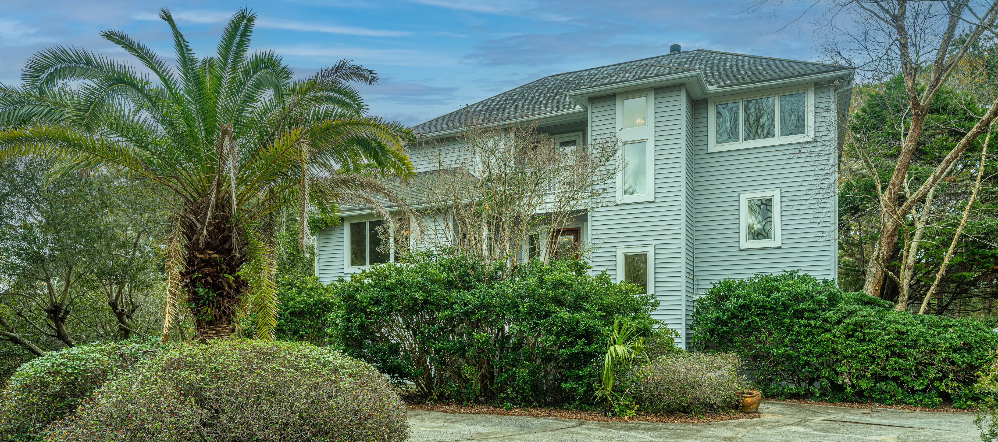

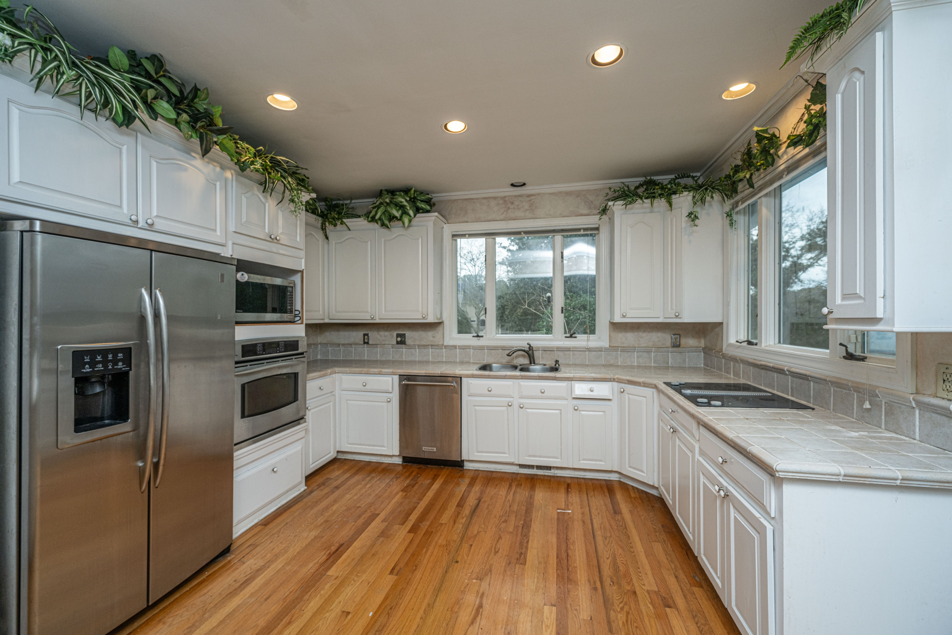
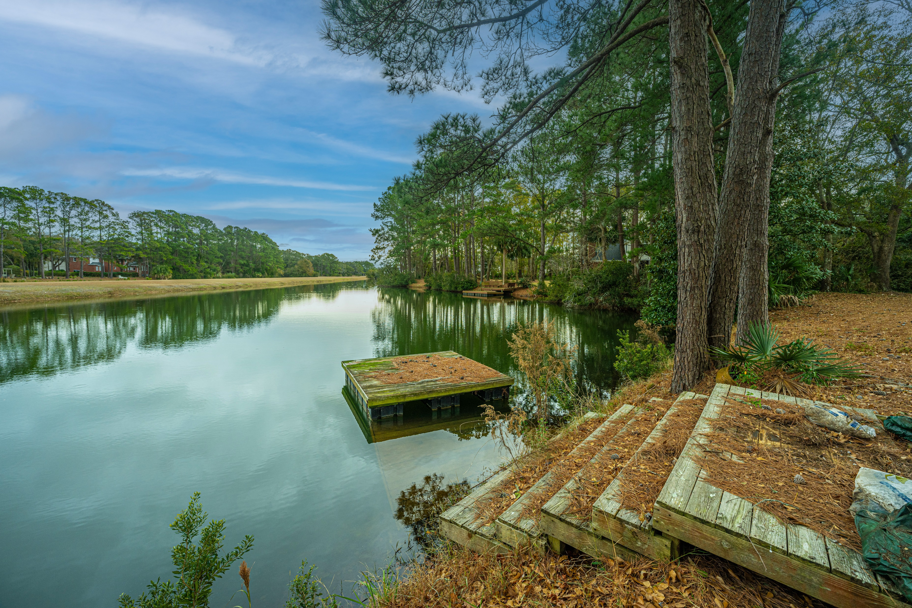
Excited to share with you an exclusive listing in Ravens Run. It is a Foreclosure sale. SO Many possibilities. We will be live to the market on Friday - stop by the open houses this weekend.
Friday 11am-1pm | Saturday 2-4pm
2060 Skyhawk Court Mt. Pleasant SC | Ravens Run Gated Community
4 bedroom | 3.5 baths | 3,054 sf | Elevated home on 1.72 acres
Yes, you read that correctly it is on just under 2 acres. Waterfront acres in a gated community!! Centrally located in Mt. Pleasant minutes from shopping, beaches and downtown. You can make this home yours.
It is a rare sight nowadays, but it is a FORECLOSURE sale! You know you can make this home yours - renovate, update, tear down .... limitless possibilities. This home is sold As Is and no repairs will be done, but when its this good of a deal that's ok.
Stop by the open house or call me for a private showing.
Timme Spanos
Carolina One Real Estate
843-367-8025 | timme.spanos@carolinaone.com
Bring yourself or your contractor but remember to bring your imagination because the possibilities are limitless!

