Slide 1
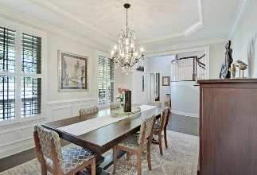
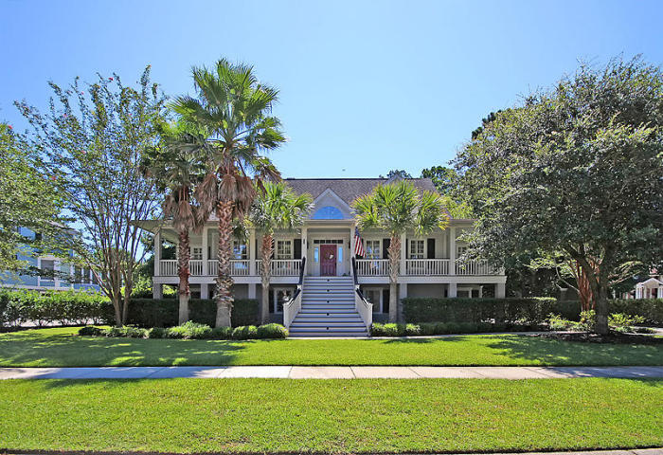
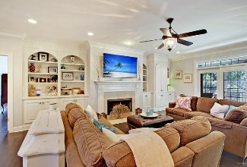
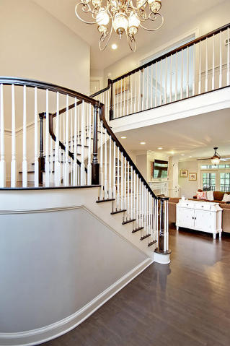
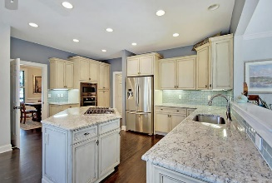
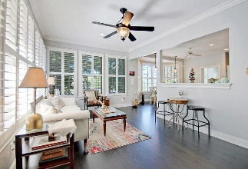
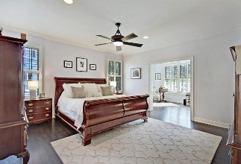
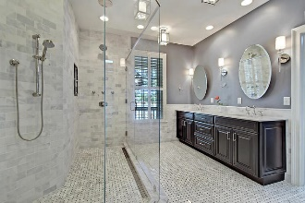
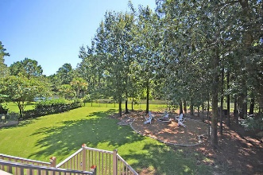
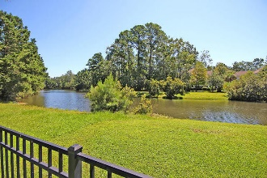
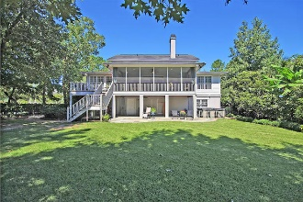

2061 Ashburton Way
Mount Pleasant, SC 29466
MLS# 17021693 ~ $799,900
The Only Deep Water Home On Daniel Island
Just Reduced in Park West!
GORGEOUS Custom Elevated Home in Desirable Park West - Andover with Gas Lanterns and Full Front Porch. This Large Pond-front lot has it all. The Sunny Gourmet Kitchen features Granite Counter Tops, 4-Burner Gas Burner Cooktop, Upgraded Stainless Steel Appliances, Kitchen Island, Eat-in Kitchen, Pantry & Plantation Shutters. The Spacious Family Room boasts Built-in Bookshelves, Gas Fireplace, Hardwood Floors, and Crown Molding. Elegant Dining Room with Upgraded Lighting, Crown Molding, Chair Rail and Handsome Hardwood Floors. The Desirable Downstairs Master Bedroom Suite has Hardwood Floors, Ceiling Fan, Large Relaxing Separate Sitting Area, and remodeled LUXURIOUS SPA-LIKE Master Bathroom with a HUGE AMAZING Seamless Glass Shower with Spectacular Tile, Body Jets and a Rain Shower.
There are His and Her Vanities, Tile Floors, Water Closet and a Huge Custom Shelving Walk-in Closet. There is also a Massive Screen Porch and Deck for Entertaining and Enjoying the Outdoors. The Upper Level have 3 more Generous Sized Bedrooms with 2 Full Bathrooms and a Large Flex Room which can also be used a Media Room or Home Office. There is a Huge 5-Car Garage with a Mother-in-law Suite that includes a Living Area, Bedroom and Full Bathroom at Ground Level. The landscaped backyard is completely fenced in with a black aluminum fence. The yard is extremely spacious and can easily ACCOMMODATE A POOL and/or outside kitchen area. Park West amenities include 2 Pools, Play Park, Several Tennis Courts, Club House, Miles of Walking Trails, and Outstanding Schools and Recreation Fields. Park West is only 7 minutes to the High School, and 5 minutes to either a Harris Teeter, Publix, or Walmart, and is a short drive to downtown Charleston with 5-star restaurants, world class shopping and iconic history as well as a short drive to the beaches, the airport, Boeing and Daniel Island. Come take a look because you will not find another home that offers as much as this one!
Stan Huff
843-670-2835
stan.huff@agentowned.com
Jill Marcacci
843-297-5590
jill@agentowned.com
www.agentownedrealty.com
AgentOwned Realty Co. Preferred Group, Inc. | 824 Johnnie Dodds Blvd | Mt Pleasant, SC 29464

