Slide 1
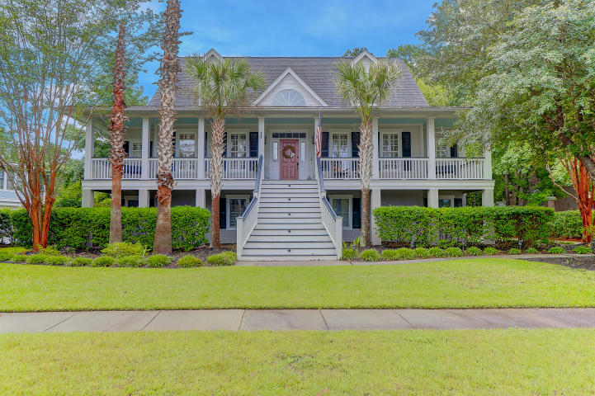
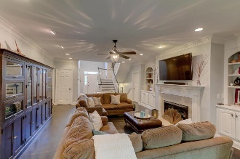
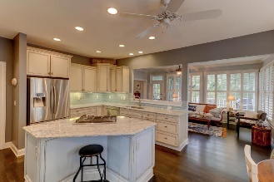
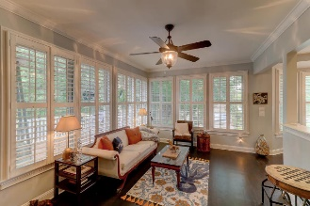
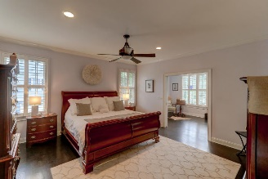
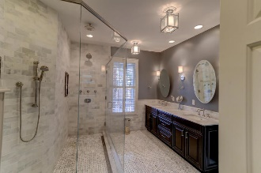
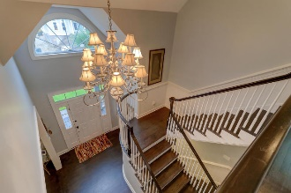
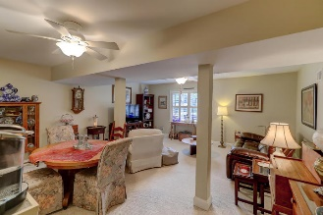
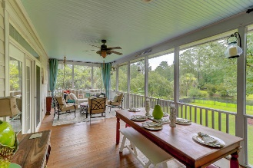
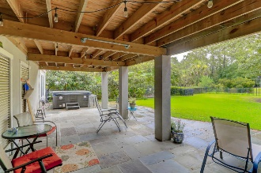
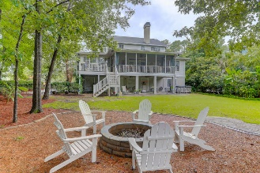


2061 Ashburton Way Mount Pleasant, SC 29466 MLS# 18020611 :: $799,900
Andover at Park West
Move Right In
Custom Elevated Home in Desirable Andover in Park West This Large Pond-front home has it all. Inviting full front porch with Toomer Creek views, including gas lanterns. Beautiful two story foyer area , formal dining with with pass through to kitchen. Great room is spacious with gas fireplace , built ins and access to large rear porch. Gourmet eat in kitchen features island with gas cooktop, custom cabinetry , other updated stainless steel appliances and newer bright granite counters . Right off of the kitchen is a keeping room/ sunroom to expand entertaining area with direct access to great room .The spacious master suite is on the main level with a separate sitting area , that would make great home office with access to rear porch.
The master bath is spa like with huge seamless glass shower with rain shower and body jets, his and her vanities , and custom walk in closet. Upstairs are three bedrooms and two baths . The lower level consists of a living / game room / media room and another bedroom and bath again with outside access to patio and fenced yard. Three car garage with room for more vehicles , great fenced in yard with fire pit and large hot tub . This is a must see. Park West amenities include 2 Pools, Play Park, Several Tennis Courts, Club House, Miles of Walking Trails and is only minutes to local beaches.
Clay Cunningham
O (843) 886-8110
M (843) 345-4647
clay@carolinaone.com
www.claysre.com
Carolina One Real Estate
1503 Palm Blvd Ste
Isle of Palms, SC 29451

