Slide 1
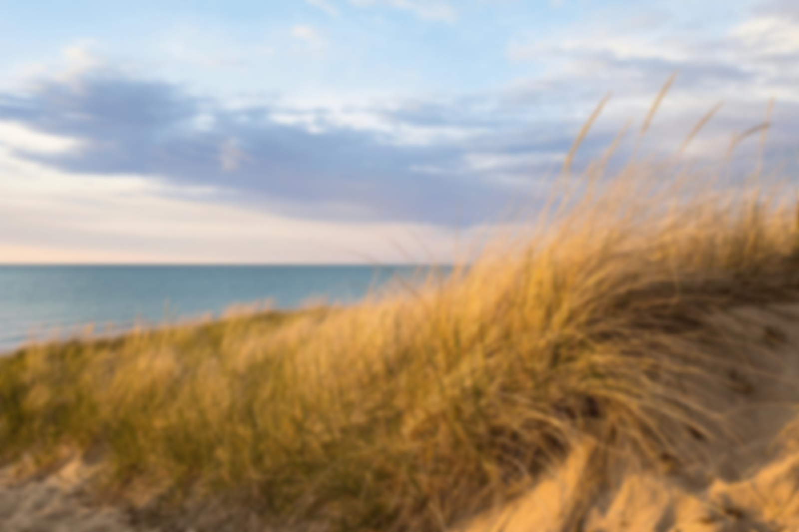
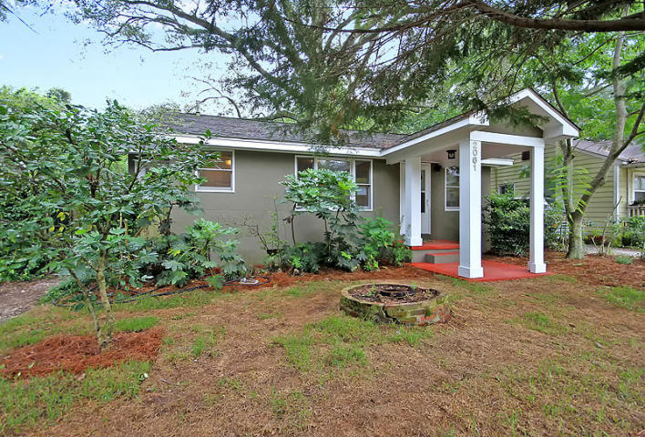
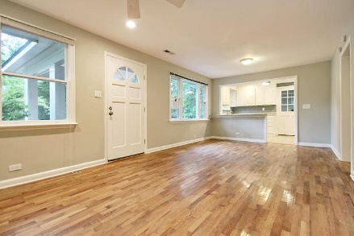
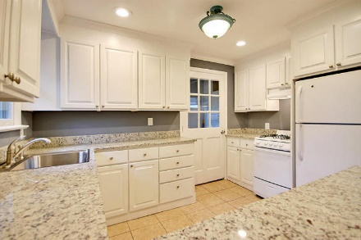
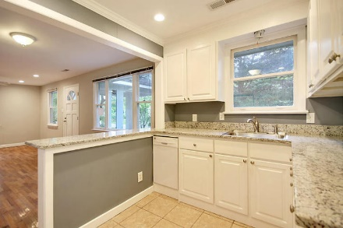
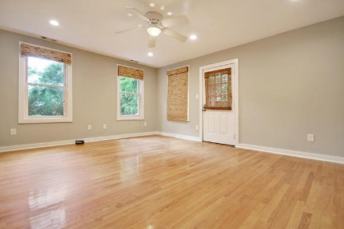
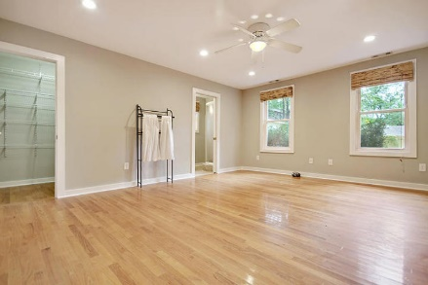
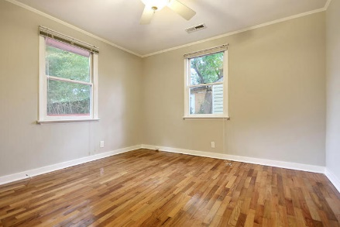
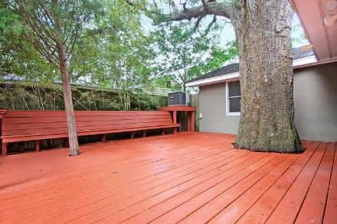
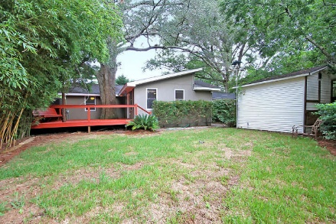


Charming Riverland Terrace Rehab
Price Reduced!
2061 Edisto Avenue
Riverland Terrace · Charleston, SC 29412 · MLS# 17020887 · $359,000
3 Bed · 2 Bath · 1,140sf
Upgrades galore in this one-level stuccoed beauty, including a brand new kitchen with custom cabinetry and beautiful granite counter tops, a new tankless Rinnai water heater, new dishwasher, new gas top range, and new full size Samsung washer and dryer. There is also a new 200 amp electrical service panel, and new recessed lighting throughout. Hardwood flooring and tile throughout, and many ceiling fans. Great backyard with a new 6’ privacy fence and large deck shaded by a beautiful oak. Middle bedroom makes a great study, nursery, or media room. Walk to live music, theater, restaurants, golf course, etc. NO HOA & NO FLOOD INSURANCE
Walk or bike to shops, restaurants, a movie theater, boat landing, playground, community garden, the Avenue of the Oaks, or one of Charleston's best music venues. Only 3 miles to historic downtown Charleston and less than 10 miles to Folly Beach!
Lee Lindler
Cell (843) 637-0803 | LeeL@NVRealtyGroup.com
NV Realty Group | 1900 Seabrook Island Rd | Johns Island, SC 29455
LeeLindler.NVRealtyGroup.com

