Slide 1
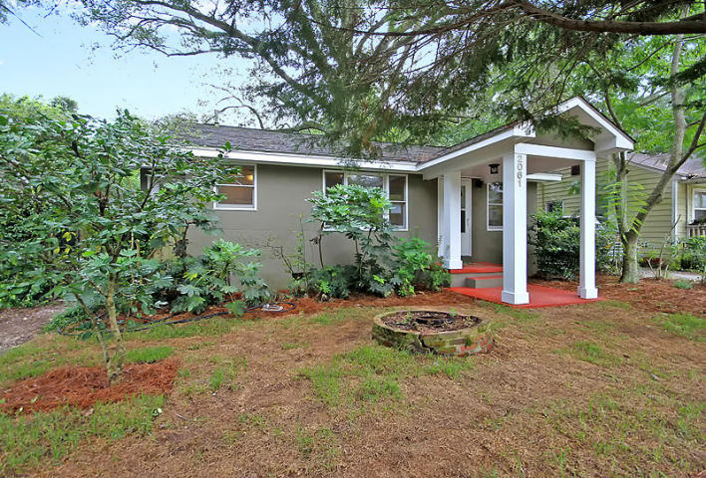
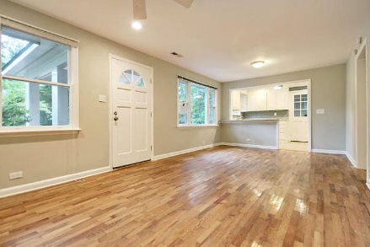
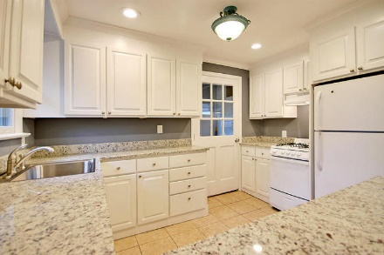
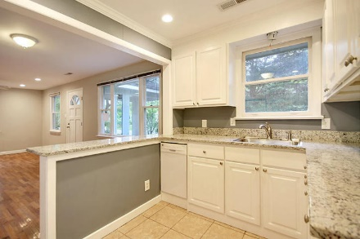
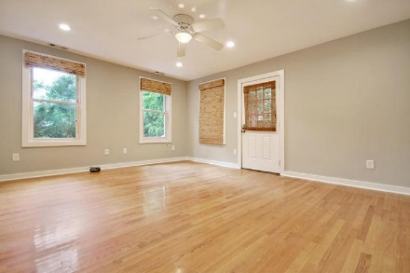
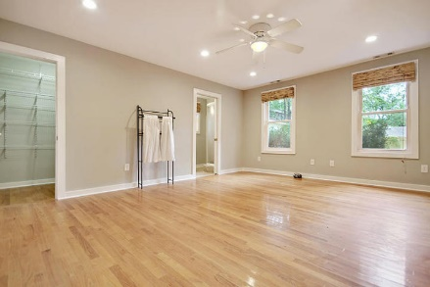
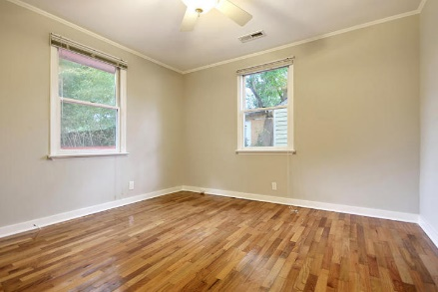
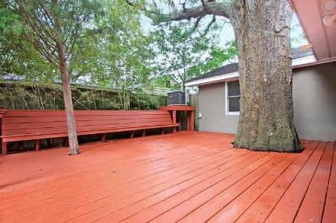
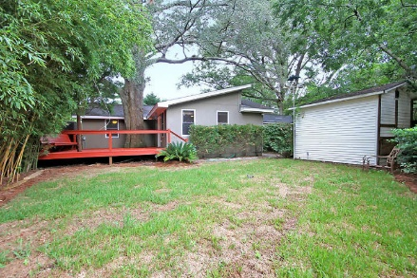


Price Reduced! Charming Riverland Terrace Makeover
2061 Edisto Avenue
Riverland Terrace · Charleston, SC 29412 · MLS# 17020887 · $369,000
3 Bed · 2 Bath · 1,140sf
Great one-level Riverland Terrace home that has been fully refurbished. Beautiful curb appeal with full real stucco and mature landscaping. Three bedrooms and two full baths, with hardwoods throughout except for tiled bathrooms and kitchen. The kitchen is completely brand new with beautiful granite counter tops, new dishwasher, new stove, and custom cabinetry, and the refrigerator and washer/dryer convey. Wonderful large backyard deck under an amazing oak. Freshly sodded front and back yards, with a shed and new privacy fence in the back. Walk to restaurants and shops, and a short drive to downtown and the beach. Medway Park's baseball field, community garden, and multi-use green space are steps away, plus you have the Riverland Terrace boat landing and playground right out the front door.
Lee Lindler Cell (843) 637-0803 | LeeL@GoldenBearRealty.com
Golden Bear Realty | 1900 Seabrook Island Rd | Seabrook Island, SC 29455
www.goldenbearrealty.com

