Slide 1

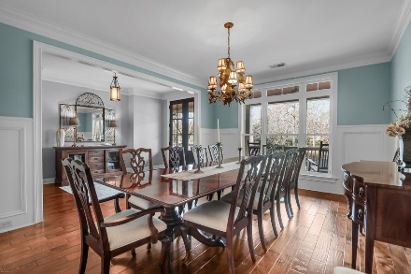
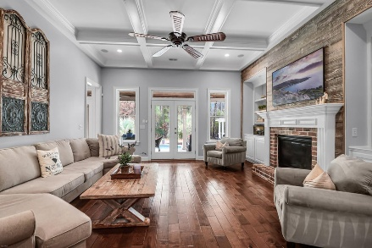
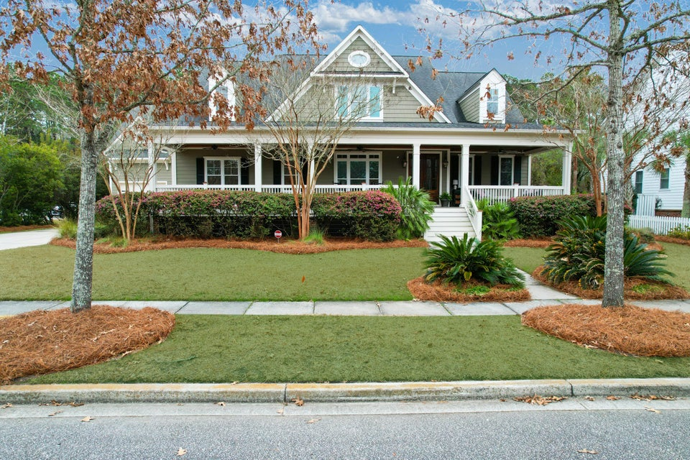
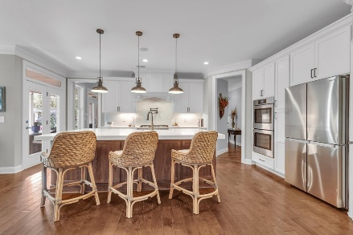
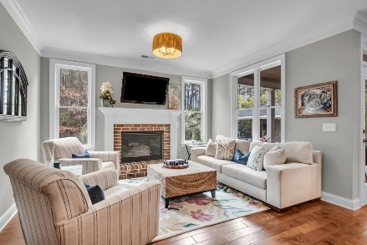
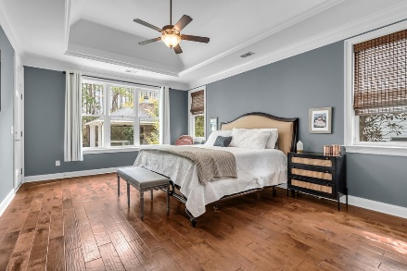
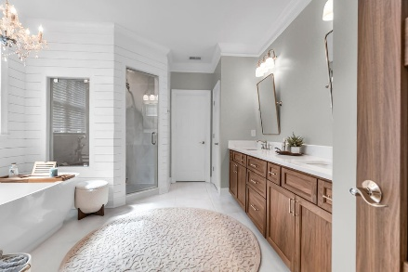
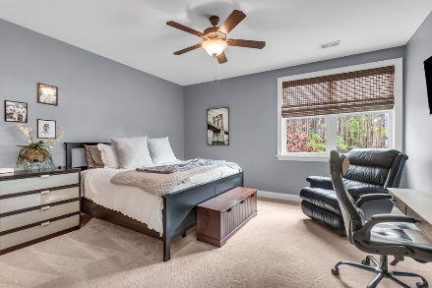
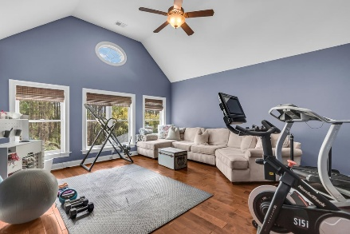
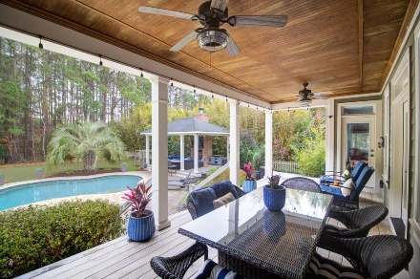
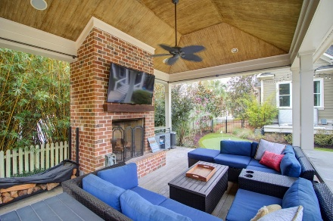
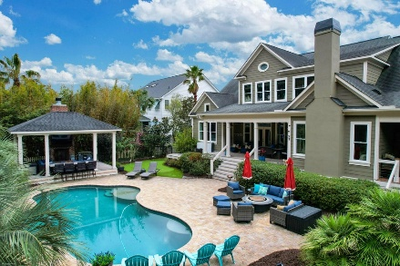
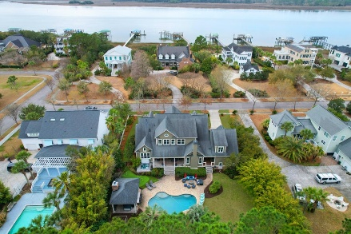


2065 Willbrook Lane
Rivertowne | Mount Pleasant, SC 29466
MLS# 26006230 | $2,175,000
AMAZING!
SHOWS LIKE A MODEL
Wind your way down Rivertowne Parkway, through flowering trees and Spanish moss, to the exclusive and highly desired enclave of homes on Willbrook Ln. Perched directly across from the Wando River, this impressive custom residence embodies true Lowcountry living. Greeted by a classic southern front porch, aglow with the soft light of gas lanterns, you'll be drawn into a home where no detail was left unattended. Custom details abound throughout the main living level; hand scraped hardwood floors and abundant millwork including multi-piece crown molding and raised panel wainscotting plus much more. This home is a perfect marriage of built-for-entertaining and perfect for everyday living. At the heart is a fully renovated, stunningly gorgeous custom kitchen
The family room boasts an exquisite coffered ceiling, a second brick surround fireplace flanked by custom built-ins and backed by a striking barnwood wall. These elements combine to create a comfortable yet elevated space. Glass doors open to a large covered porch, which is where the fun and relaxation begin! Crank up the sounds with the Alexa controlled surround sound system that is located throughout the kitchen, family room, porch and pool pavilion. It's hard to imagine, but all of the incredible interior features pale in comparison to the outdoor living space. Lowcountry life is all about time outdoors, on the water, and in the sun and this home provides a wealth of options for just that. The definition of backyard oasis, just beyond the covered porch is a large paver patio for sun loungers gathered around the free form saltwater pool.
All of this and located in the prestigious Rivertowne on the Wando Neighborhood with three community docks for fishing, boating or just to relax and watch the amazing Wando River sunsets. Enjoy golf at Rivertowne Country Club's Arnold Palmer Signature Course then meet friends at the club for dinner. Additional amenities include neighborhood pool, tennis courts, walking trails and play park all conveniently located to beaches and the world class dining and shopping of historic downtown Charleston.
VIRTUAL TOUR
Don Dawson
843-514-0452
ddawson@carolinaone.com
Carolina One Real Estate • 2713 Highway 17 North • Mount Pleasant, SC 29466
www.TeamDawsonSC.com

