Slide 1
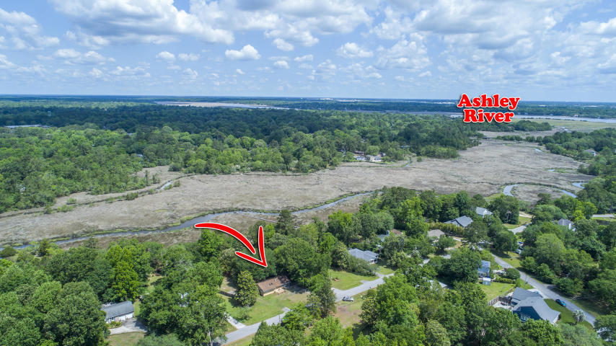
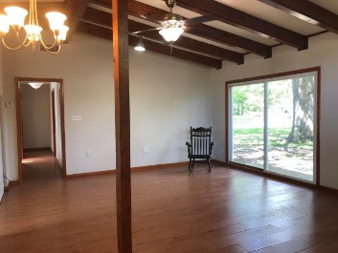
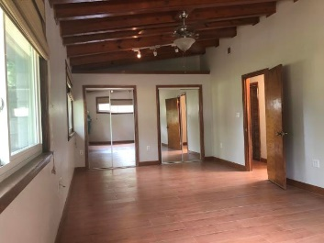
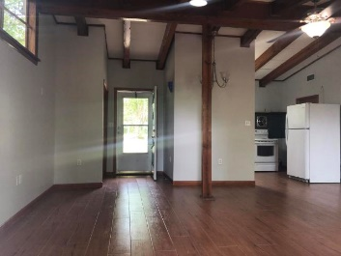
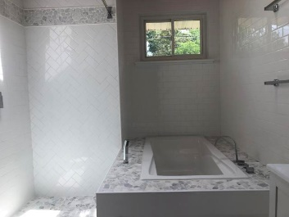
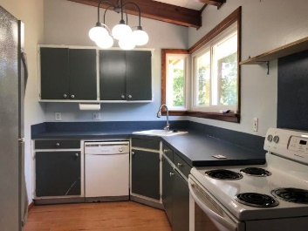
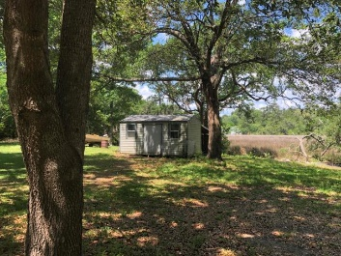
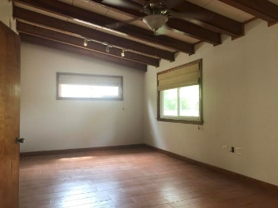
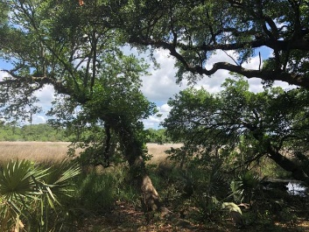


2066 Marshland Drive
Magnolia Ranch
Charleston, SC 29414
MLS# 19013599
$279,900
Elevator to all levels
Lot Elevation is AE 13
Viwinco Hurricane rated windows
Raised seam metal roof
Water faucets on front, rear, and screened porches!
(No reason for dead flowers!)
Paver Patio
Garage is up fitted with additional electrical for golf cart charge or workshop
Custom heavy duty garage door, Custom Mahogany finished
Exterior door from inside garage to rear living area and paver patio
Hot/Cold Outdoor Shower
Spray foam insulation in attic ceiling
Multi zoned HVAC
10'Ceilings
Custom Rosewood Cabinetry in kitchen with 2 Corner lazy Suzanne's to maximize use of space, soft close drawers, pull outs
GE Profile Kitchen Appliances that include:
-Microwave/Convection Oven
-Wall oven
-Refrigerator
-Trash Compactor
-Dishwasher
Deep Sinks
Garbage Disposal
Custom Built closets throughout all bedrooms, linen and laundry
Granite in kitchen and all baths
Custom tile in all bathrooms and entry and oak wood floors throughout
Master bath elegant oval soaking tub with wand for body rinse
Oversized shower with wide glassed door entrance
Dual vanity with cosmetic seating area
Additional cabinetry
Separate commode area
Main level Bedroom/Office with window seat with storage
and attached bath.
Pocket doors maximize wall space.
Front entry door is custom Mahogany
Boat slips are available for lease and purchase Morgan's Creek Marina
"The Church Creek Cabana!"
Come for a while...stay for a lifetime! Whether you choose to enjoy it as your primary residence, improve, or rebuild, this is a wonderful property in an equally wonderful neighborhood! Nature and sounds of wildlife (deer, too!), marsh views and dock potential on .68 Acre...it's perfect! Shade from a gorgeous age old magnolia tree, RV/boat pad, storage building, fire pit and horseshoe pit ... all of this embraces this cozy cottage and welcomes you, family and guests! Inside, you'll find charm in plenty of light, volume beamed ceilings, stained doors and trim and wide plank tile flooring. New coastal designed bathroom is a WOW with steeping tub and large separate tiled shower! All windows have been replaced, HVAC is newer. What else? THIS IS A HIGH LOT! This location is within minutes of local businesses, shopping, medical, dining and grocery.
$10,000 Bonus!
Listed by
Bill Donovan
843-991-0146
donovans@carolinaone.com
Renee Meyer
Mobile - (843) 991-0007
renee@carolinaoneplus.com
www.CharlestonHomesHotline.com
Carolina One Real Estate
1503 Palm Blvd
Isle of Palms, SC 29451

