Slide 1
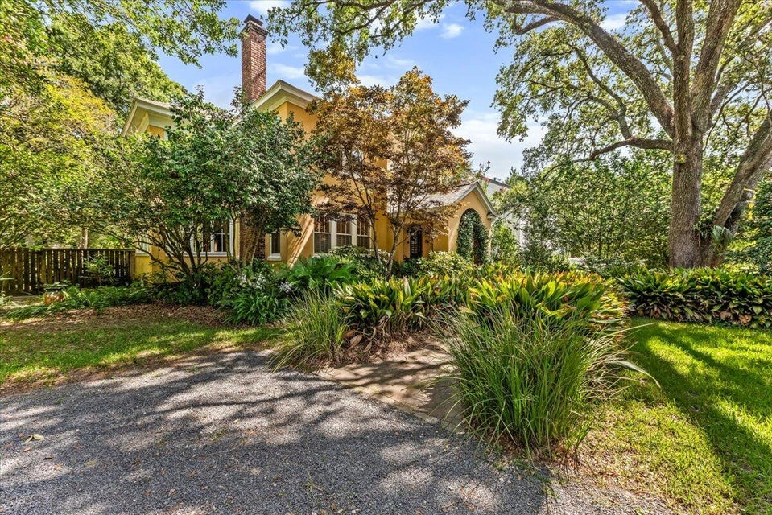
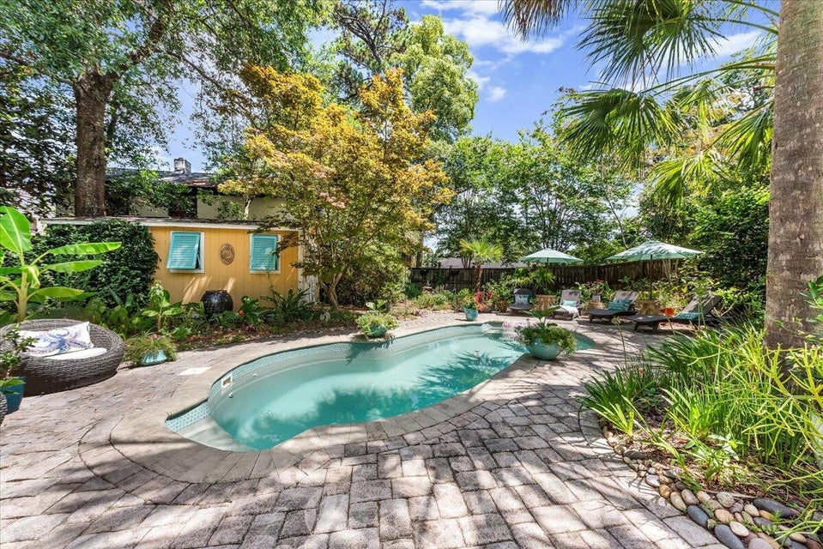
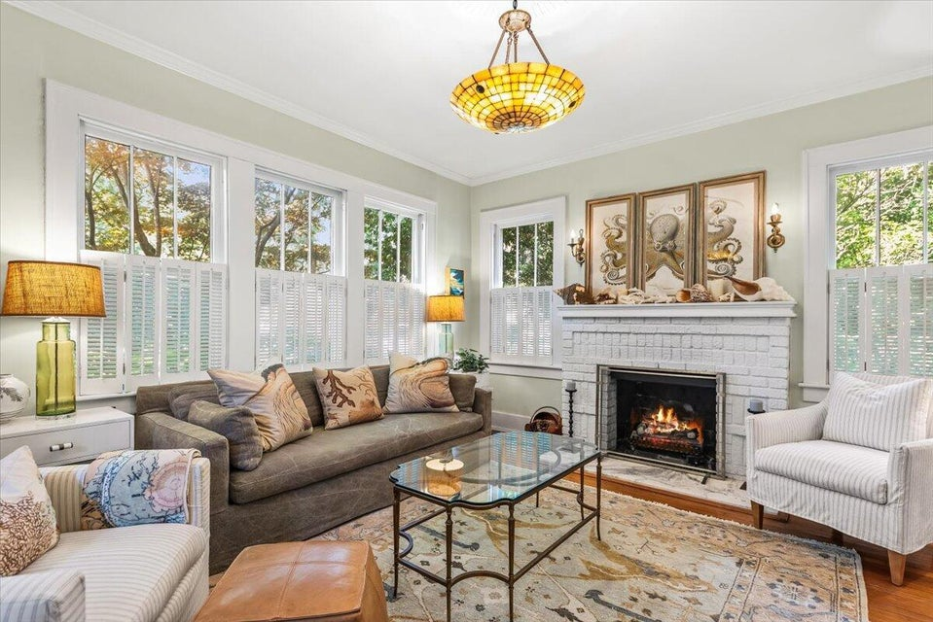
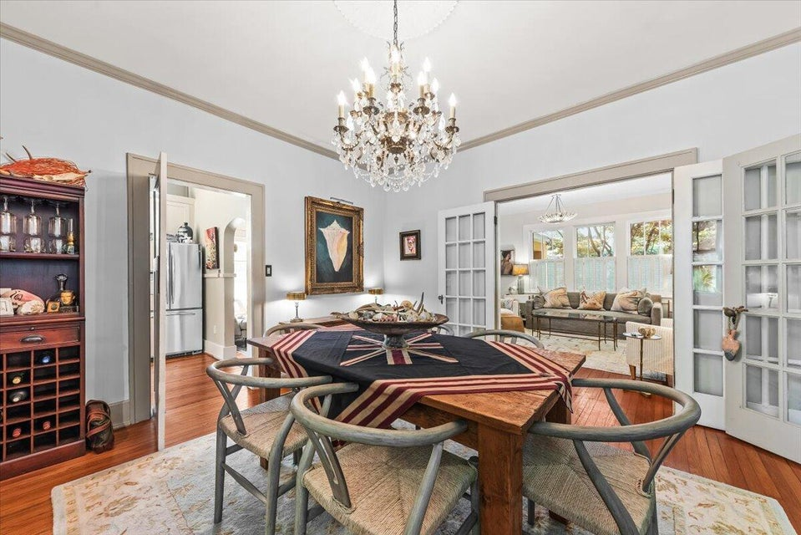
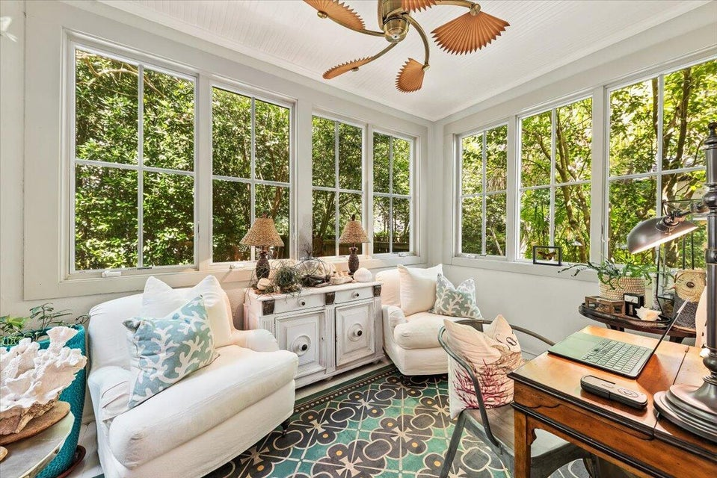
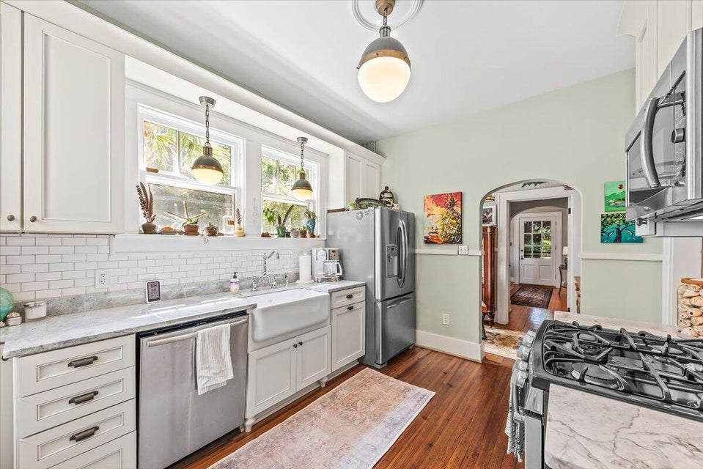
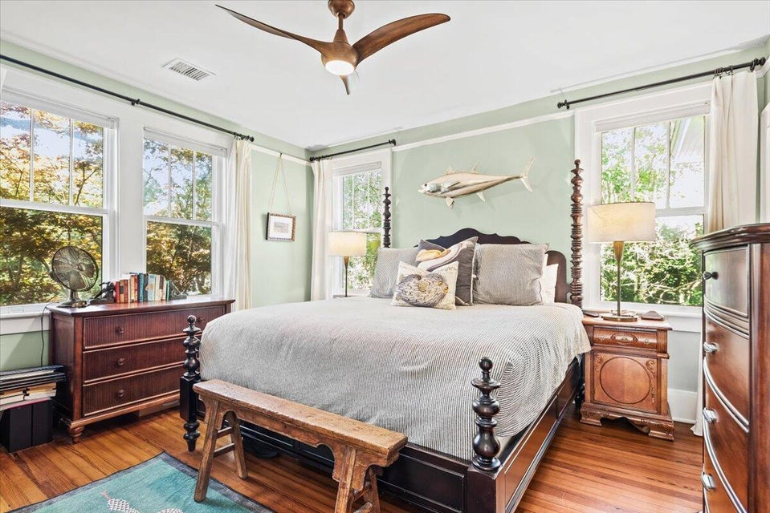
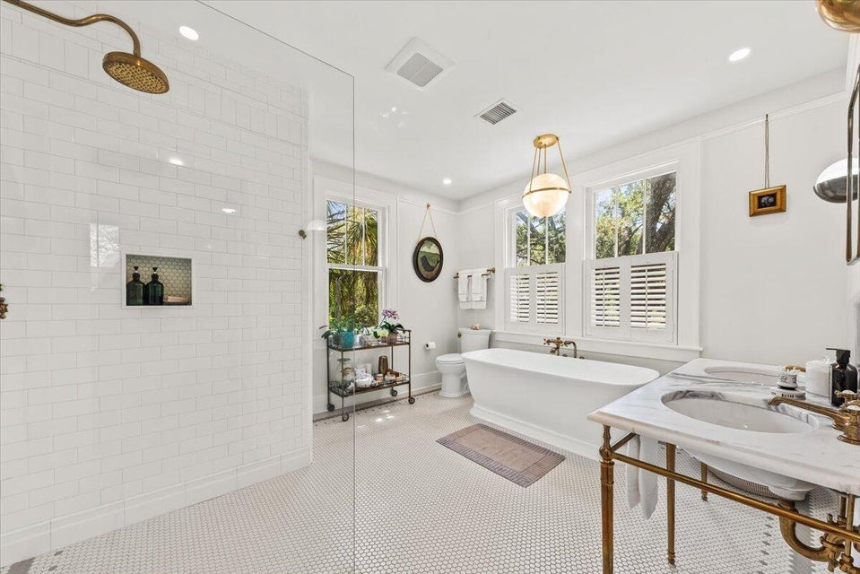
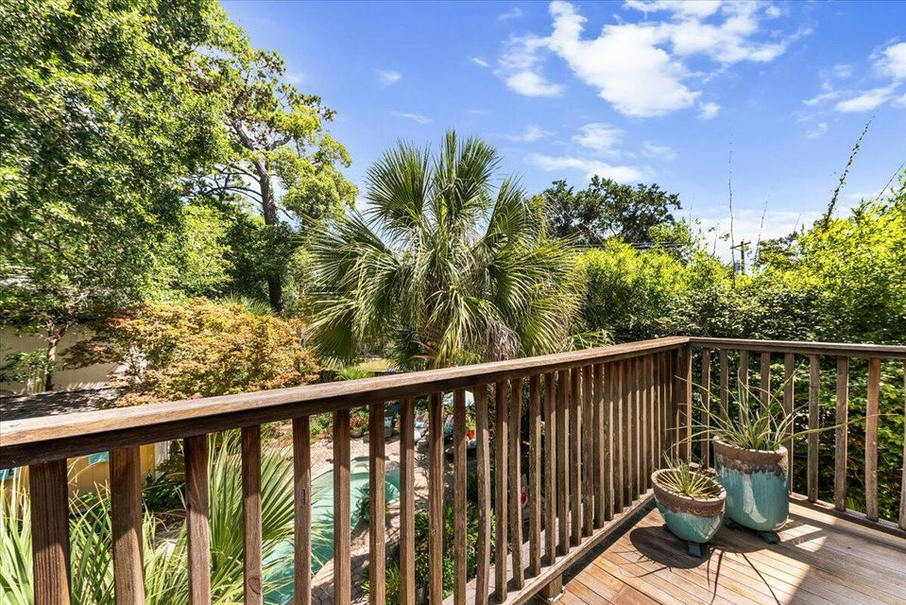
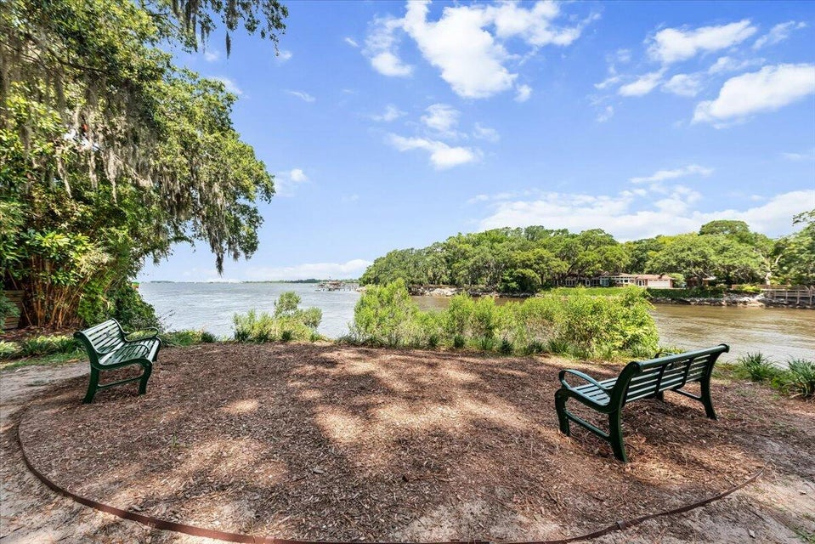

RIVERLAND TERRACE GEM WITH POOL
2066 WAPPOO DRIVE
RIVERLAND TERRACE · CHARLESTON, SC 29412 · MLS# 25018037 · $1,399,990
Welcome to your Lowcountry Oasis nestled in the highly sought after Riverland Terrace neighborhood. This charming 3 bedroom, 2 and a half bath home perfectly blends historic character with modern amenities, offering an idyllic Charleston Lifestyle. The true gem of this home is its incredible outdoor living spaces. The expansive and exceptionally private backyard is a tropical paradise, featuring a sparkling inground pool surrounded by lush landscaping and mature palm trees, ideal for cooling off on warm Charleston days or hosting unforgettable pool parties. Enjoy al fresco dining in the outdoor dining room or gather around the cozy fire pit area for s'mores. Step inside and discover inviting living spaces with beautiful hardwood floors. The spacious dining room is perfect for elegant gatherings. Prepare for gatherings in the well-appointed kitchen which has been completely renovated, featuring stainless steel appliances, ample cabinet space, a farmhouse sink and a butler's pantry, making it a chef's delight. Additional living space includes a relaxing living room, with tons of natural light and a gas fireplace, as well as a cozy sunroom. A half bath is tucked under the stairwell in the foyer. Head upstairs and you'll find three bedrooms, two full bathrooms and a second sunroom, perfect for a home office space. The primary bedroom boasts a new spacious bathroom with dual sinks, a free-standing tub and spacious separate shower. This home has been meticulously well maintained by the sellers.
Beyond its natural beauty and modern comforts, Riverland Terrace offers a rich sense of history and community. Developed in the 1920s as one of James Island's first master-planned communities, it was envisioned as a tranquil escape from the bustling city, connected by the iconic Avenue of Oaks - a grand entrance lined with over 70 live oak trees, many believed to be over a century old. This neighborhood has preserved its charming, eclectic character, where no two homes are alike, fostering a tight-knit community that cherishes its unique heritage. From the historic Terrace Theater to the storied Charleston Municipal Golf Course (the "Muni"), which was once an airstrip where Charles Lindbergh landed, Surrounded by the Stono River and Wappoo Cut (where there is a deepwater boat landing), Riverland Terrace offers a lifestyle steeped in Lowcountry charm and a vibrant, friendly atmosphere. Restaurants, bars and a movie theater as well as the local Farmers Market are just a short walk away!
This is indeed a special property and won't last long!
Robyn Lane
843-222-5599
robynlane01@icloud.com
Bobby Shealy
843-442-7373
bobby@shealyrealestate.com
bobbyshealy.erawilderrealty.com
ERA Wilder Realty
1282 State Rd
Summerville, SC 29486

