Slide 1
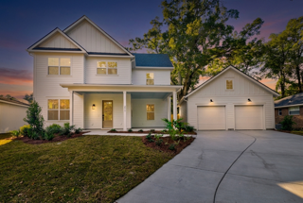
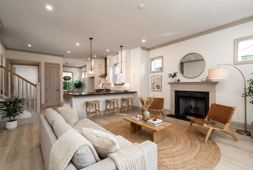
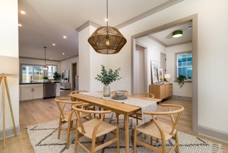
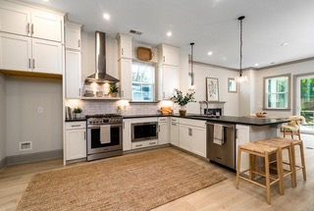
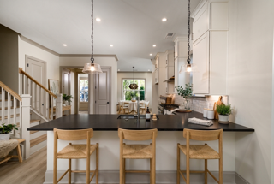
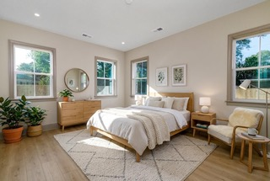
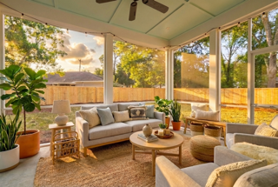
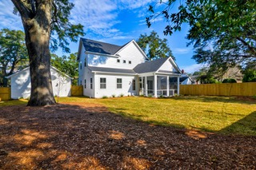
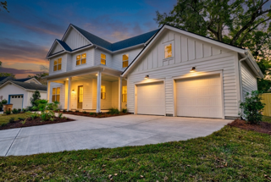



Riverland Terrace - Brand New Construction Just Listed
2069 Seabrook Avenue
Riverland Terrace
Charleston, SC 29412
MLS# 25031810
$1,875,000
4 Bedrooms :: 3½ Baths :: 2,600 sf
Brand new construction in one of Charleston's most popular neighborhoods. This 4bd 3.5ba home is located on a quiet street in the heart of Riverland Terrace but walking/biking distance to all of the area's great shopping, golf, dining and entertainment. The home features an open living area, separate dining area, downstairs primary bedroom and a spacious foyer. Upstairs are 3 bedrooms, a loft area plus a home office which could be a 4th bedroom and 2 full bathrooms. The kitchen features granite countertops, breakfast bar, gas cooktop, and ample cabinetry along with a built-in pantry and a pantry closet. Formal dining room. The home is situated on a .24 acre lot with a large custom fenced backyard and a detached two car garage. Room for a pool in the backyard. Hardy plank siding. Detached two car garage. Enjoy sitting on the large front porch and waving to your new neighbors or relax in private on the large screened in back porch. Home was constructed by New Leaf Builders.
Reid Adams
919-638-5618
reid@charlestonrealestategroup.com
www.charlestonrealestategroup.com
Charleston Real Estate Group | 443 Folly Road | Charleston, SC 29412

