Slide 1

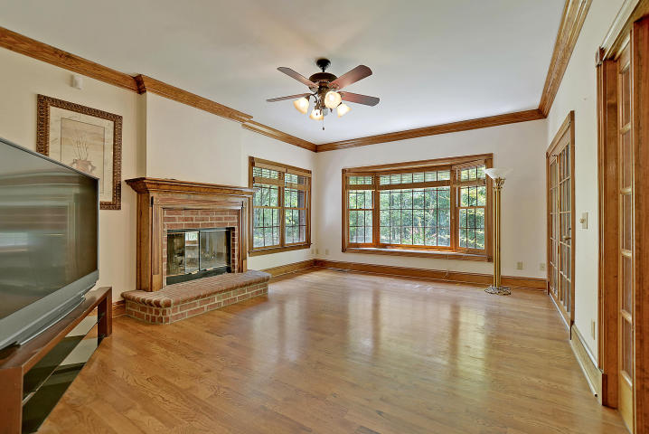

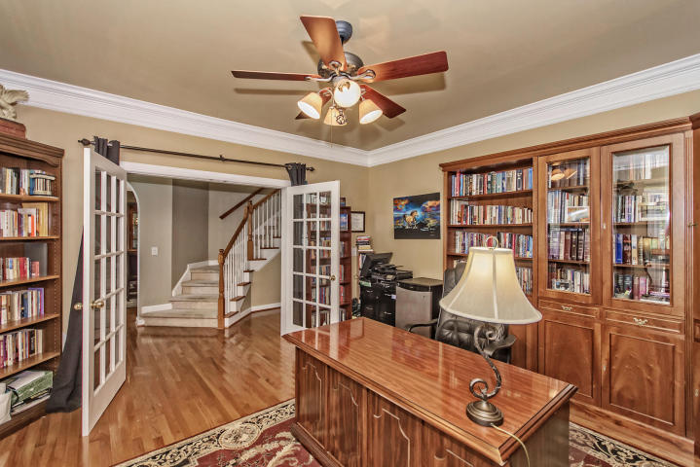
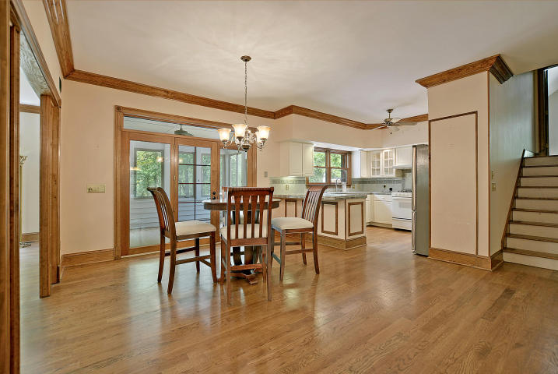
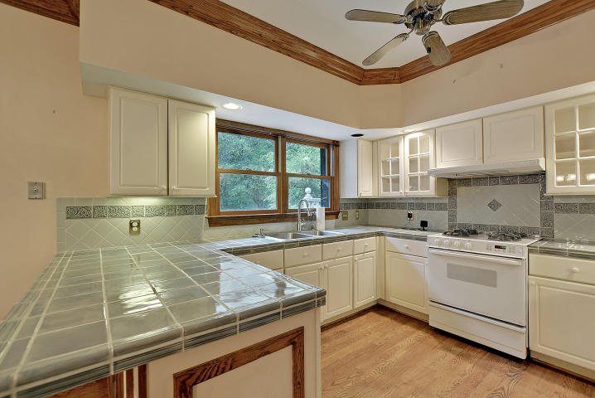
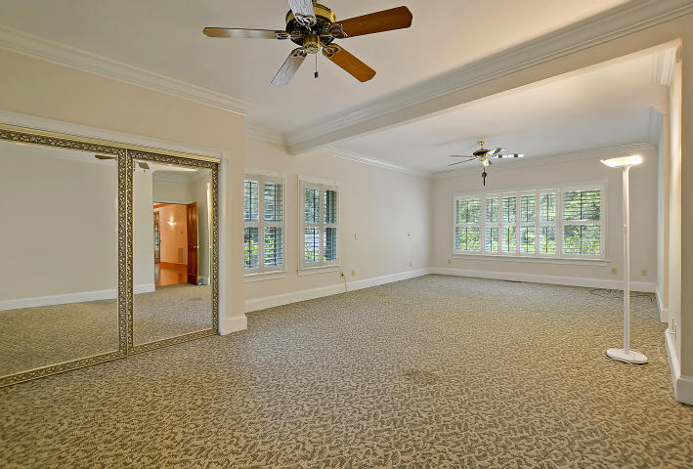
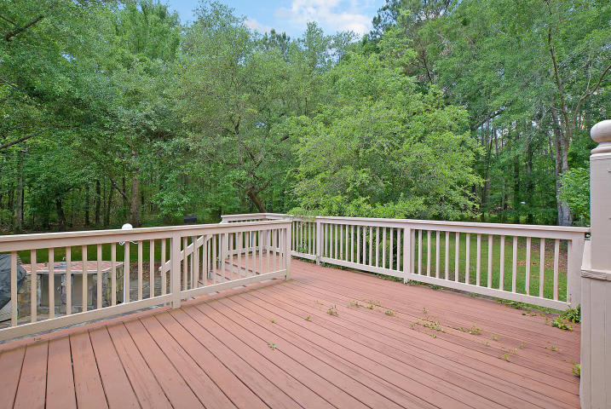
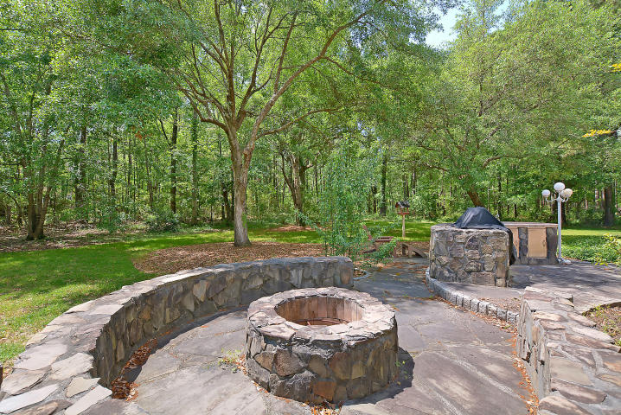

#1 BEST VALUE IN MT PLEASANT, WANDO AND/OR DANIEL ISLAND!
206 Ferry Point Drive Cainhoy Landing ~ Wando, SC 29492
MLS# 17011995 ~ $699,900
3 Bedrooms ~ 4½ Bathrooms
Absolute Bargain!
Unbelievable Price!
Priced low and firm for your pre-approved buyer who wants a great deal on the nicest house in the Clements Ferry/Mount Pleasant, Daniel Island area.
Hurry, it won’t last long at this low, low price.
Do your buyer a favor and submit a squeaky-clean full-priced offer today and save yourself all the fun of a full-priced counter offer.
Chip Walsh
843-822-4663
chipwalsh@gmail.com
The Boulevard Company, LLC 35 Broad Street Charleston, SC 29401
www.TeamWalshRealEstate.com

