Slide 1
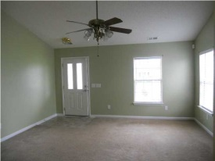
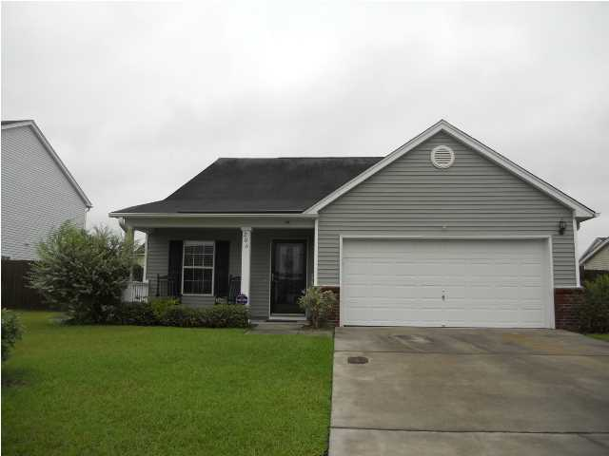
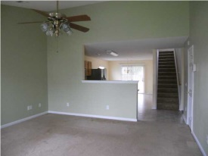
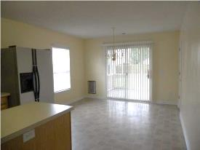
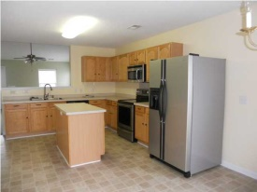
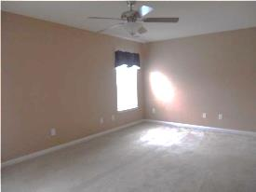
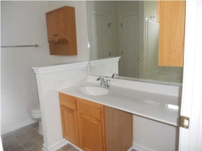

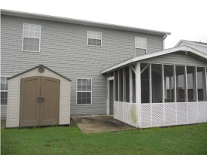

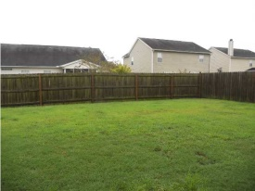
Priced to Sell!
206 Southport Dr
Weatherstone
Summerville, SC 29483
MLS# 1425712 | $169,000
3 Bed / 2½ Bath
Like New! This beautiful home features an over sized family room with vaulted ceilings and large eat in kitchen with island. All kitchen appliances convey allowing this to be a true move in ready home! Master bedroom is located down stairs with two spacious bedrooms upstairs. Screened in porch and fenced in back yard add to the completeness and enjoyment of home ownership. Neutral colors can be found throughout ready for new owner. We have the home priced to sell! Buyers agents to verify school.
Connie White, Broker
C: 843-532-3356
conniesyouragent@gmail.com
Omni Carolina Real Estate
126 Eston Dr
Goose Creek, SC 29445

