Slide 1
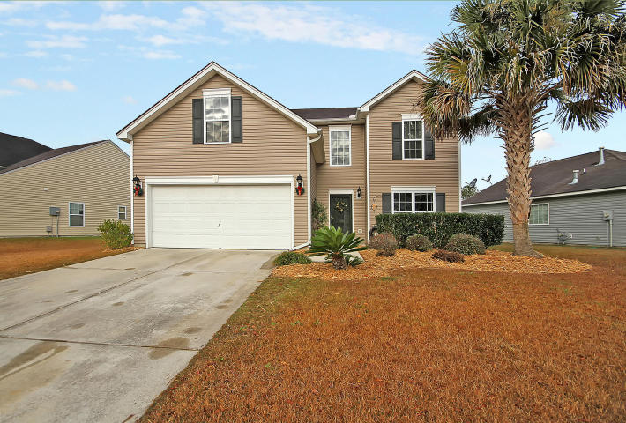
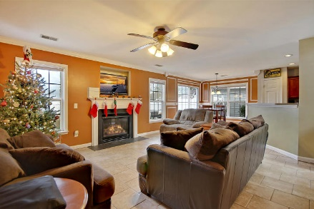
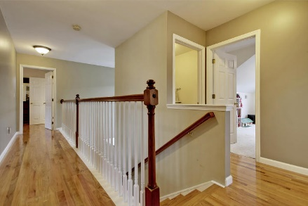
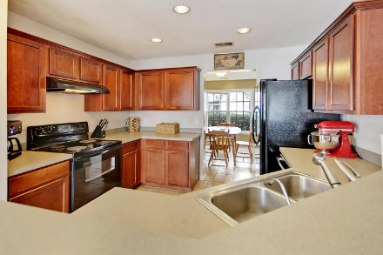
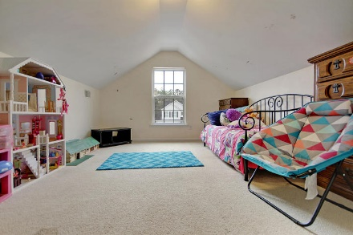
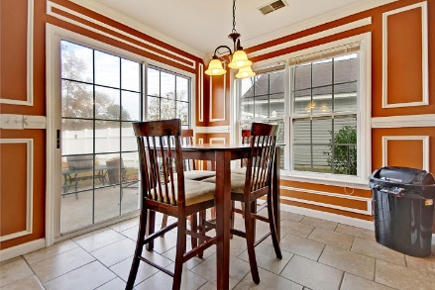
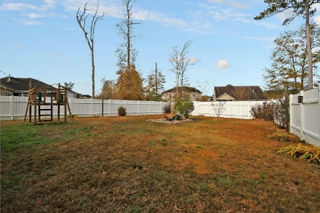
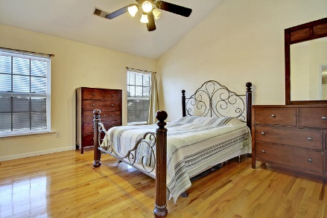
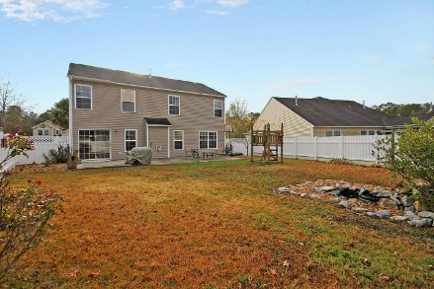
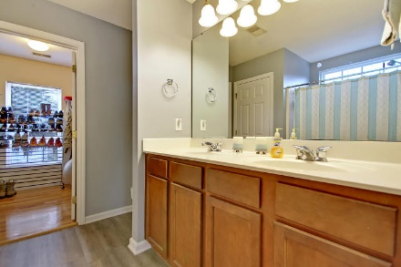
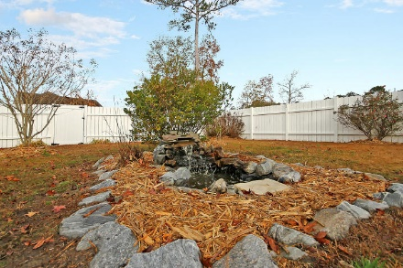
Enjoy Your Own Private Oasis!
5 Bedrooms
2½ Baths
206 Sparkleberry Lane
Summerhaven ~ Ladson, SC 29456 ~ MLS# 17033166 ~ $244,000
What’s the next best thing to living on the water? Having soothing sounds of a gorgeous water feature in your huge, private, fenced-in backyard! That’s just one of the things that you’ll love about this amazing, two story home in Summerhaven. A tropical palm tree and fresh landscaping lead up to the welcoming two story foyer of this home. Gather around the fireplace in the living room, enjoy meals at the eat-in area with its wainscoting or visit with those working in the kitchen while sitting at the breakfast bar. The master provides a great escape with an airy, cathedral ceiling, hardwood floors, a huge walk-in closet and dual vanity in the en-suite bath. Let your entertaining spill outdoors onto the spacious patio which runs the length of the home. Put this home at the top of your list!
Additional features include:
Bedroom and bath on the first level
Ceramic tile flooring on the first level
Book your showing today!
Justin Miles justin@mattoneillteam.com 843-446-1978

