Slide 1
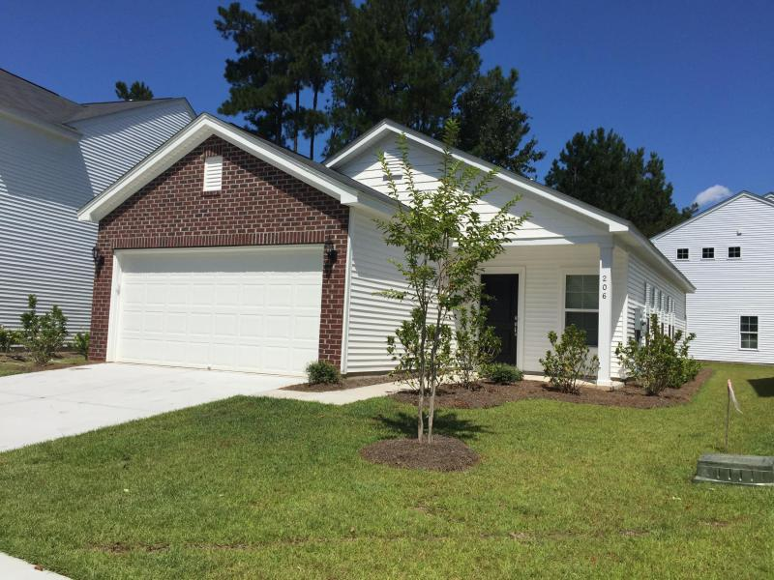
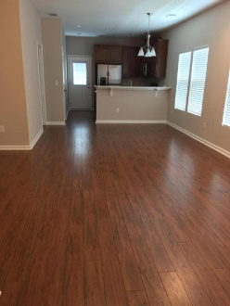
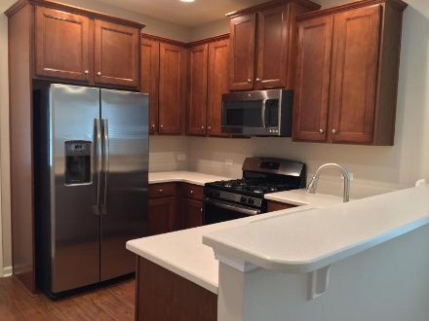
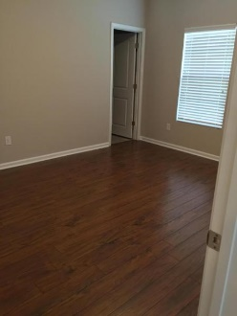
Help me find a buyer...
206 Tuscany Court Limehouse Villas ~ Ladson
MLS# 16023717 ~ $172,500
Are you looking for a one story 3 bedroom and 2 full bath home with an open floor plan, look no further. This is truly a turn key home...no work is needed. This open floor plan is great for entertaining guest the family and dining room opens up to the kitchen. Vintage Walnut laminate floors throughout all living areas and master bedroom. The beautiful kitchen features, 42'' staggered height Landen Saddle Cabinets with designer pulls, crown molding, and rollout trays in bottom cabinets. Corian countertops with a Corian sink, a spacious pantry, and Stainless Steel appliances less than a year old including a gas cook top stove and a side by side refrigerator. Two secondary bedrooms each with great closets share a full bathroom right next to the bedrooms with an upgraded raised vanity. The spacious Master Suite is tucked away at the back of the home with a huge walk-in closet. The Master Bath comes with dual sinks, raised vanities, and a spa like tub/shower combo. This natural gas, HERS rated home is very energy efficient and includes radiant barrier roof sheathing. The gorgeous washer and dryer will convey. Also, home comes with a drop down ladder for attic access. So many upgrades to list, come see for yourself. Close to all shopping, located in the Dorchester II district schools.
Rita Adkins
yourcharlestonrealestate@gmail.com | (843) 270-8814 | www.yourcharlestonrealestate.com
Brand Name Real Estate | 4 Carriage Lane, Suite 106 | Charleston, SC 29407

