Slide 1
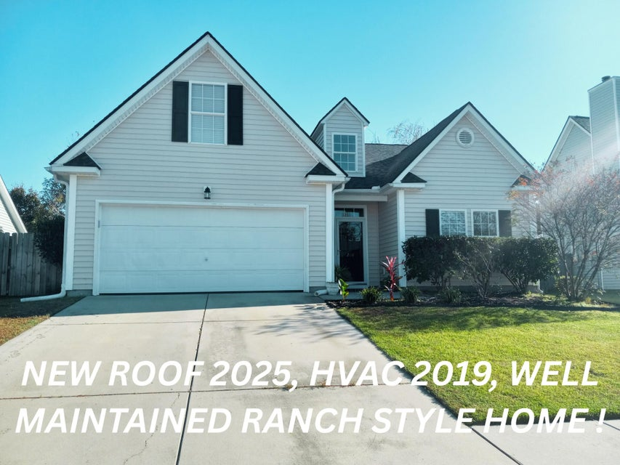
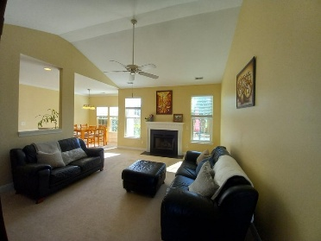
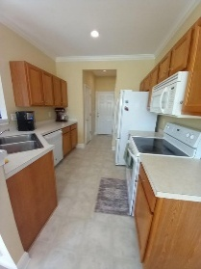
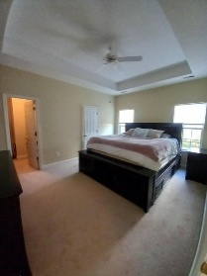
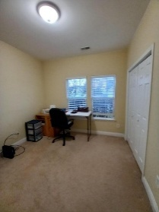
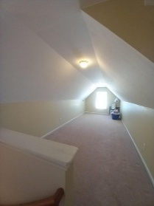
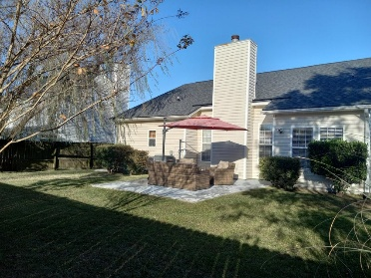

206 EQUINOX CIRCLE
HEATHERWOODS | LADSON, SC 29456
MLS# 25030432 | $344,000
SELLER IS OFFERING $1000 BONUS
TO BUYER’S AGENT
W/ ACCEPTED OFFER
This well maintained 1 story ranch home with 4 bedrooms, 2 bathrooms. 4th large bedroom over the garage - ideal for a home office, playroom, or guest space. Open floor plan, flexible living areas. Convenient location close to shopping, dining, and major highways. Walking distance to schools. NEW ROOF 2025, new dishwasher, and HVAC system 2019, current termite bond. The master BR features - tray ceiling, walk in closet, dual vanity, soaking tub and separate shower. Step outside to the oversized patio, fenced in backyard. Refrigerator to convey.
Move in Ready!
Aigul & Paul Pavilonis
Aigul | 843-964-8679 | aigulpavilonis@gmail.com
Paul | 843-804-2085 | paulpavilonis430@gmail.com
Olde Towne Realty, LLC | 239 Leach Lane | Cross, SC 29436

