Slide 1

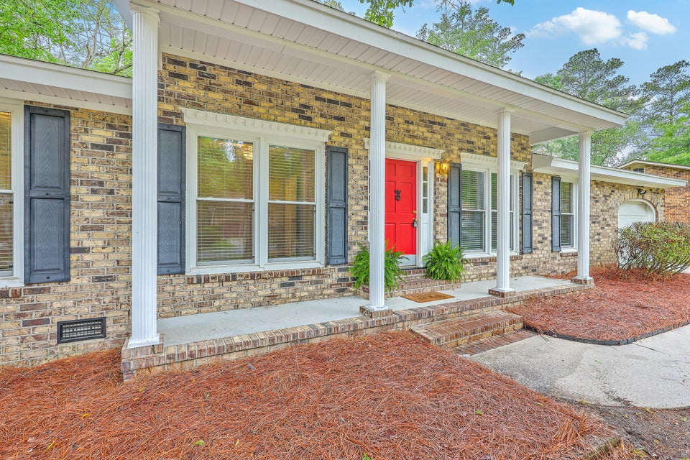
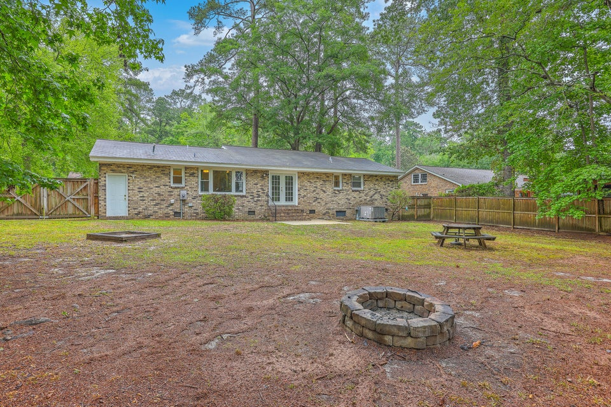
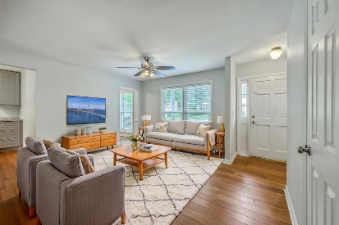
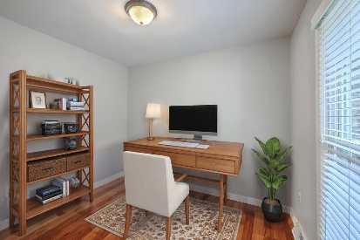
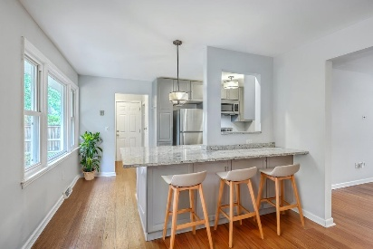
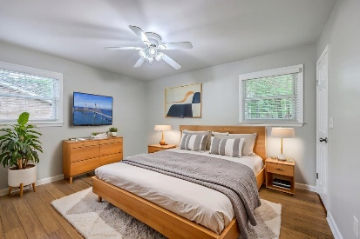

Classic Brick Ranch In Summerville - Brand New Roof!!
206 Jimbo Road
Evergreen | Summerville, SC 29485 | MLS# 25013106 | $338,500
This home is in the Perfect LOCATION, close to downtown Summerville, new Berlin G Parkway, Summerville Prep Academy, Ashley River Park, & new Dorchester County Library. This beautiful Brick Ranch is Classic and Timeless. From the HUGE covered front porch flanked with white columns, to the black shutters and red front door, this home is a TRUE Southern Gem! Step into the open living, dining, and kitchen area complete with island and ship-lap accents. The kitchen includes stainless steel appliances and granite counter-tops. The laundry room is conveniently located off of the kitchen. From the laundry room you find a massive walk-up attic space for all of your storage needs.
There is also a spacious home office ready for the remote worker. Down the hallway you find two good-sized bedrooms on the left directly across from the large hall bath. The primary bedroom is located at the back with an en-suite bathroom. Through the French doors, enjoy your incredibly large & private backyard, fully fenced and ready for your landscaped oasis! Recent updates include a brand NEW Hot Water heater and crawlspace work. There is NO HOA, you can easily store your boat or RV, install a pool for those Hot Summer days, or plant the home garden of your dreams. The possibilities are endless! This is the perfect starter home or investment property. Schedule your showing today!
Century 21 Properties Plus
140 N Main Street
Suite 101
Summerville, SC 29483
Andrea Barlow
864-451-2098
abarlow@century21properties.com
www.century21properties.com

