Slide 1
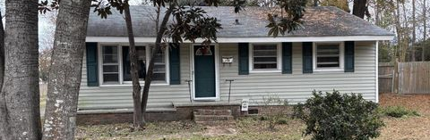
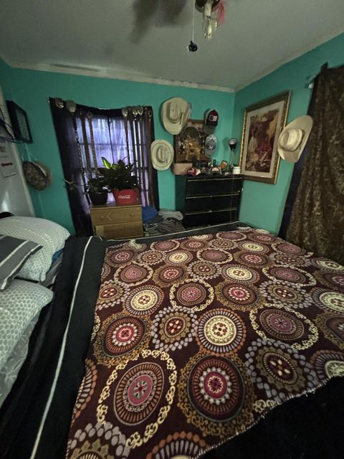
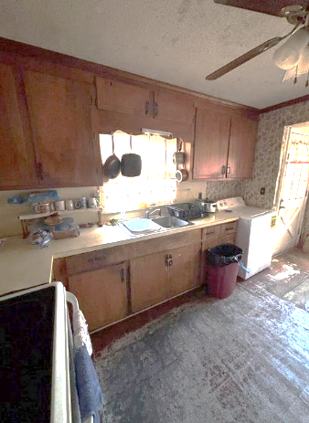
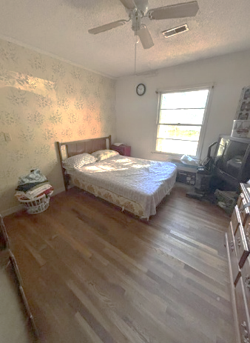
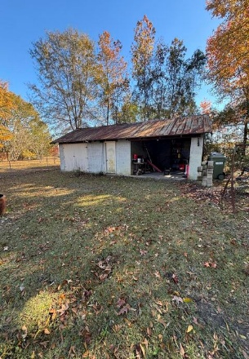
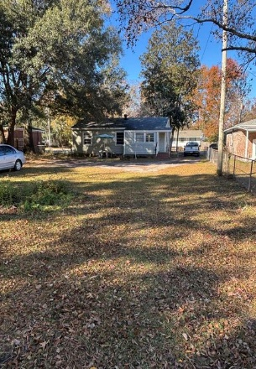

Handyman Special in
Downtown Moncks Corner!!
Michael Moseley
843-442-0959
michaelsmoseley@gmail.com
charlestonrealestateandgolf.com
206 Palmetto Street
Fairlawn | Moncks Corner, SC 29461 | MLS# 25000199 | $189,900
10k Price Improvement in prime location in the heart of Moncks Corner - restaurants and shopping are in walking distance. Large lot with detached garage/workshop in backyard. 15 minutes to Cypress Gardens and Mepkin Abbey and only 40 minutes to CHS airport. Great opportunity for a little sweat equity!
Carolina Elite Real Estate | 1081 East Montague Ave | N Charleston, SC 29405

