Slide 1
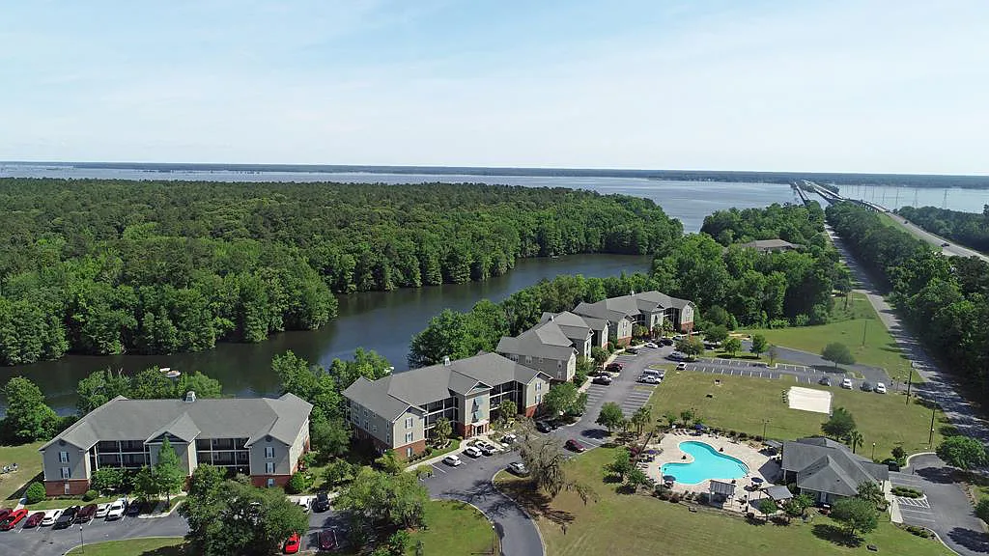
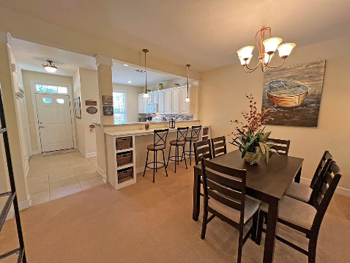
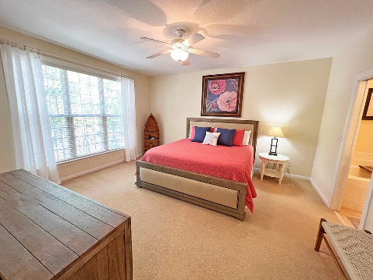
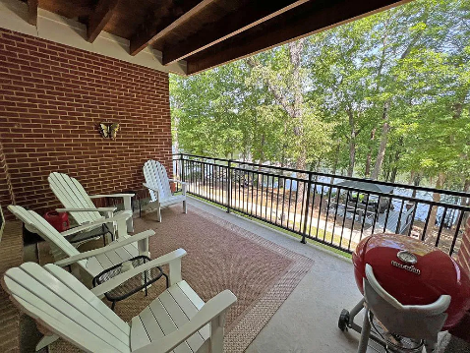
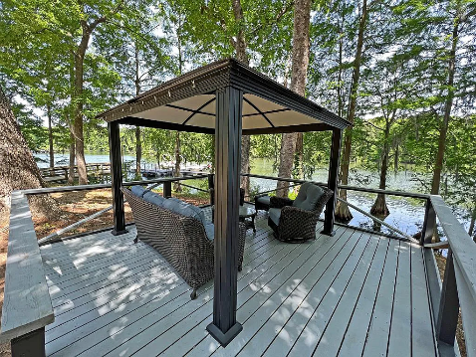

Open House Friday 11-2
206 Trillium Ct
Santee, SC 29142 ~ MLS# 156861 ~ $250,000
Spacious fully furnished first level 2 bdrm condo overlooking Lake Marion. Great for a full-time owner or a weekend retreat. New countertops and backsplash installed in 2021. HOA covers grounds, outside maintenance, pool with entertaining area, volleyball, horseshoes, boat ramp, small gym, meeting area, and a waterfront covered/sitting area. Located off of I-95 exit 98 and only one hour to Charleston or Columbia. Santee is a host to 2 grocery stores and local dining. Five golf courses within 20 minutes. Lake Marion hosts fishing tournaments and attracts many recreational boaters and fishermen.
Lake Homes Realty, LLC
Elloree, SC 29047
www.SCLakeLife.com
Kristie Anderson
(803) 387-9459
kristie@sclakelife.com

