Slide 1
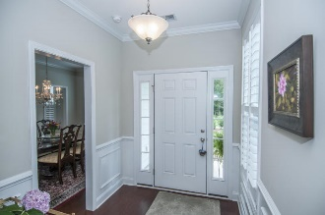
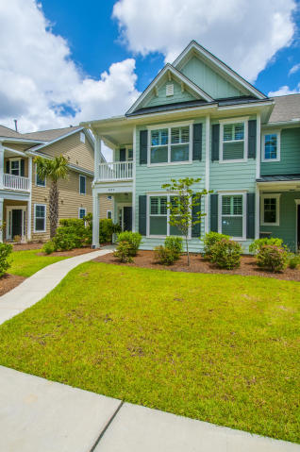
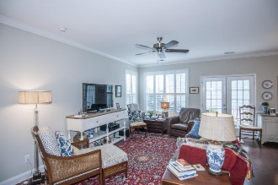
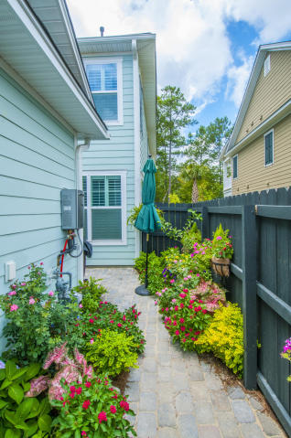
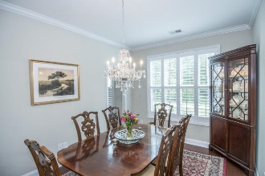
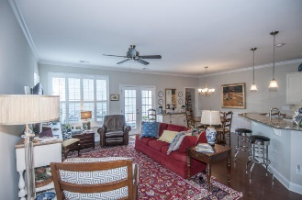
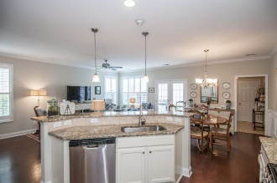
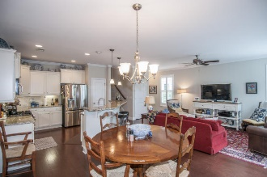
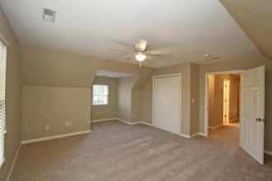
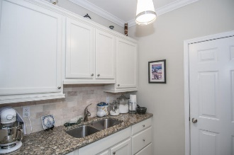
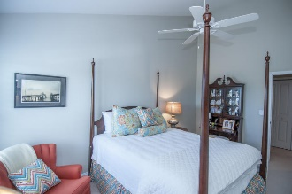
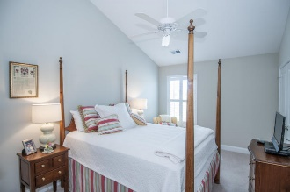
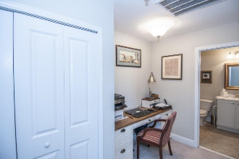
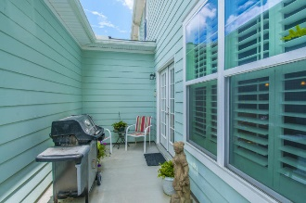

2072 Promenade Ct Park West :: Mount Pleasant :: MLS# 15019553 :: $350,000
Carefree Townhome Living!!!
Just Reduced!
Charming 4 bd, 3 1/2 bath Charleston Style townhome. End unit in desirable Park West Neighborhood. Located near schools, MP Rec. Dept. and PW Pool. Like new with many upgrades. Hardwood floors downstairs, tile in baths, crown molding with wainscoting. Beautiful granite kitchen counters with coordinating tile backsplash. Master bd and walk-in closet downstairs. Master down is currently being used as a beautiful dining room with lovely crystal chandelier. Upgraded mirrors in all baths. Upstairs there is another large master suite with sun porch. 2 additional large bedrooms upstairs share a hall bath. Out back is a beautiful fenced patio and garden area with stonework and plantings. Refrigerator, washer/dryer and courtyard statuary does not convey. Owner is a SC licensed real estate agent.
Greg Hughes
843-884-1800 - O
843-708-4734 – C
ghughes@carolinaone.com
Carolina One Real Estate
Mt Pleasant Office 195 W Coleman Blvd Mt Pleasant, SC 29464

