Slide 1
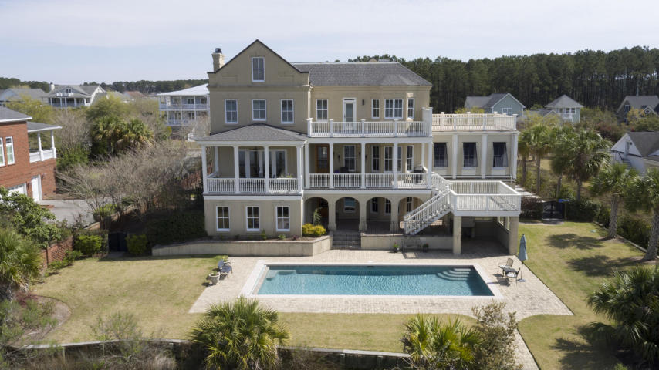
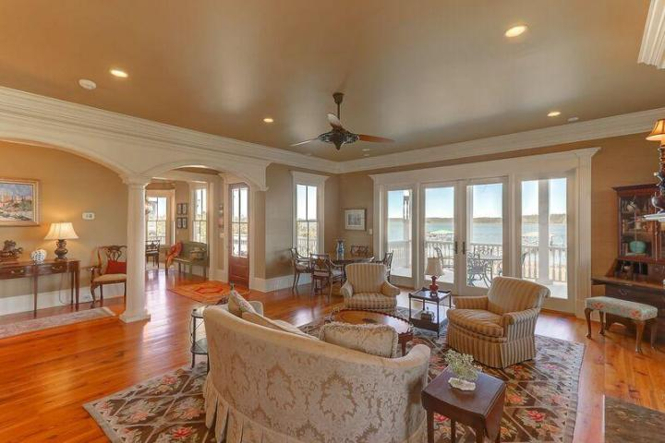
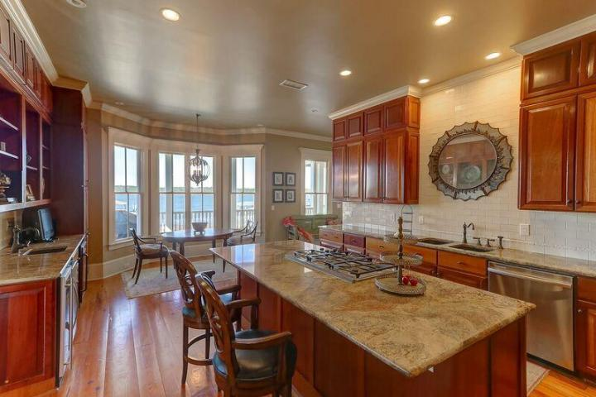
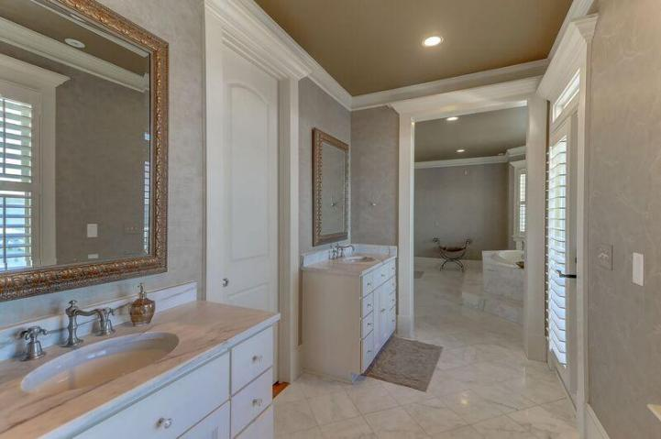
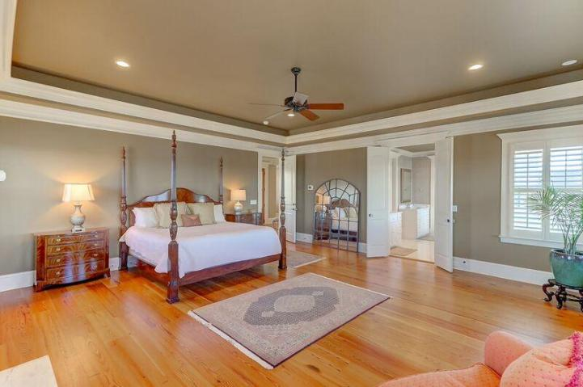
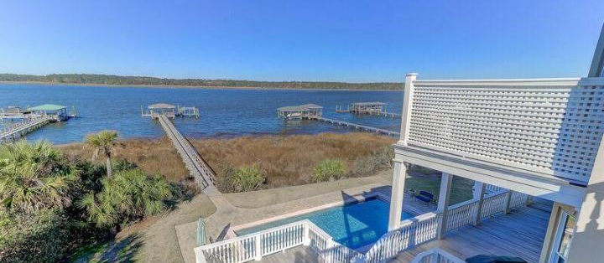
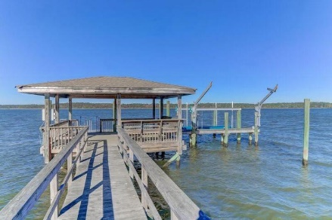


2072 Willbrook Lane Mount Pleasant, SC 29466 ~ MLS# 18006338 ~ $1,875,000
Rivertowne on the Wando
Charleston charm at its finest, this waterfront estate is located on the shores of the beautiful Wando River. Stunning views are accompanied by a manicured .67 acre lot, private deepwater dock and boat lift, tranquil front-access courtyard, covered patio, and sparkling swimming pool. Elevator from ground to third floor and many decks to provide any stellar view you desire. Spacious rooms, tray ceilings, wainscoting, and reclaimed heart pine antique hardwood flooring add allure and character to this unique home. The gourmet kitchen will suit your every need with its 5-burner gas cook top, warming drawer, stunning Brazilian cherry cabinetry, sub zero refrigerator, wet bar, and double decker wall ovens. Directly off of the kitchen, a cozy family room with fireplace and built-ins awaits you and your guests.
The downstairs of this 3 story home offers a finished space for endless recreational or entertainment possibilities. The inviting and intricately decorated formal dining room is perfect for dinner parties, as well as everyday life. Along with a stylish and storage-filled walk-in closet, the Master Suite provides a spacious bathroom oasis with marble details and spa. This estate ensures gorgeous views, safety, and natural light with large storm windows throughout. Bedrooms in this home are conveniently accompanied by beautiful, attached full bathrooms. The amenities in Rivertowne On The Wando will provide you with endless opportunities to enjoy your new home. The luxurious club house, tennis courts, community pool and hot tubs, golf course, and walking and jogging trails provided by this neighborhood cannot be beat!
Kimberly Ritter
Cell Phone (843) 693-8802
kritter@carolinaone.com

