Slide 1
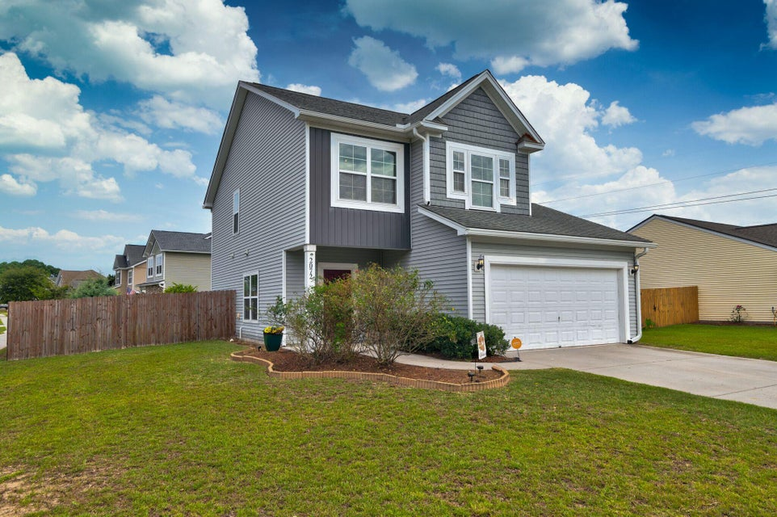
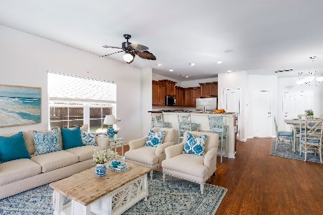
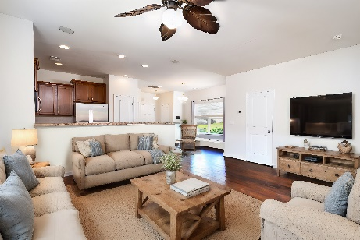
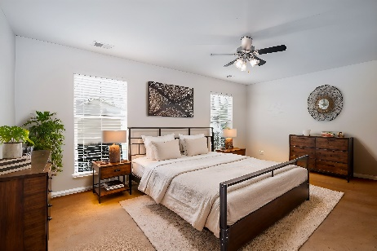
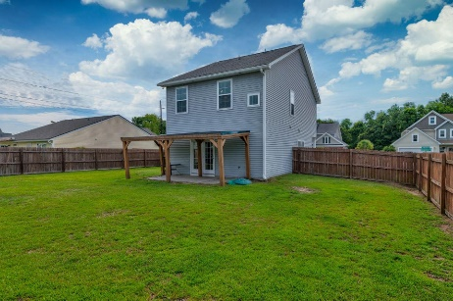



JOHNS ISLAND UNDER $500K!
BA COMPENSATION OFFERED!
2072 Chilhowee Drive
Staffordshire
Johns Island, SC 29455
MLS# 24021054
$479,000
3 Bedrooms :: 2½ Baths :: 1,524 sf
Welcome to 2072 Chilhowee Drive in Staffordshire, one of Johns Island's most conveniently located neighborhoods! This delightful 3-bedroom, 2.5-bathroom home, built in 2013, features an open floor plan and sits on a spacious corner lot. The first floor boasts a very open plan with stylish vinyl flooring that mimics wood, while the second floor has carpet. The kitchen is equipped with 42'' cabinets, molding, and brushed nickel hardware. Enjoy a central music system for customized listening throughout the home. Elegant French doors open up the living area to the spacious backyard with a covered terrace. The backyard provides a nice refuge for relaxation or activities with a full privacy fence and a double gate, ideal for securely storing your boat or RV.
*Interior photos are virtually staged
Enjoy a video tour!
Jon Moore
(843) 732-3365
jon@charlestonrealestategroup.com
www.charlestonrealestategroup.com
Charleston Real Estate Group | 443 Folly Road | Charleston, SC 29412

