Slide 1
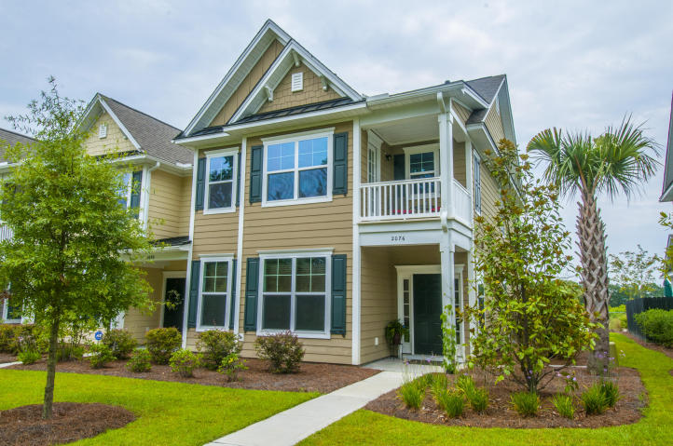
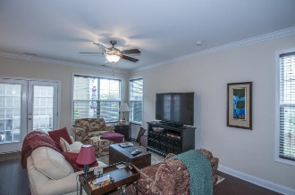
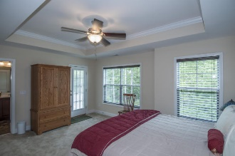
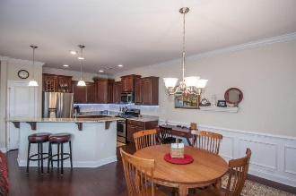
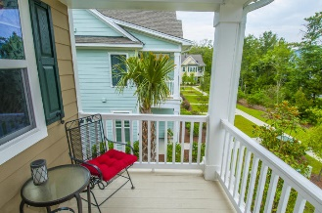
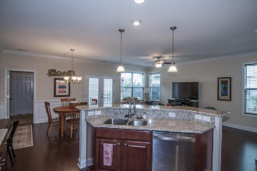
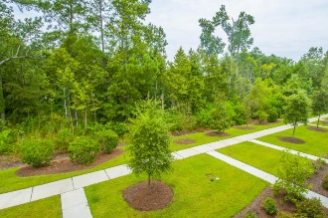
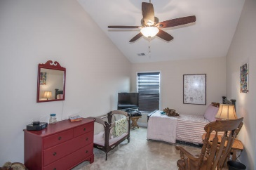
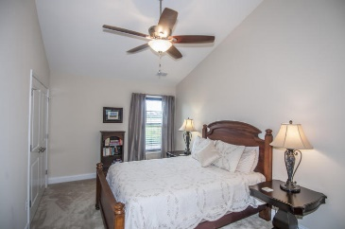
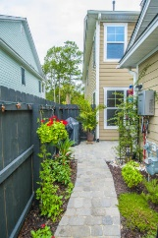
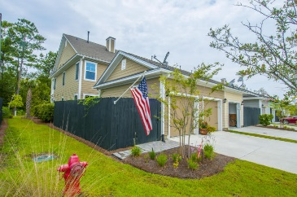
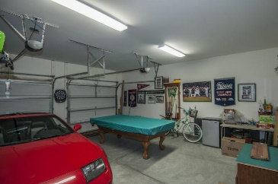

2076 Promenade Ct
Park West :: Mount Pleasant :: MLS# 15020330 :: $350,000
Carefree Townhome Living!!!
Better than New!! Easy to show on short notice!
Just Reduced!
Almost new 4 bedroom, 3 1/2 bath Charleston Style Townhome. End unit in desirable Park West Neighborhood. Located near schools, MP Rec. Dept. and PW Pool. Like new upgrades. Hardwood floors downstairs, tile in baths, crown molding with wainscoting. Beautiful granite kitchen counters. Master bedroom and walk-in closet downstairs. Upstairs is another master suite with sun porch. Two additional large bedrooms upstairs share a hall bath. Out back is a beautiful fenced patio and garden area with stonework and plantings. Make this your forever home.
Greg Hughes
843-884-1800 - O
843-708-4734 – C
ghughes@carolinaone.com
Carolina One Real Estate
Mt Pleasant Office
195 W Coleman Blvd
Mt Pleasant, SC 29464

