Slide 1
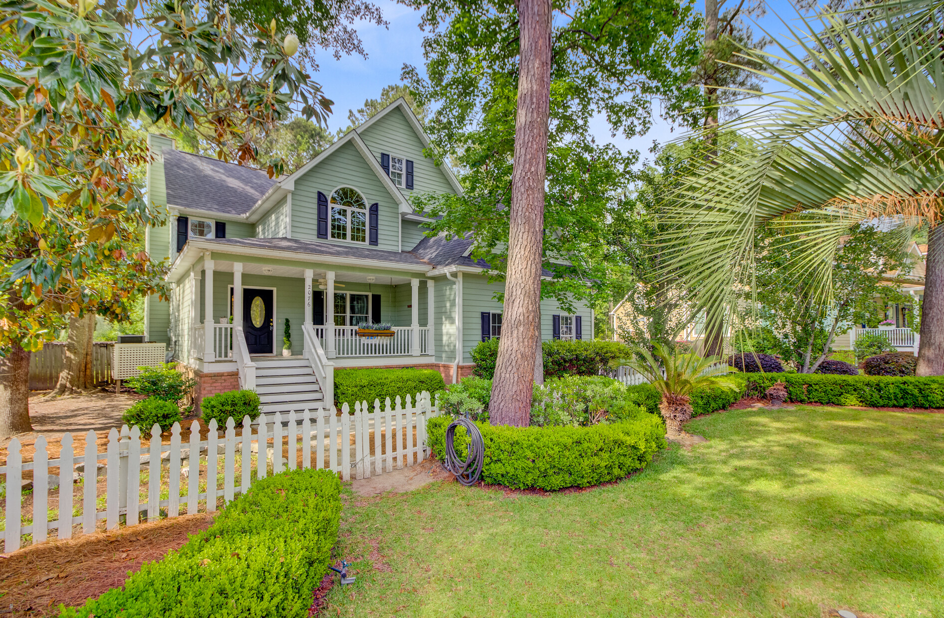
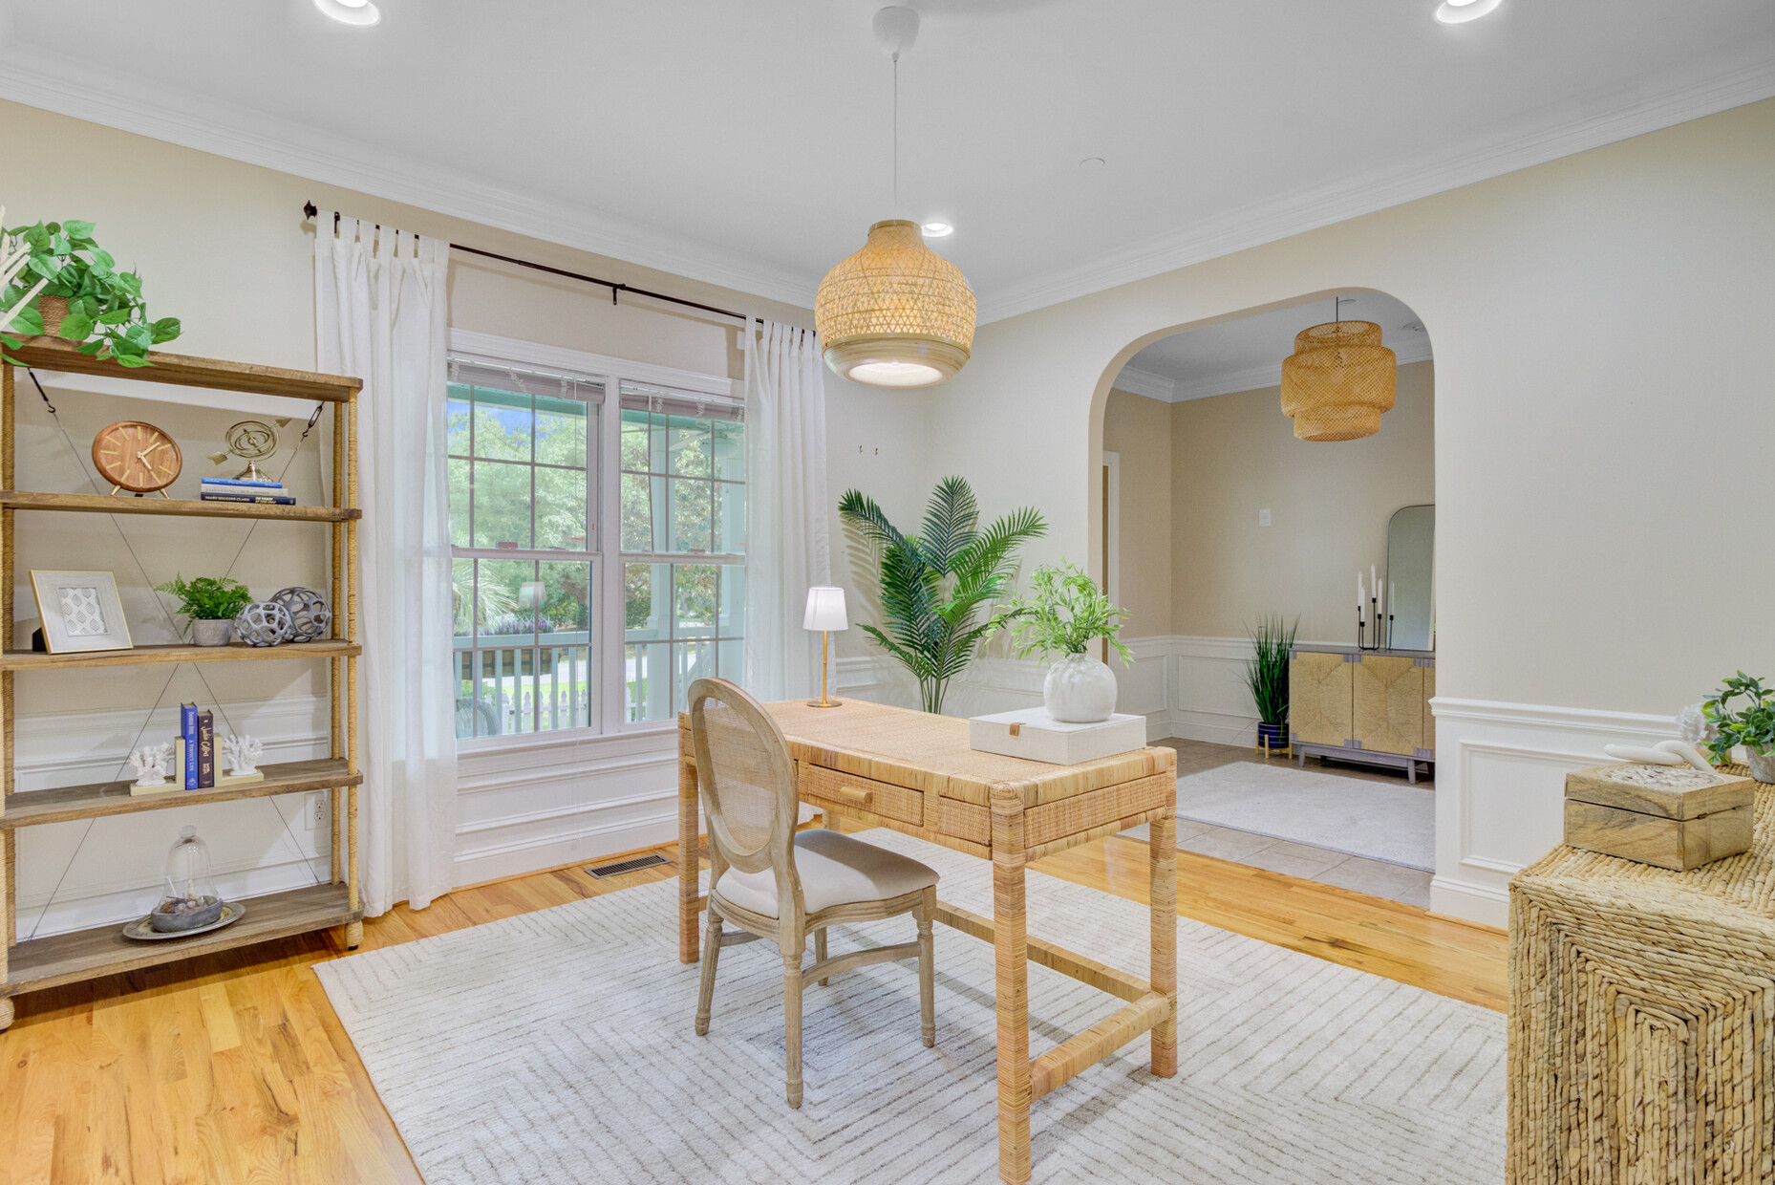

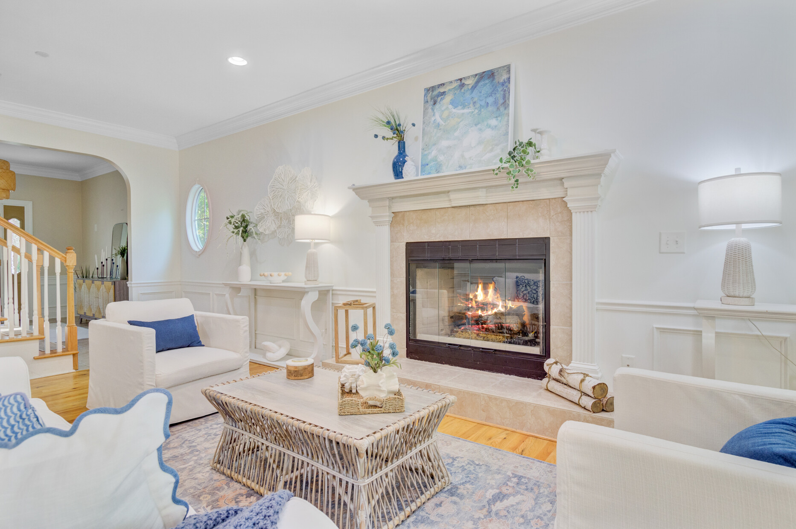



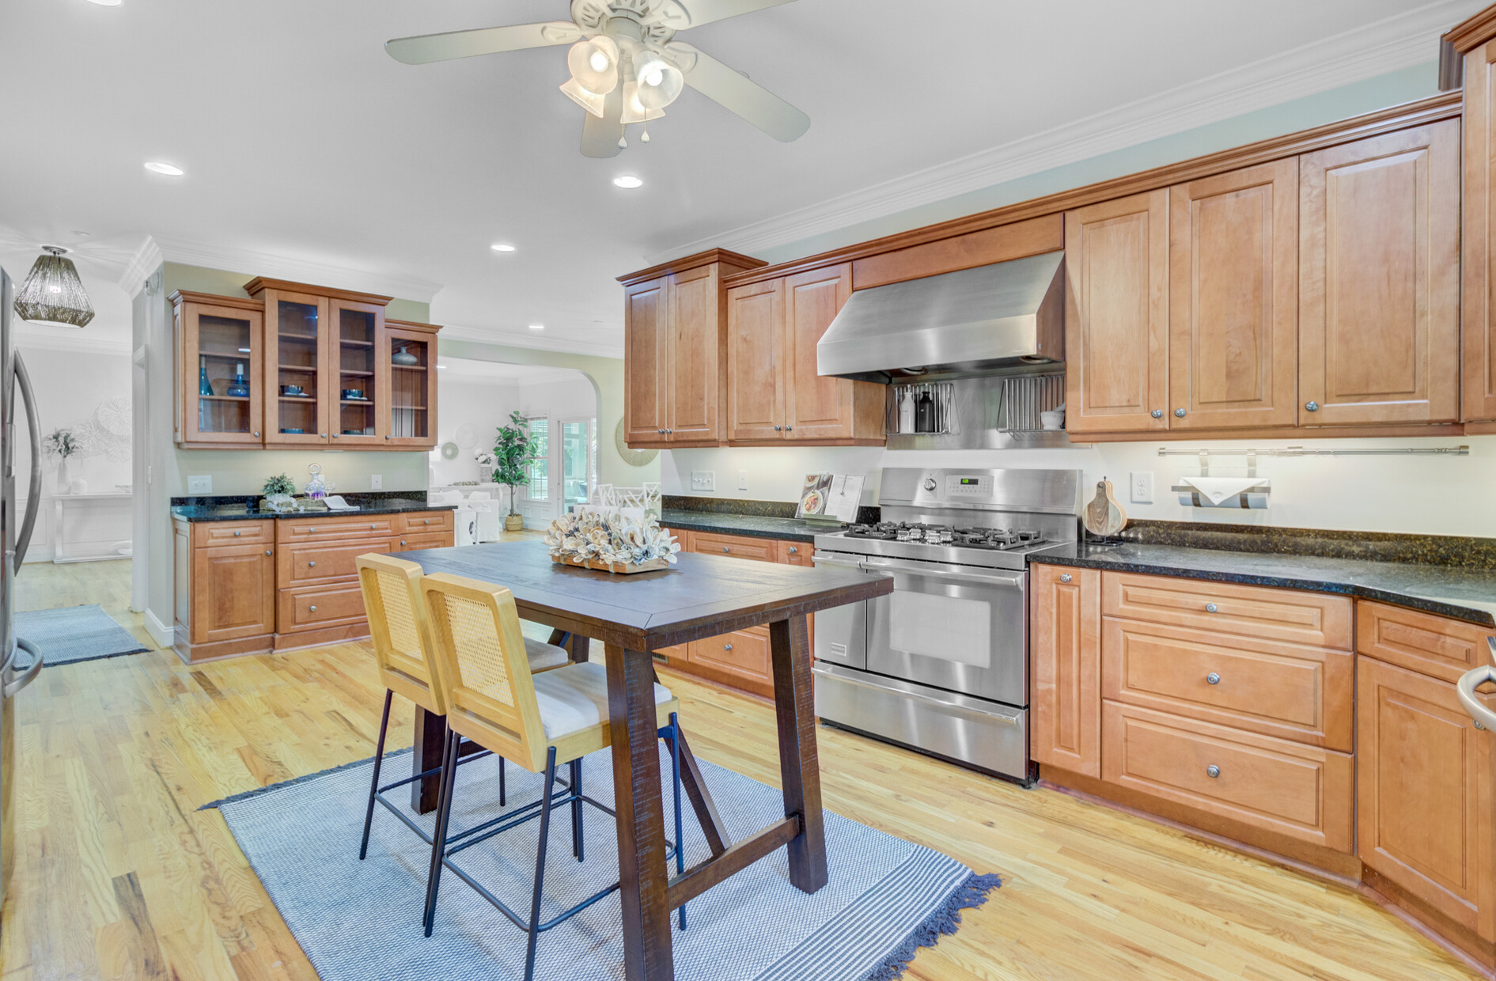


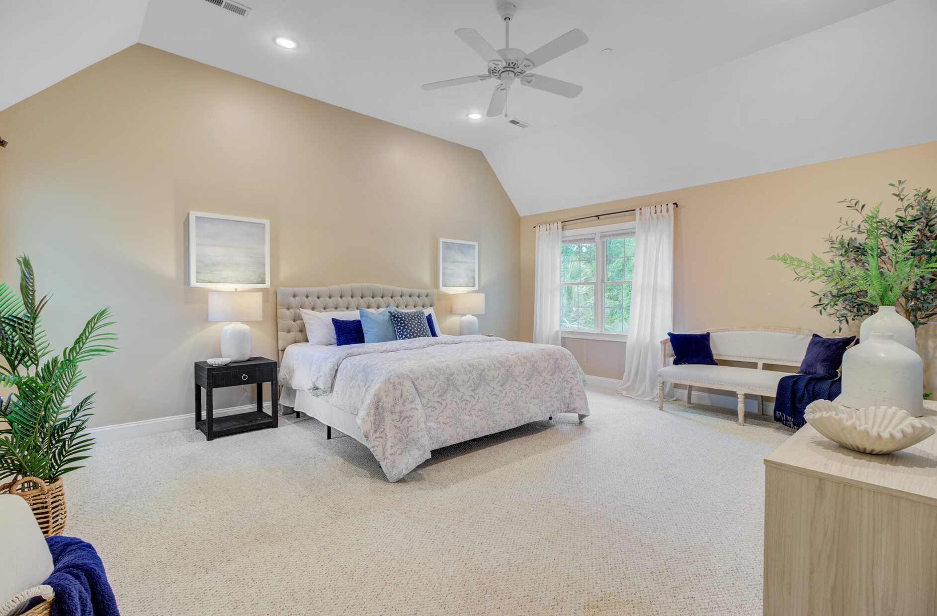


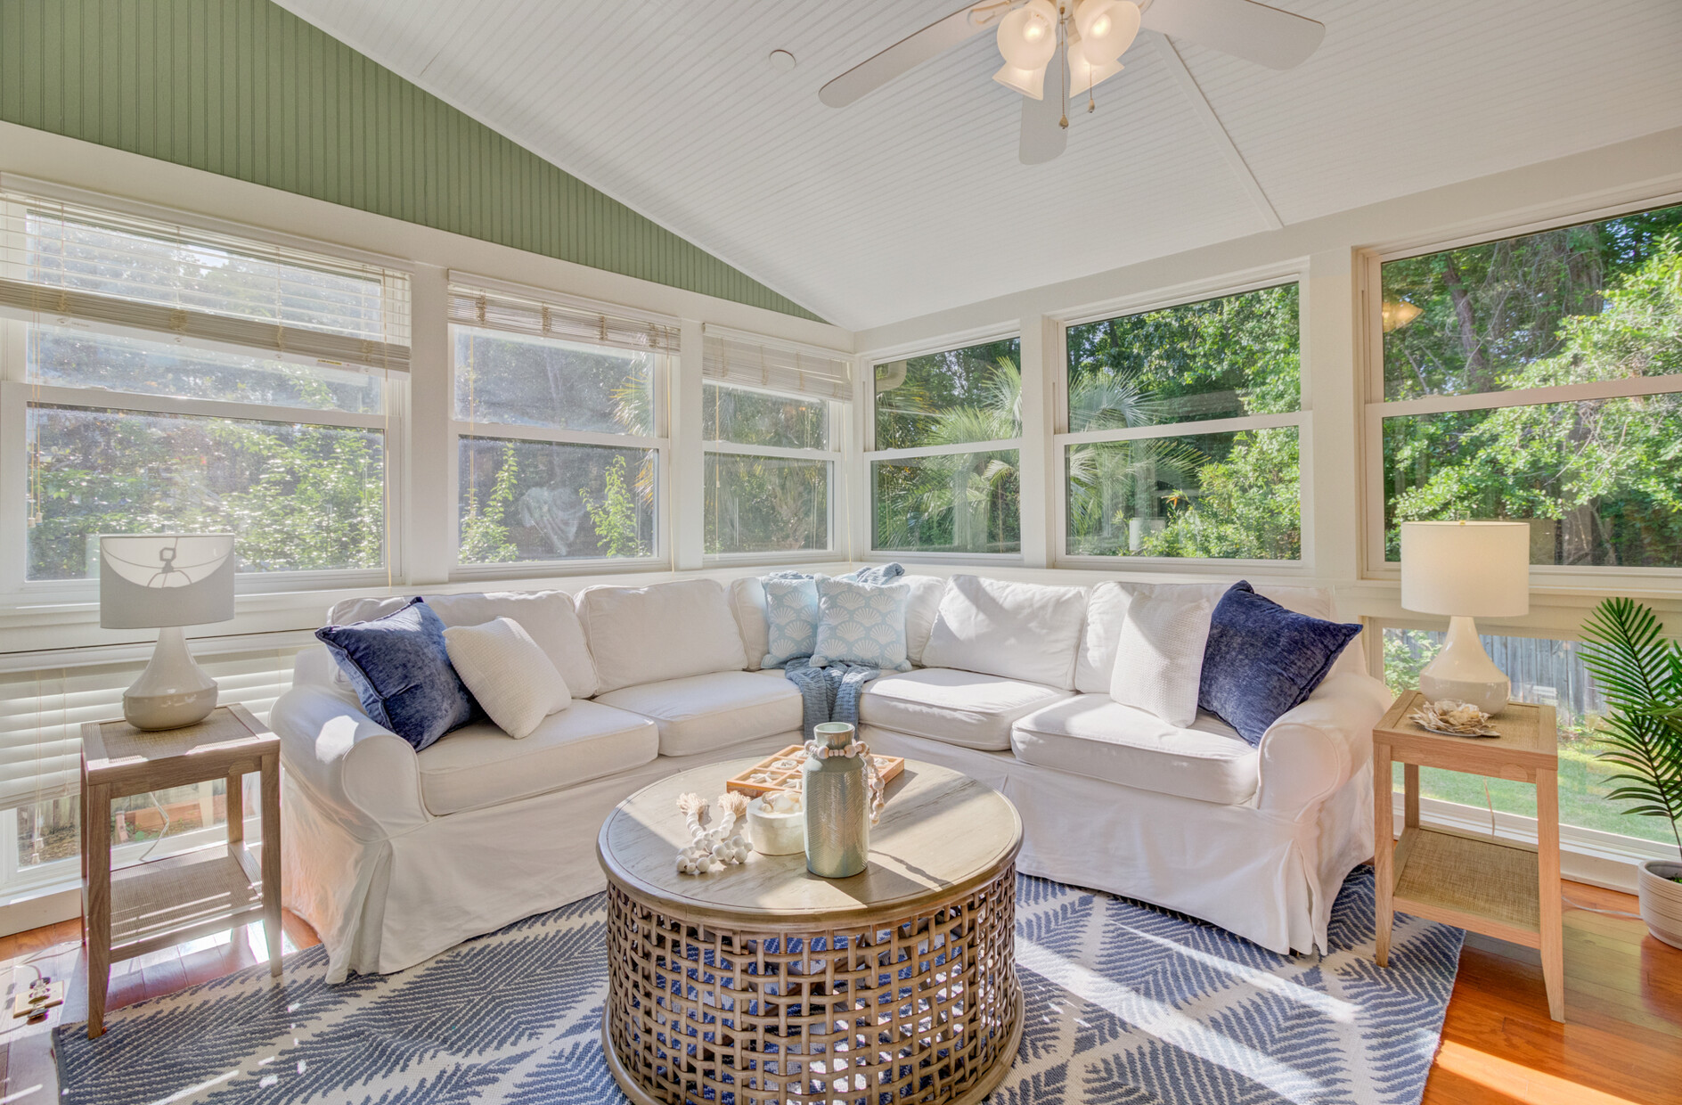



New Listing Open House Sun. May 18. 1:00-3:30 PM
Video Tour
2076 Rookery Lane
Croghan Landing | Charleston, SC 29414 | MLS# 25013046 | $875,000
Virtual Tour
Southern charm meets Lowcountry living at 2076 Rookery Lane!
This move-in-ready custom home in Croghan Landing offers boat parking, access to the West Ashley Greenway, and a community dock.
Enjoy a spacious floor plan, upgraded finishes, and unbeatable location—just 15 minutes to downtown Charleston and the airport. This is the Charleston dream—schedule your tour today!
Video Tour
Ellen O'Neil
Broker/Owner, ABR, e-PRO, CNE
Charleston Realtor of Distinction
843-300-8530
www.EllenONeilProperties.com

